Slide 1
CEIS 114 final
By William Call

Slide 2
Introduction
During this class we are working on building a smart traffic light system using the program Arduino and a tech kit. This is also some pictures of the items we used during the project

Slide 3
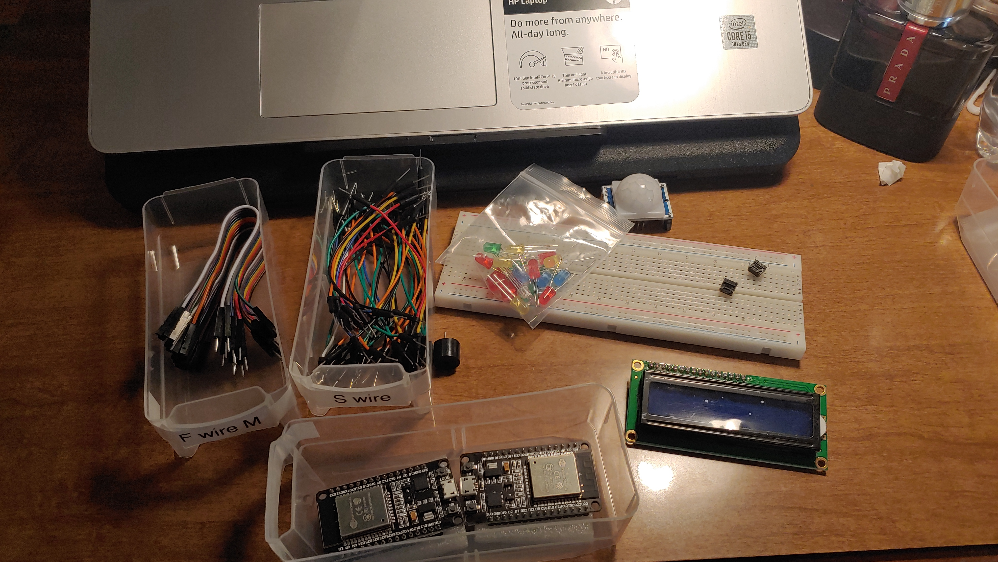
Inventory (Picture)
ESP 32 Board
Colored LEDs: Red, Yellow, Green, and Blue
220 Ohm Resistors (optional)
Wires
Breadboard(s)
LCD Unit with I2C Adapter
Active Buzzer
Mini Router
Push Button(s)
PIR Motion Sensor

Slide 4
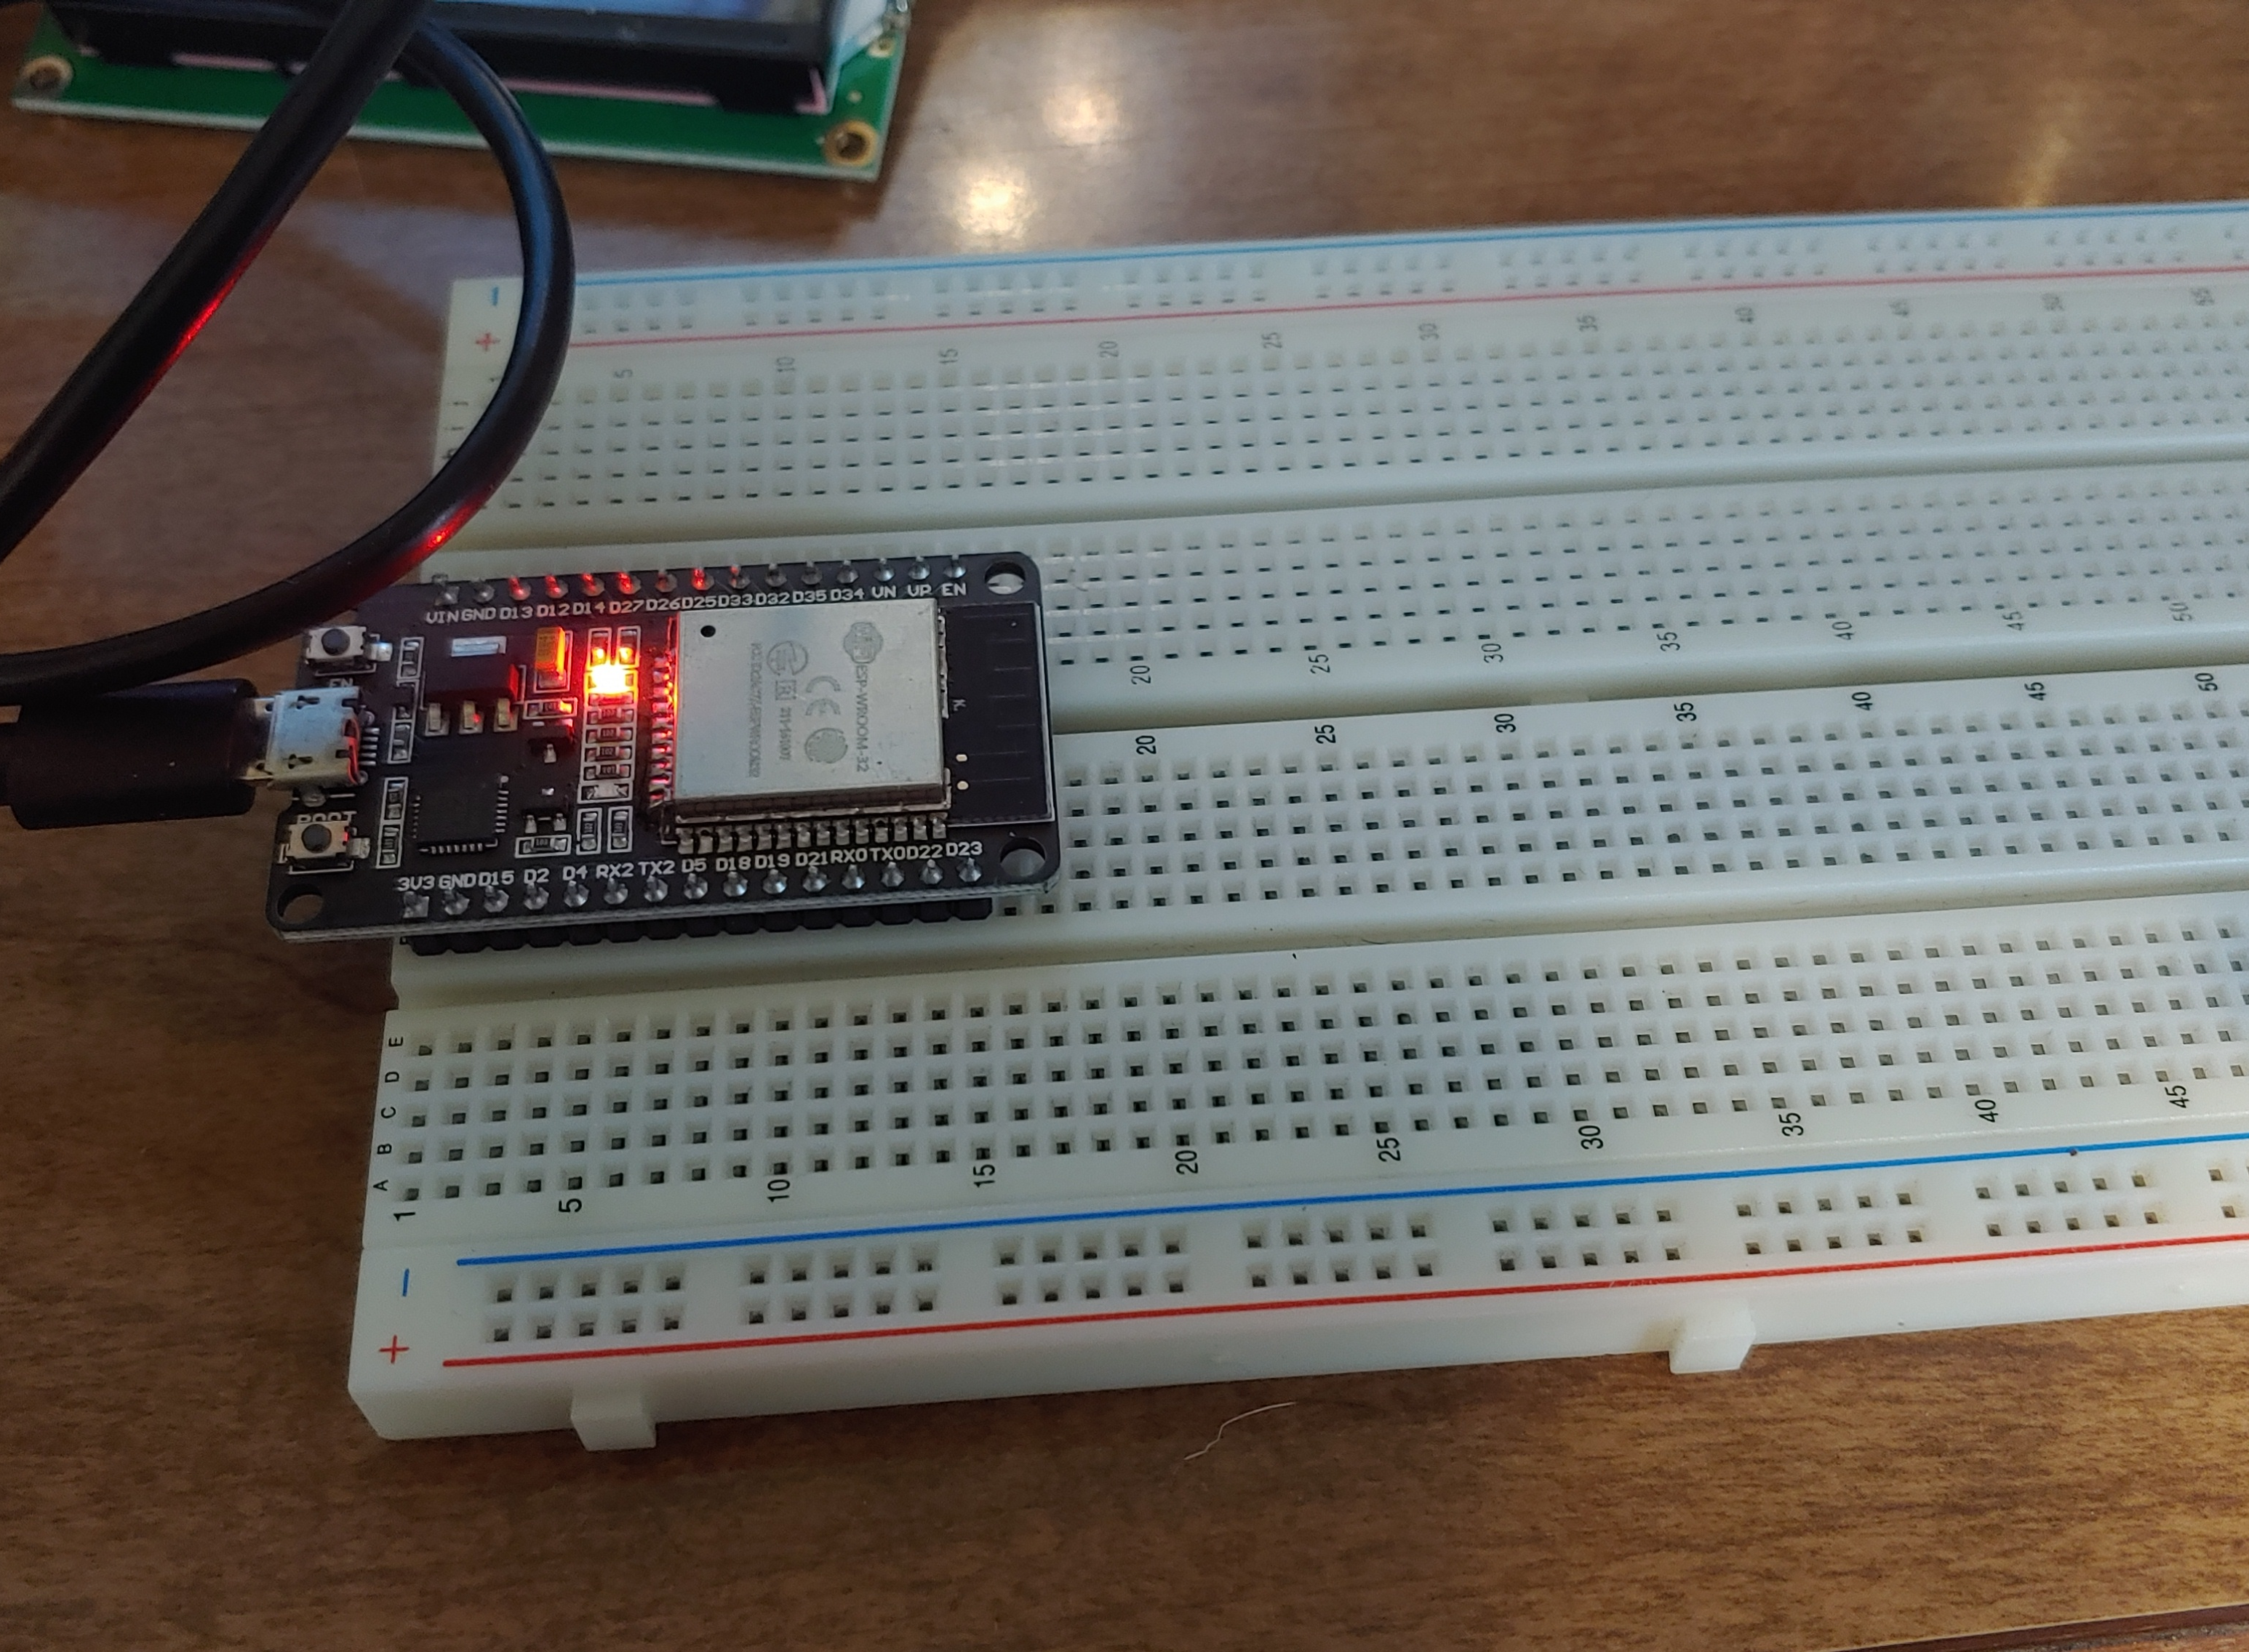
ESP32 (Picture)
Microcontroller mounted and powered ON

Slide 5
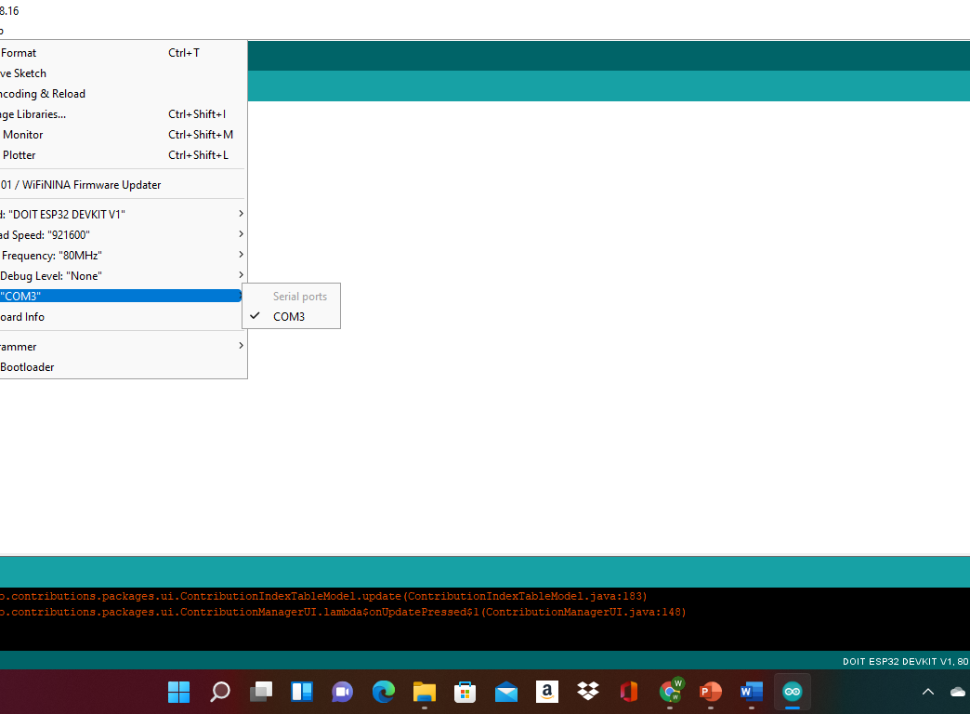
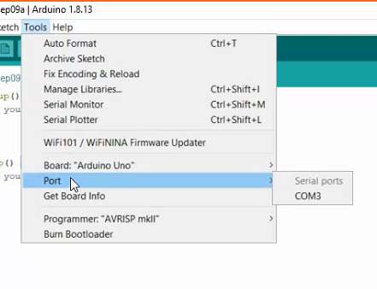
Installation of Arduino IDE
Screenshot of Arduino IDE with Port selected from Tools menu.
Example

Slide 6
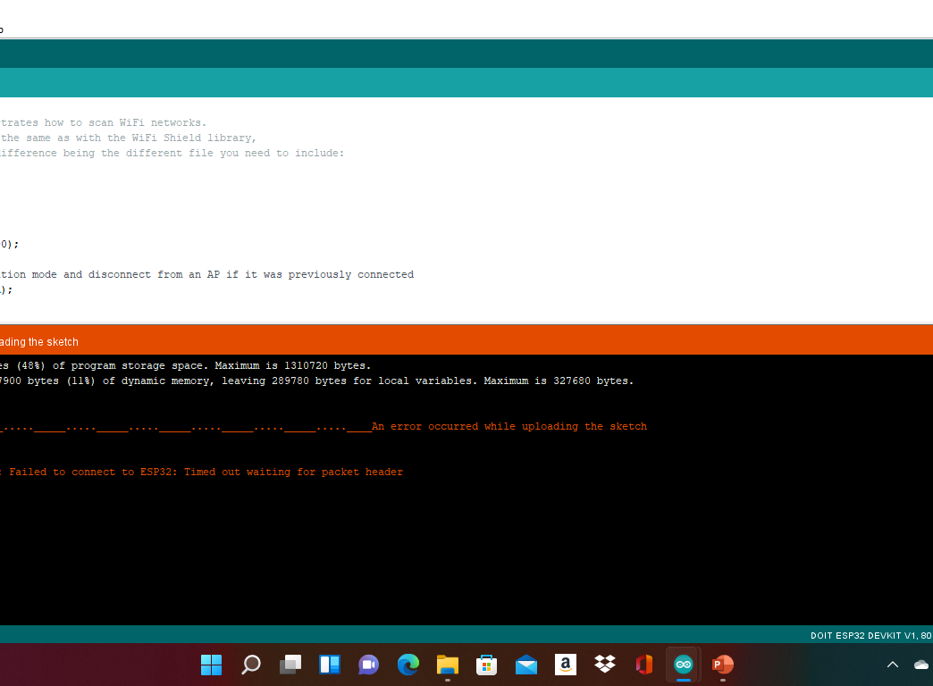
ESP32 WiFi Scan
Screenshot of Serial Monitor in Arduino IDE showing the available networks

Slide 7
Project 1
In this project we had to get the led lights working with the ESP32 board.

Slide 8
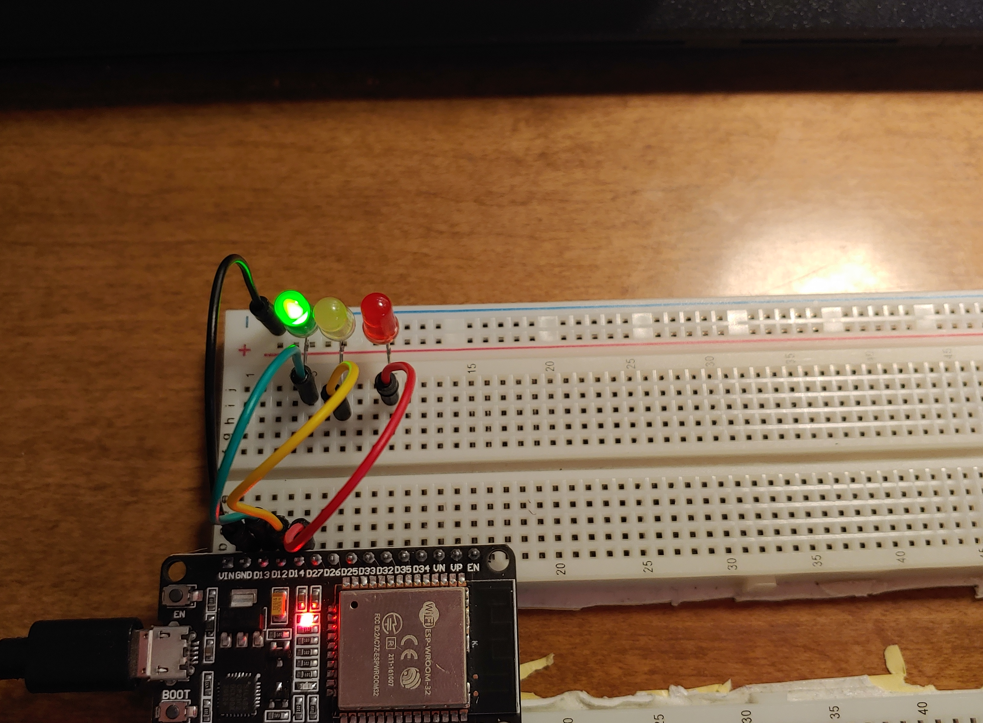
Picture of circuit with working LEDs
ESP 32 Board
Colored LEDs: Red, Yellow and Green
220 Ohm Resistors (optional)
Wires
Breadboard

Slide 9
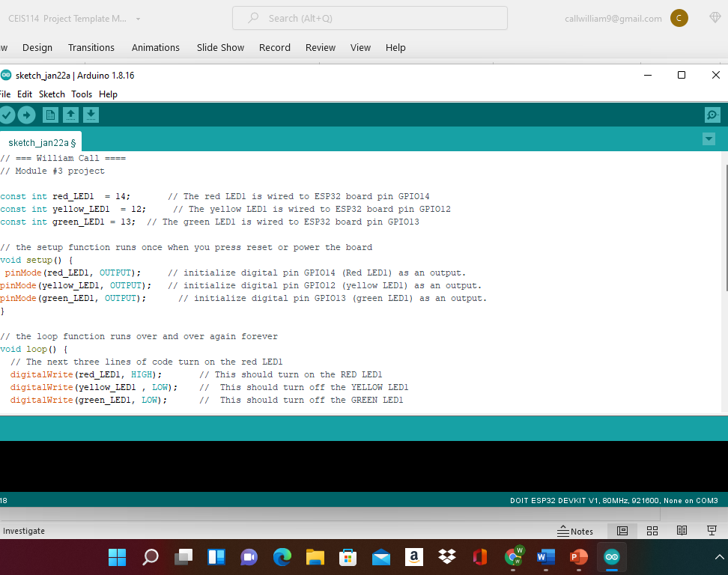
Screenshot of code in Arduino IDE
Screenshot of code in Arduino IDE showing your name in the comment

Slide 10
Project 2
We had to add another set of lights to add to our project.

Slide 11
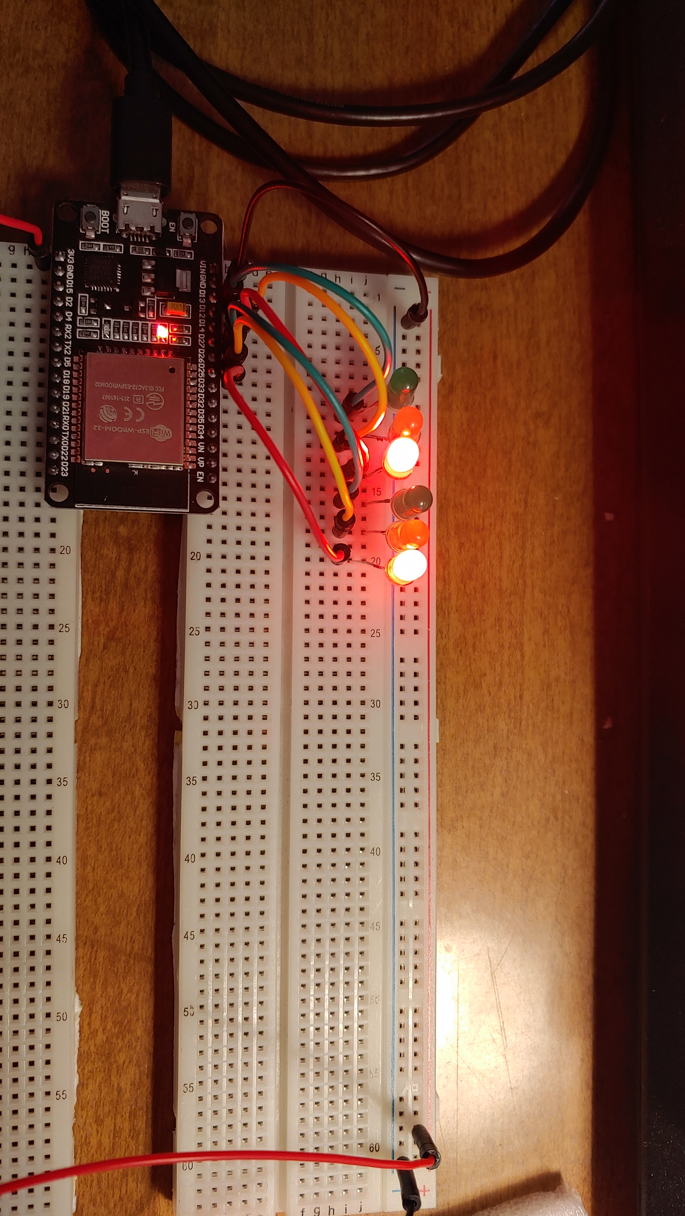
Picture of circuit with working LEDs
ESP 32 Board
Colored LEDs: Red, Yellow and Green (two sets)
220 Ohm Resistors (optional)
Wires
Breadboard

Slide 12
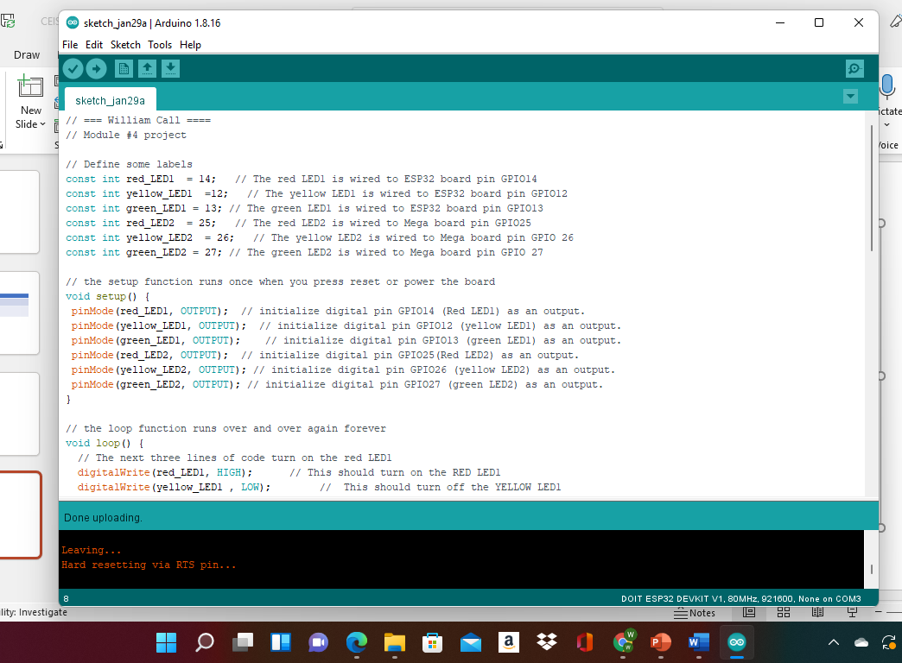
Screenshot of code in Arduino IDE
Screenshot of code in Arduino IDE showing your name in the comment

Slide 13
Project 3
In this project we had to add a trigger button to our bread board so that we could have control on when the traffic lights change.

Slide 14
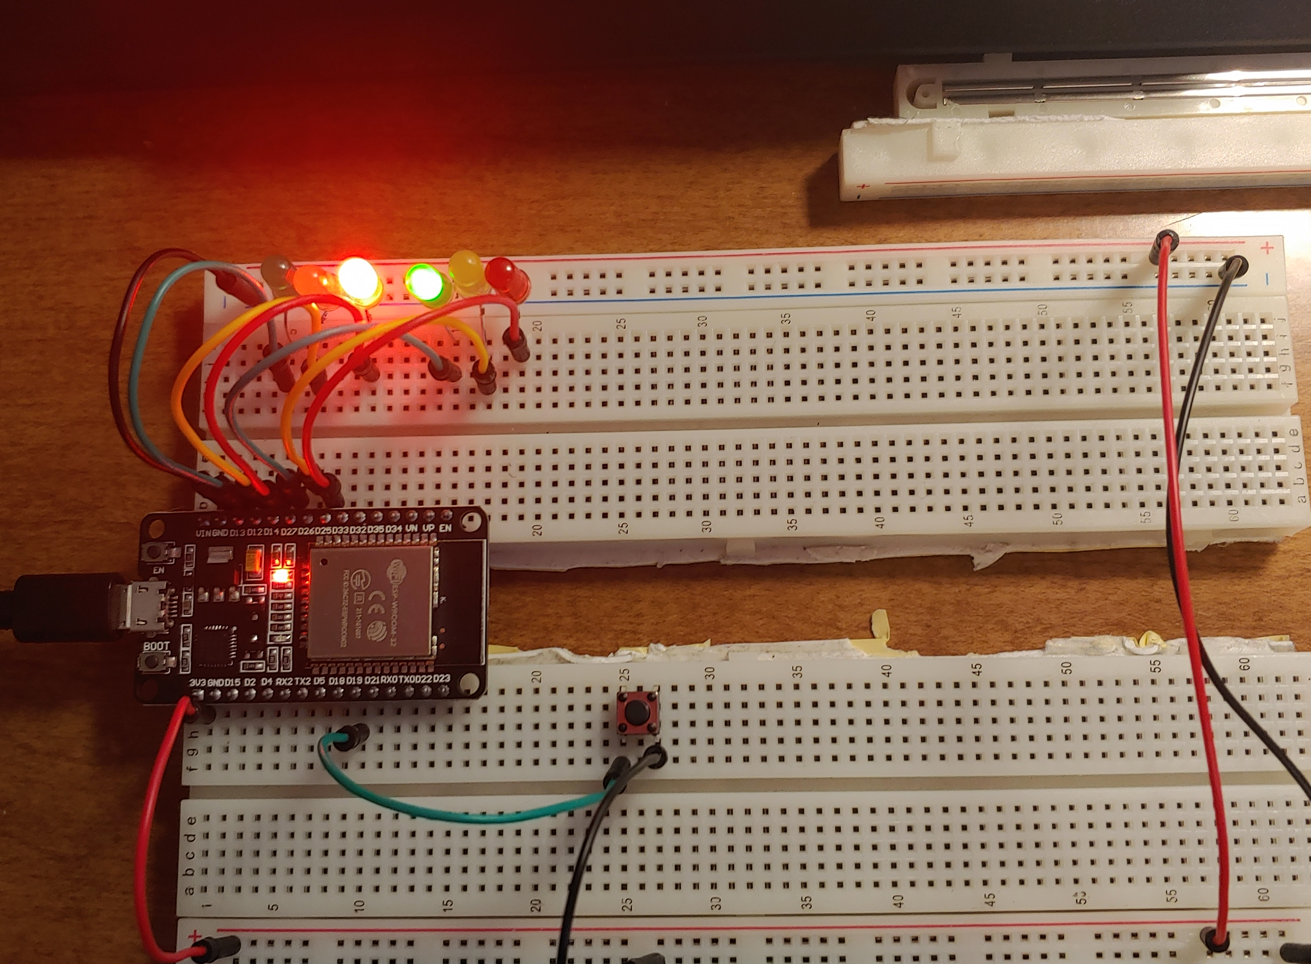
Picture of circuit with working LEDs
ESP 32 Board
Colored LEDs: Red, Yellow and Green (two sets)
220 Ohm Resistors (optional)
Push Button
Wires
Breadboard

Slide 15
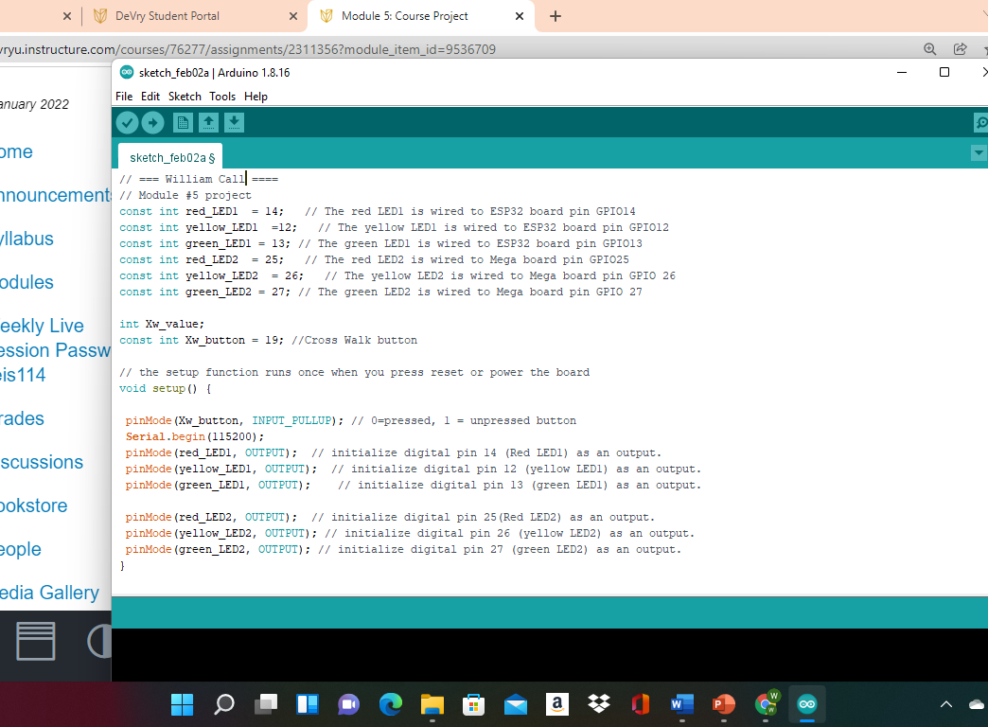
Screenshot of code in Arduino IDE
Screenshot of code in Arduino IDE showing your name in the comment

Slide 16
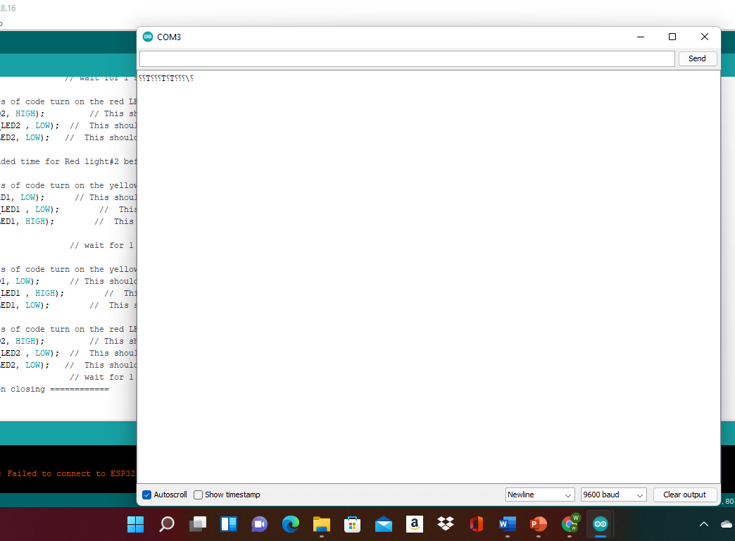
Screenshot of Serial Monitor in Arduino IDE
Screenshot of output in Serial Monitor

Slide 17
Project 5
In this project we had to add a buzzer and led screen to our bread board so that we will be able to see the walk and do not walk sign we are controlling our smart traffic light system

Slide 18
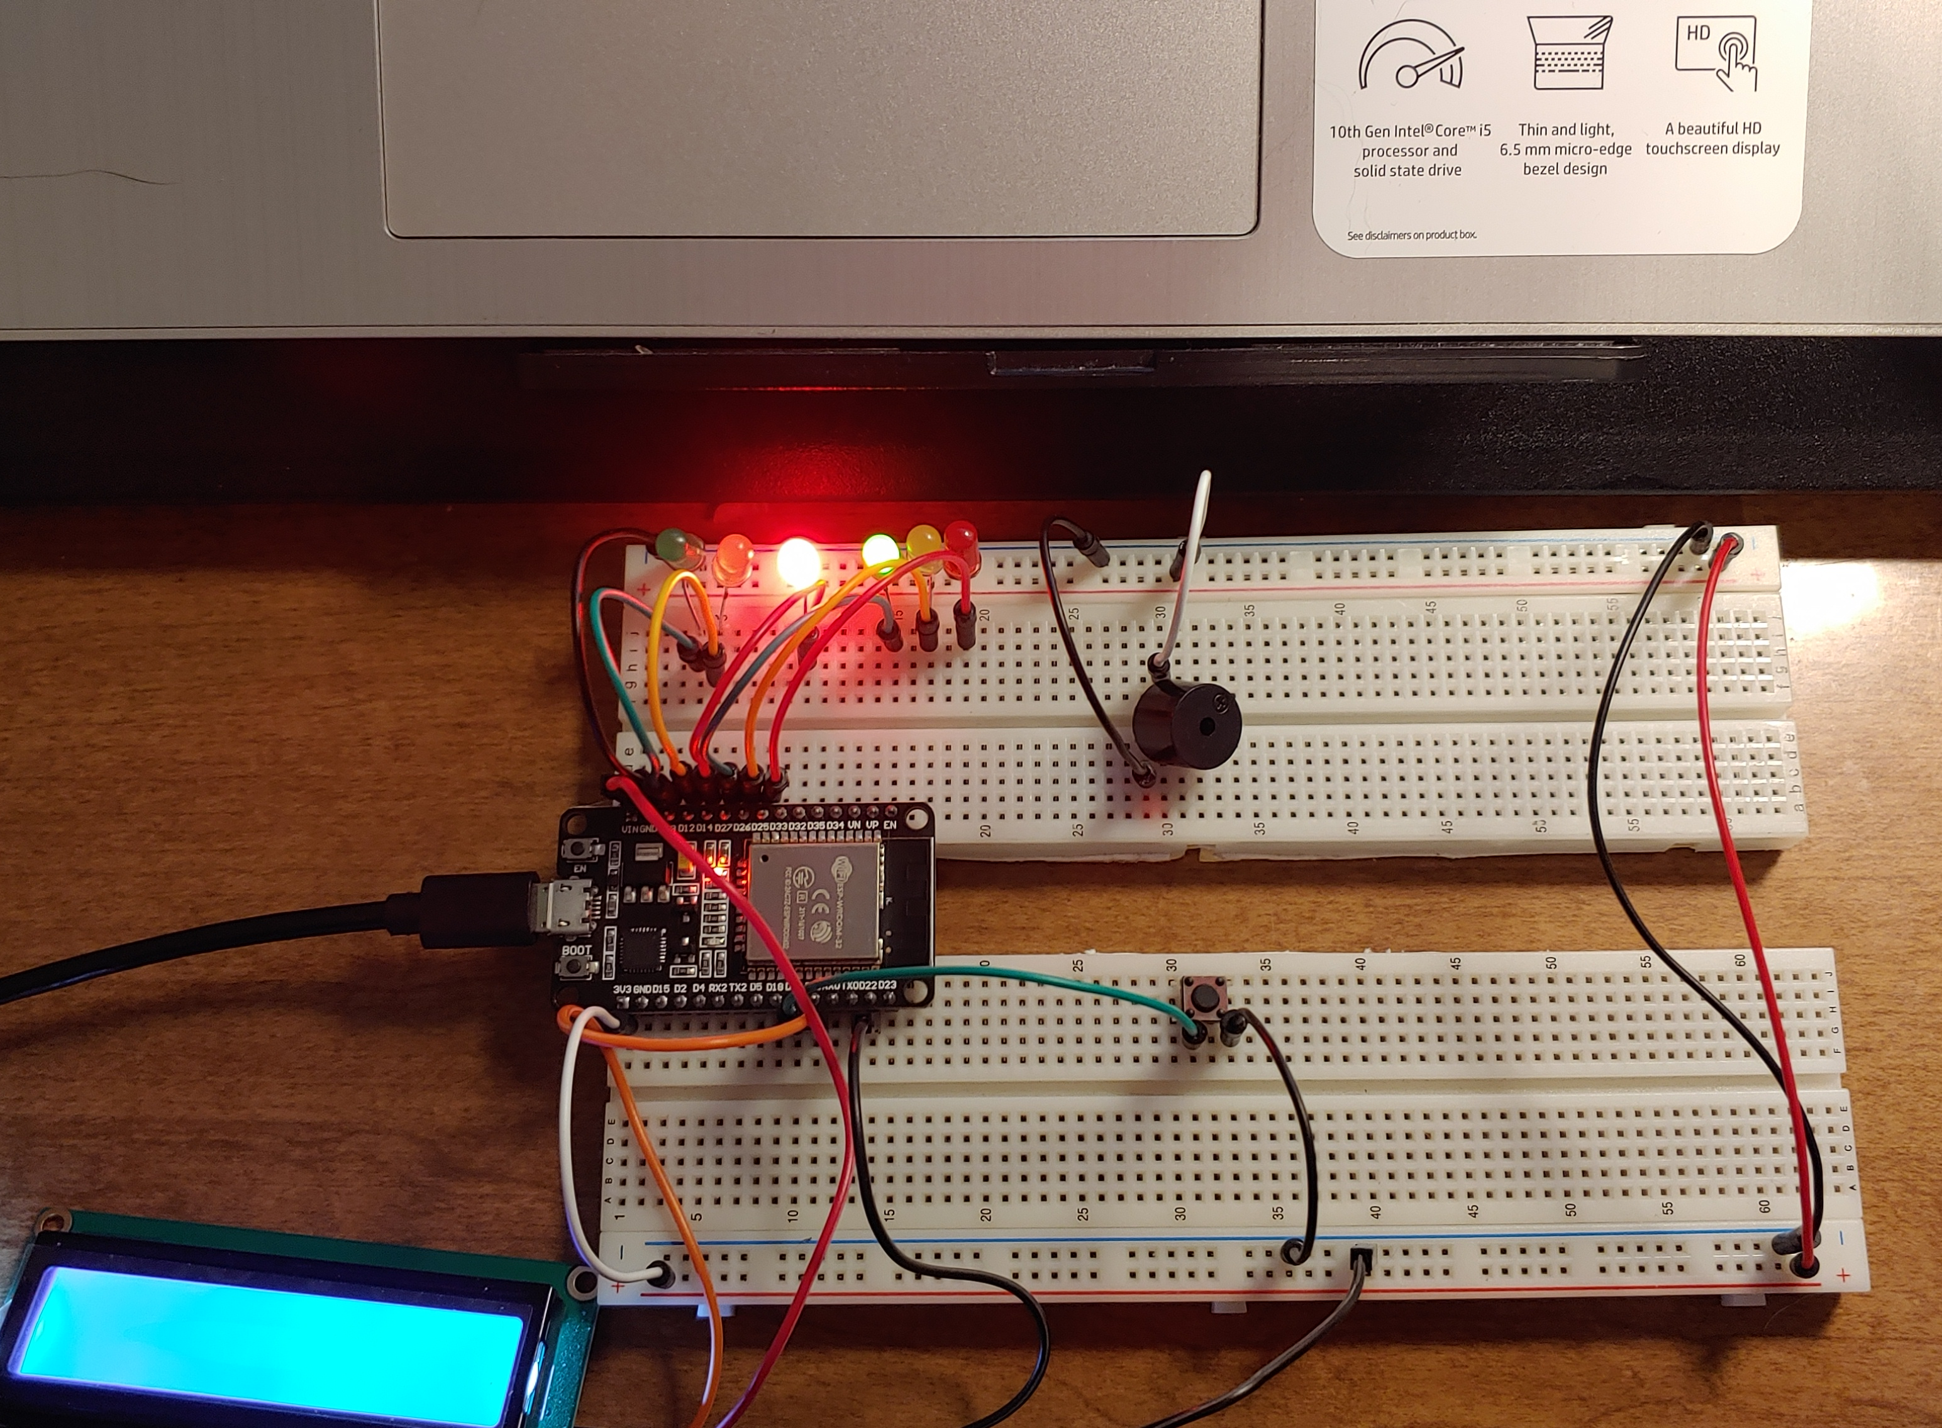
Picture of circuit with working LEDs and LCD display
ESP 32 Board
Colored LEDs: Red, Yellow and Green (two sets)
220 Ohm Resistors (optional)
Push Button
LCD Unit with Message Display
Wires
Breadboard

Slide 19
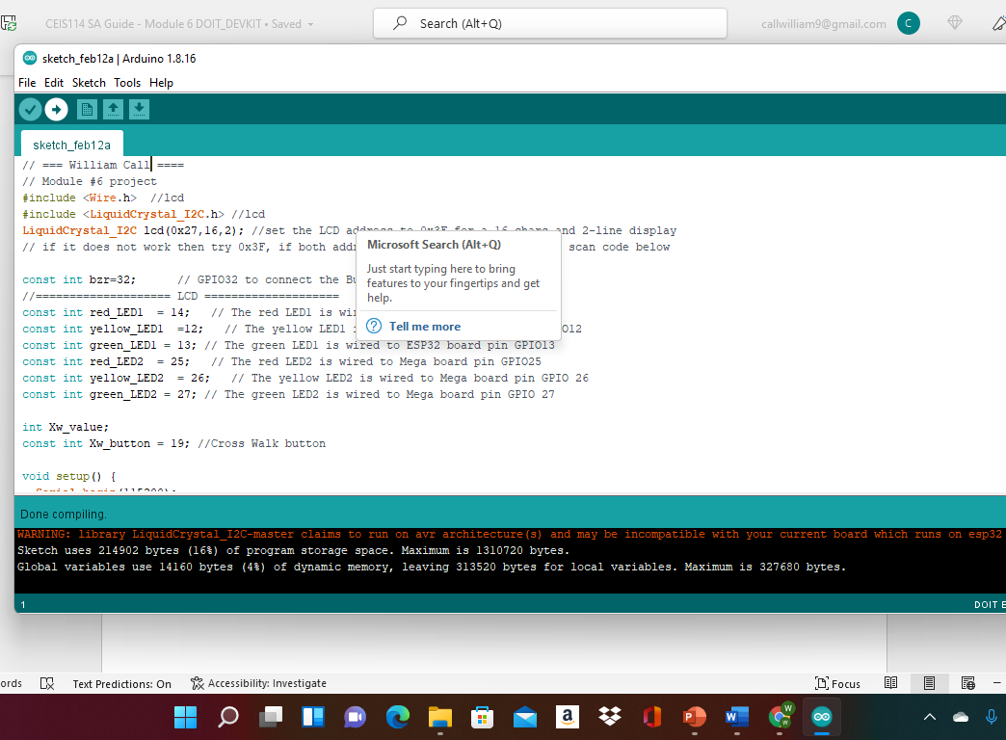
Screenshot of code in Arduino IDE
Screenshot of code in Arduino IDE showing your name in the comment

Slide 20
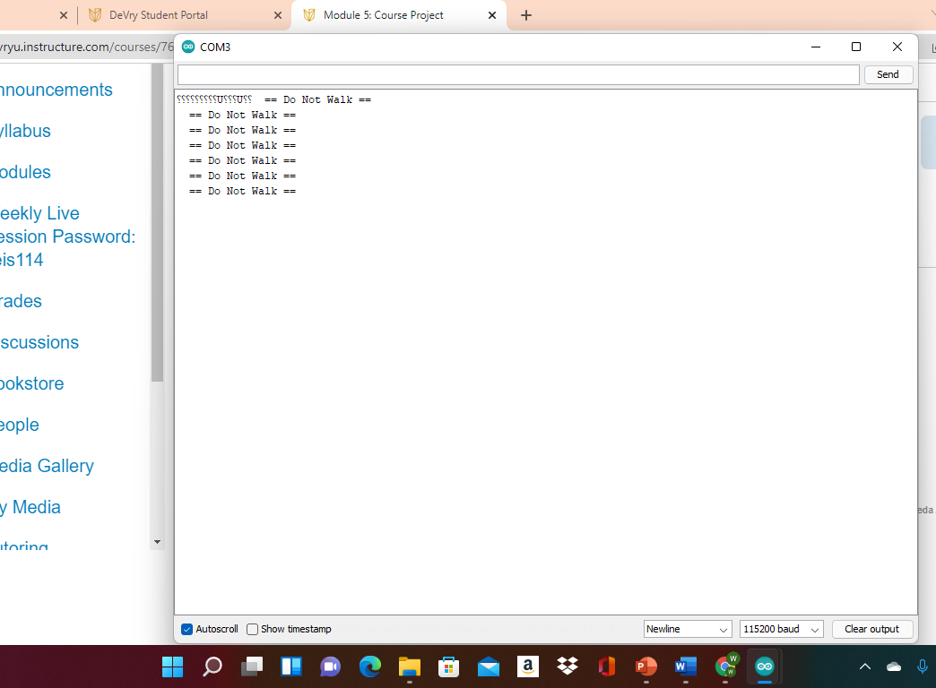
Screenshot of Serial Monitor in Arduino IDE
Screenshot of output in Serial Monitor

Slide 21
Challenge
This course did make me think out sound the box during the class. I had too really patination to what wires I was working with and make sure I had everything plugin the right spot before add power to the device.

Slide 22
Career
I did realize I do want to into the technology field I would love to find a way to but a GPS system in a hospital to make life easier for people to get around to find there loved ones or for works to find their way around the build if they must go to an area, they are not sure about.

Slide 23
Conclusion
During this class I had to do a lot of trouble shooting to find the problem and I had to ask the profess for people every know and than, but this was a fun project, and I had a great time building the traffic light system

