Slide 1

CEIS101 course project smart home automation and security system
Presented by
William Call

Slide 2
INtroducation
Hello I will be showing you the steps I have taken to build a smart home automated security system.
Working in tinker cad to test if the system would work virtually before try to build it
Working with my tech core kit to build the system and working with Arduino IDE to program my system.

Slide 3
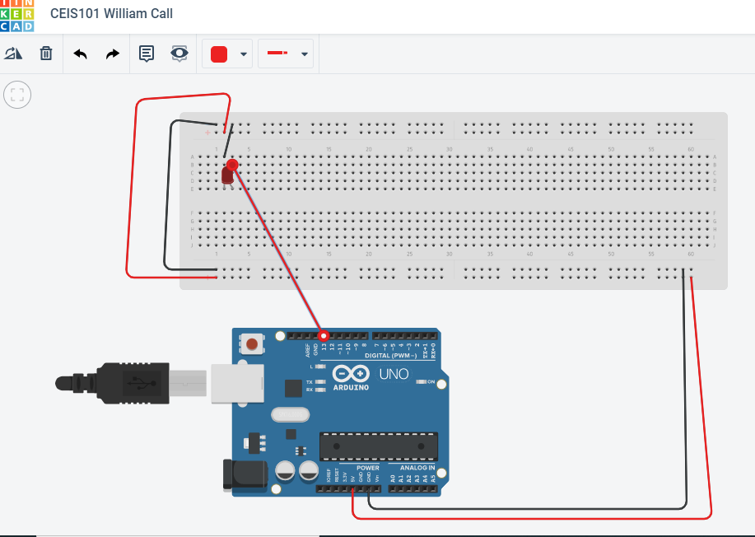
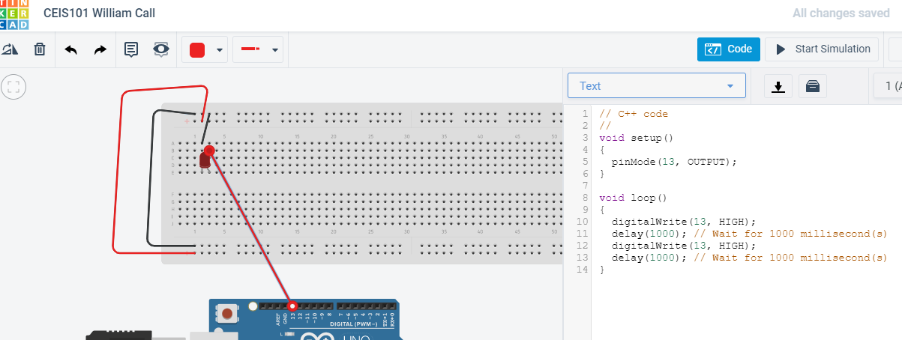
In this slide you will see the system I build in tinker cad. Along with the code I used to see if the system would work.

Slide 4
Inventory of parts, circuits, the building and displaning messages

Slide 5
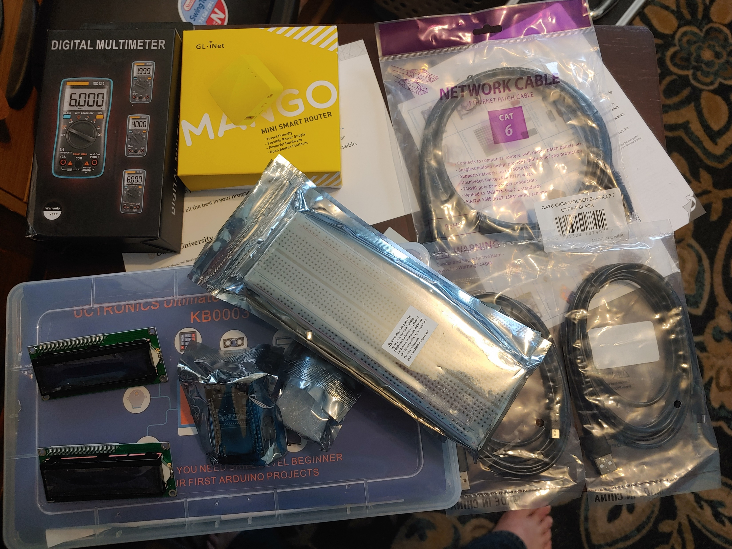
Inventory of IoT Kit (picture)
UCTRONICS Kit
ESP32 (2)
LCD Modules (2)
Breadboards (3)
Mini Router
Patch Cable
Digital Multi Meter
USB to Micro USB (2)

Slide 6
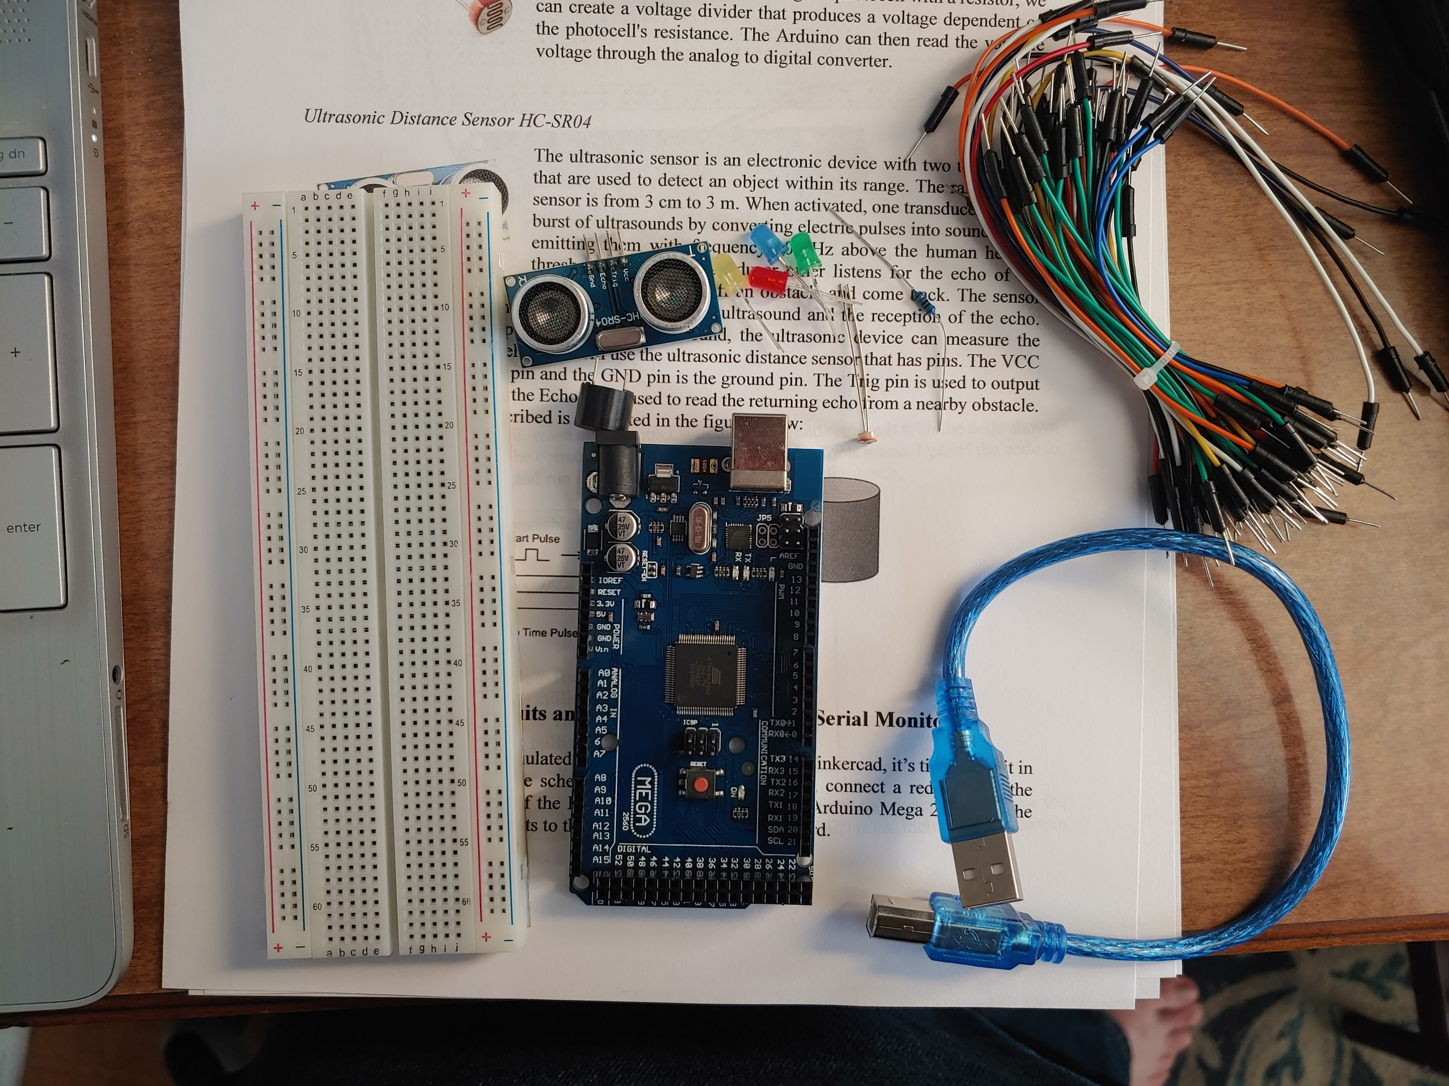
Organization of Project Components (picture)
Arduino Mega 2560
Breadboard
Resistor 10kΩ
LEDs
Ultrasonic Sensor
Active Buzzer
Photoresistor
Wires
USB Type B cable

Slide 7
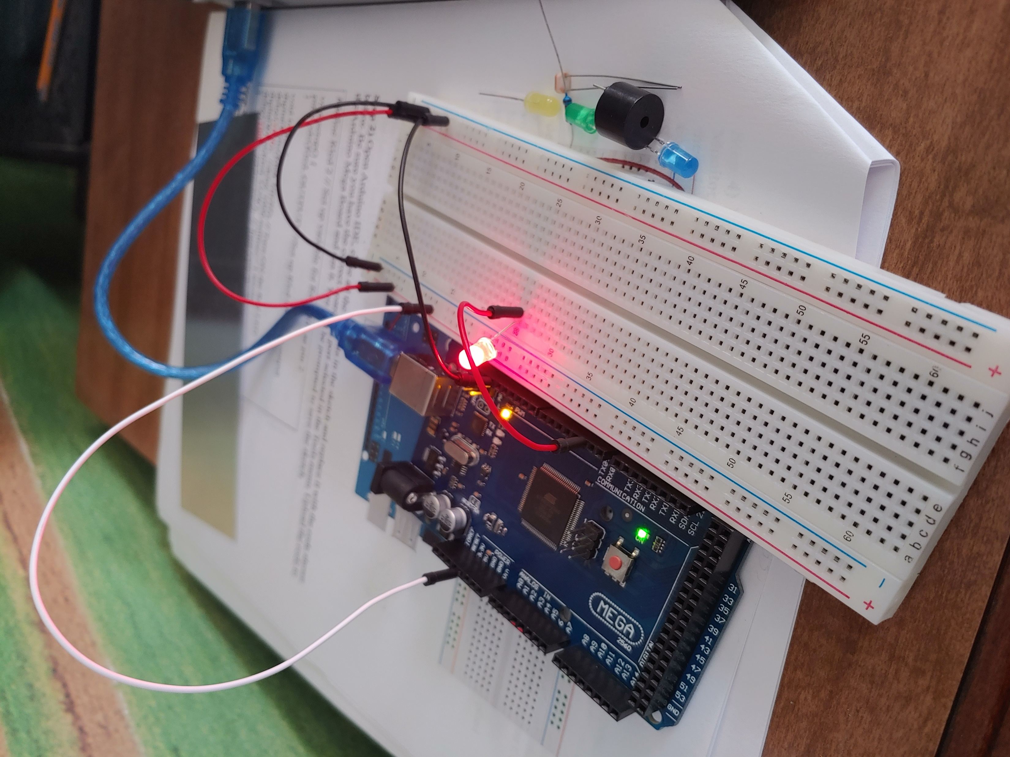
Circuit with red LED on (picture)

Slide 8
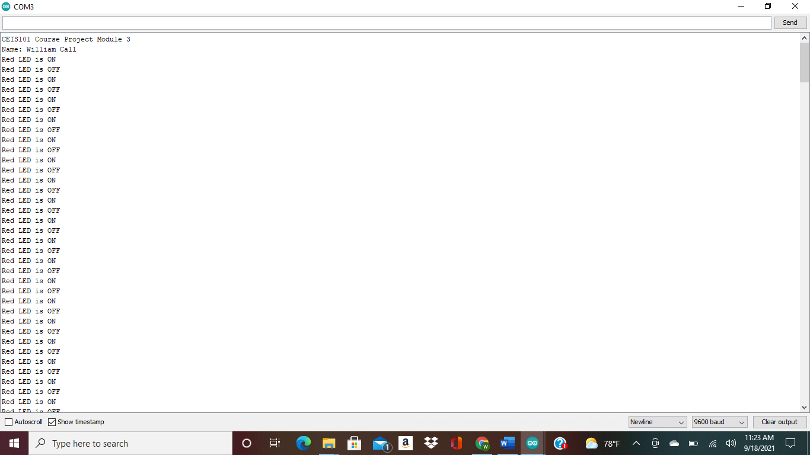
Serial Monitor (screenshot)

Slide 9
Adding a door sensor to our home security system

Slide 10
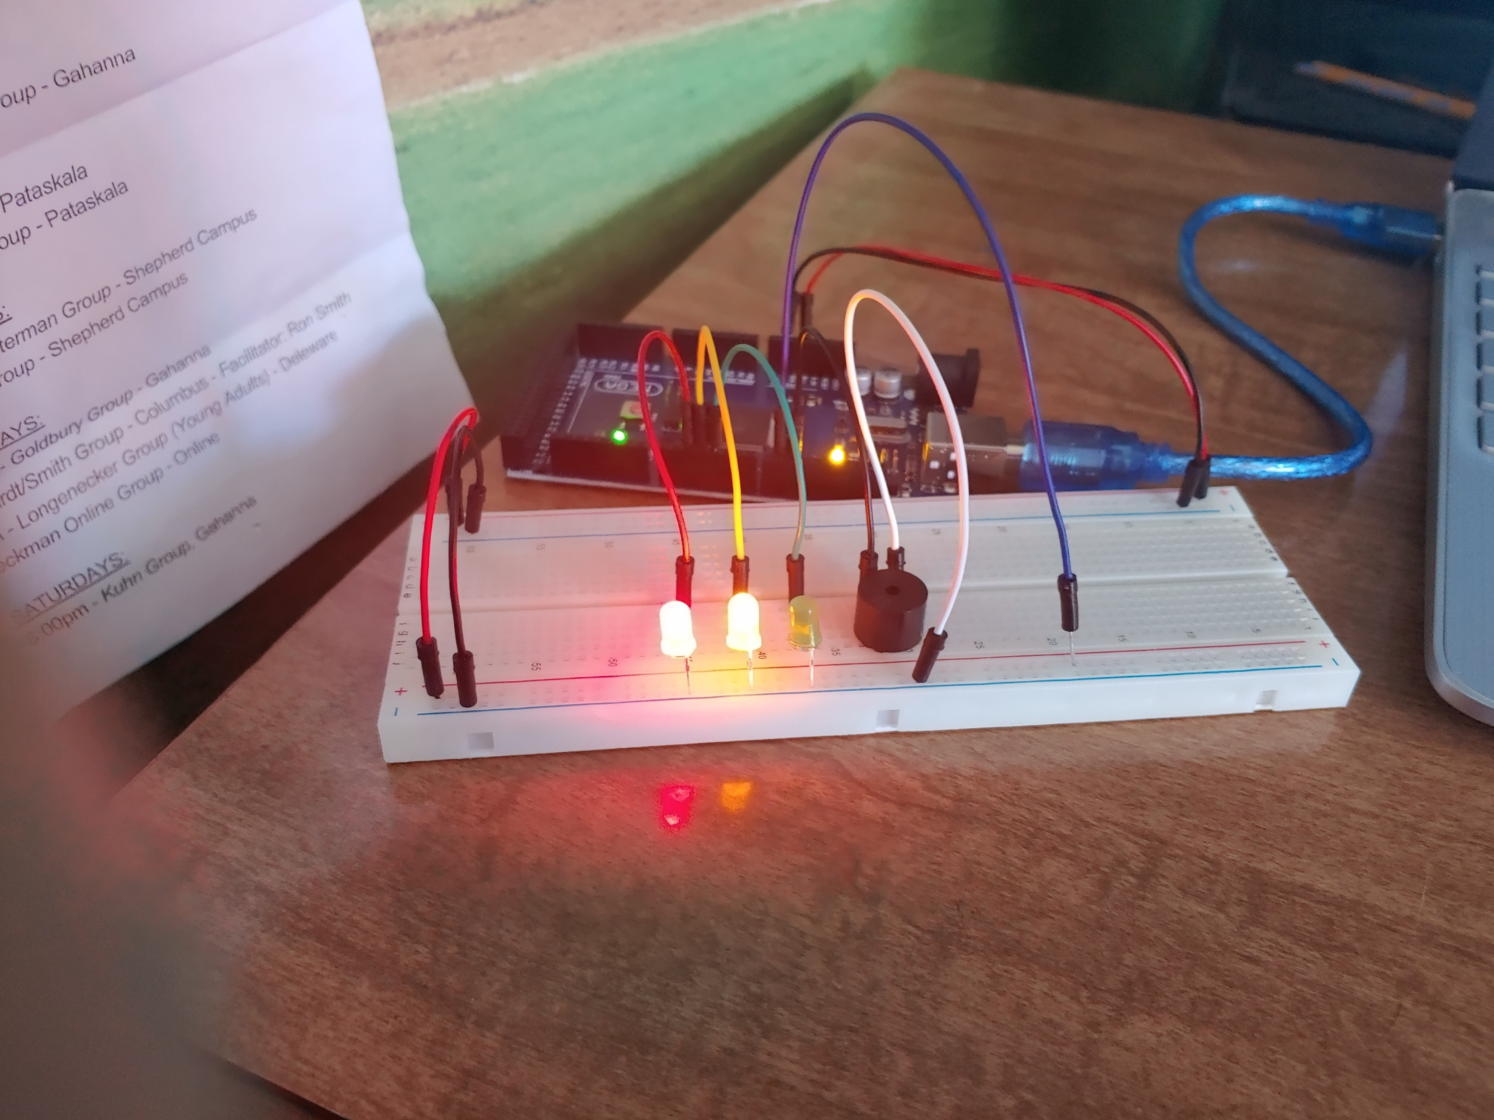
Circuit of door open with Green LED OFF (picture)

Slide 11
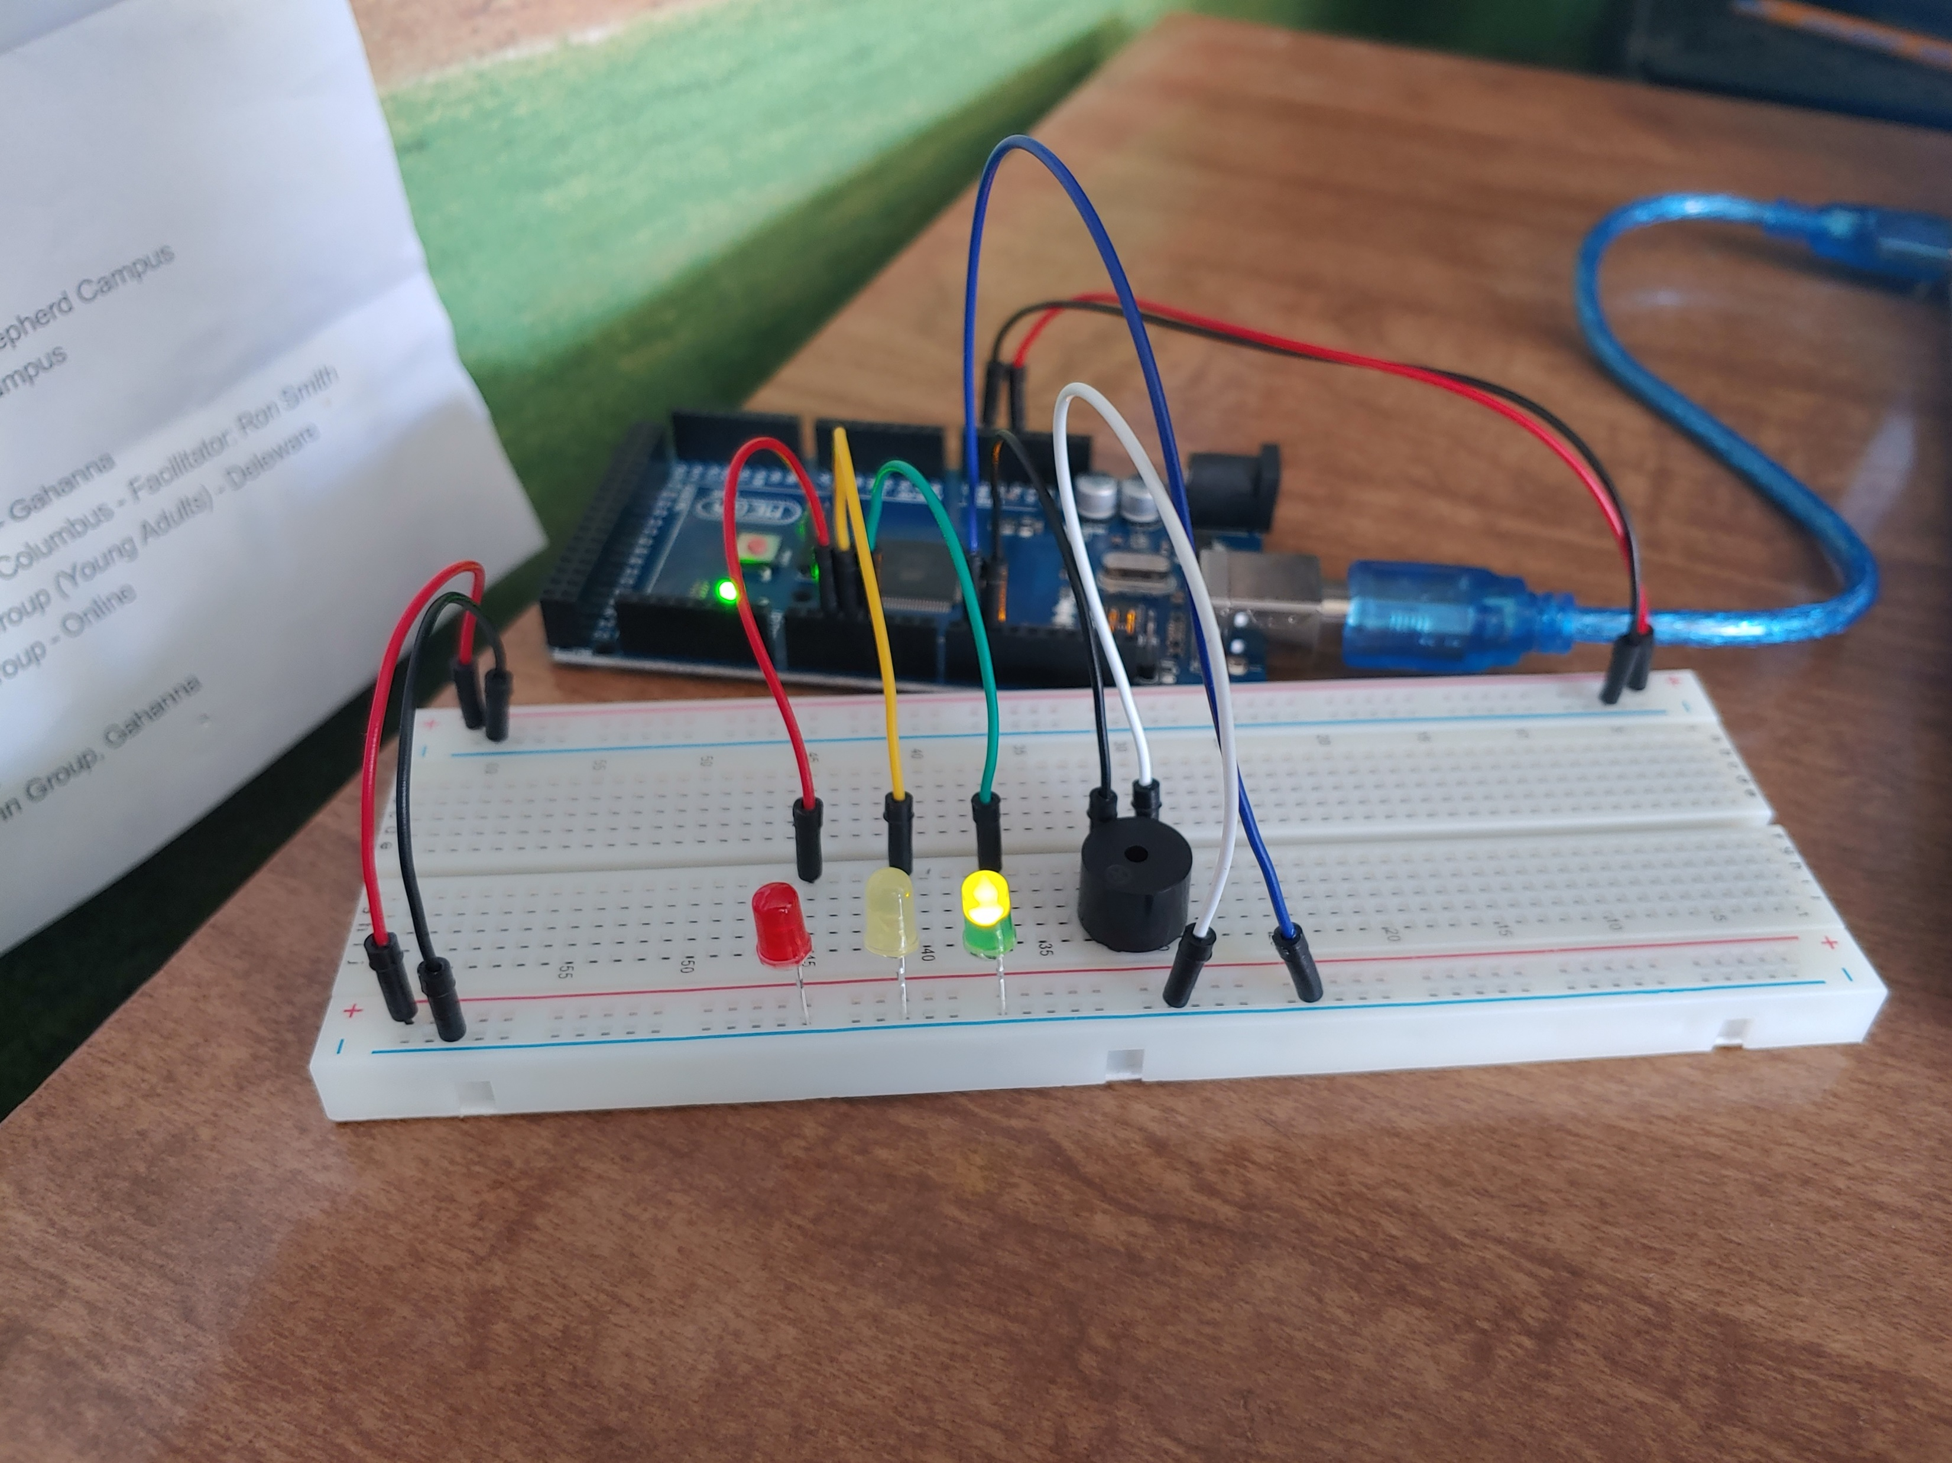
Circuit of door closed with Green LED ON (picture)

Slide 12
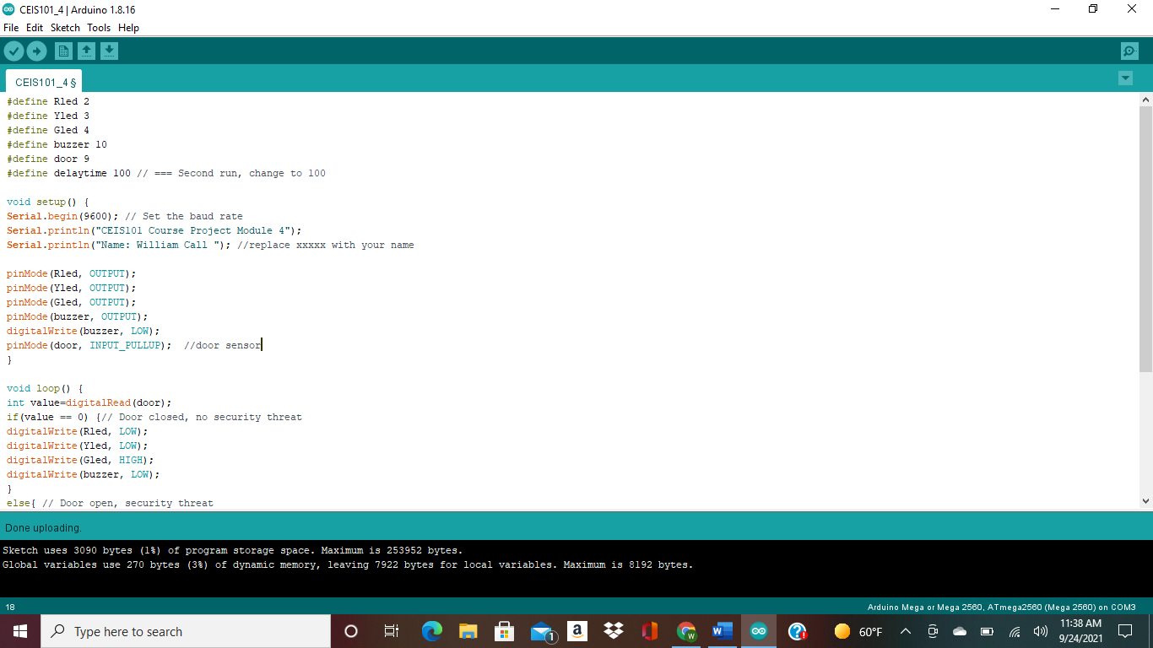
Arduino Code (screenshot)

Slide 13
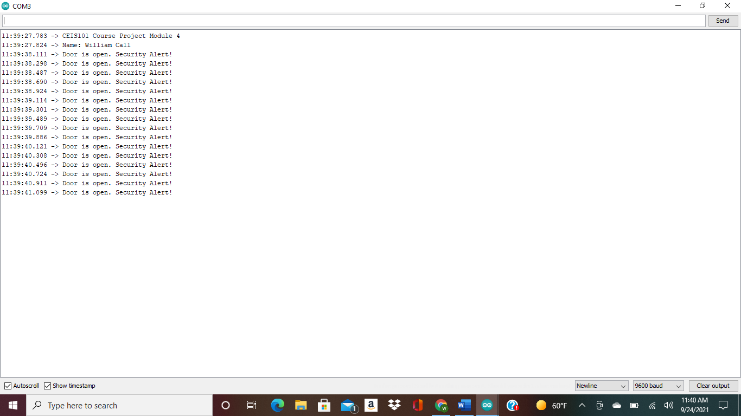
Serial Monitor (screenshot)

Slide 14
Adding a distance sensor to our home security system and collecting data

Slide 15
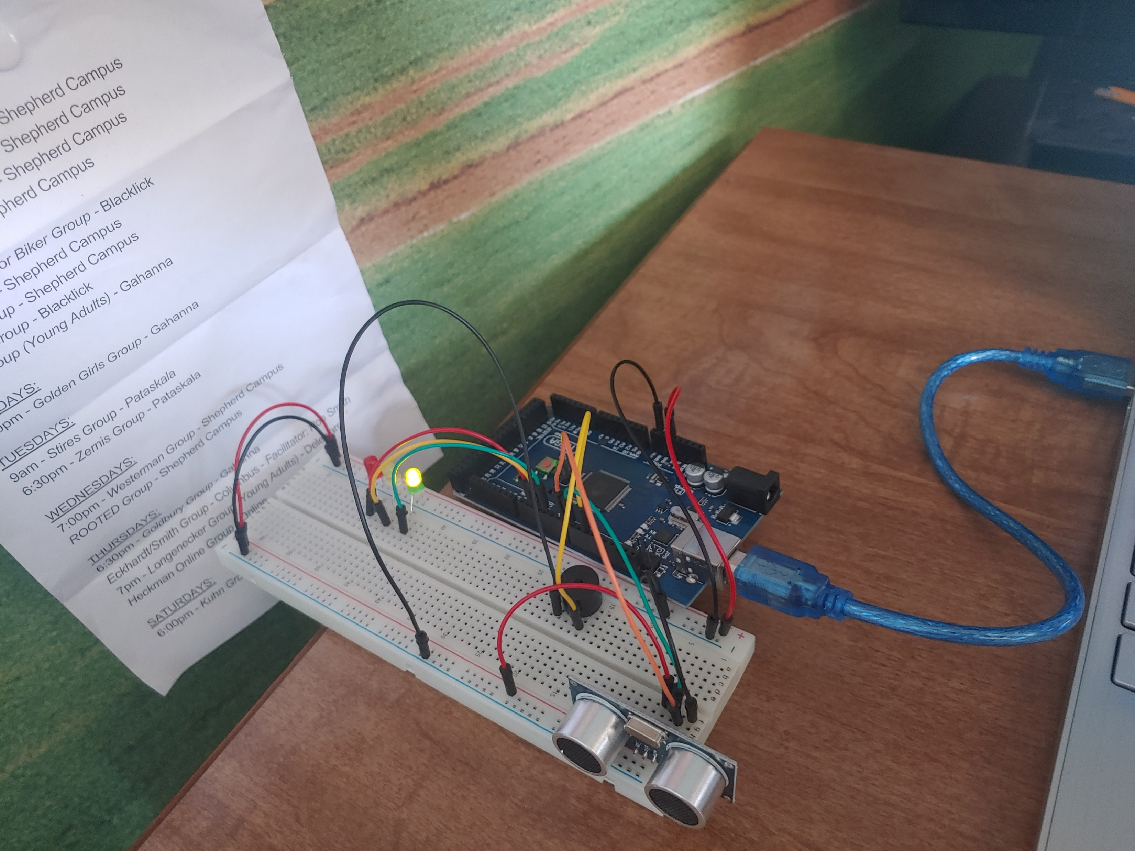
Circuit with green LED on (picture)

Slide 16
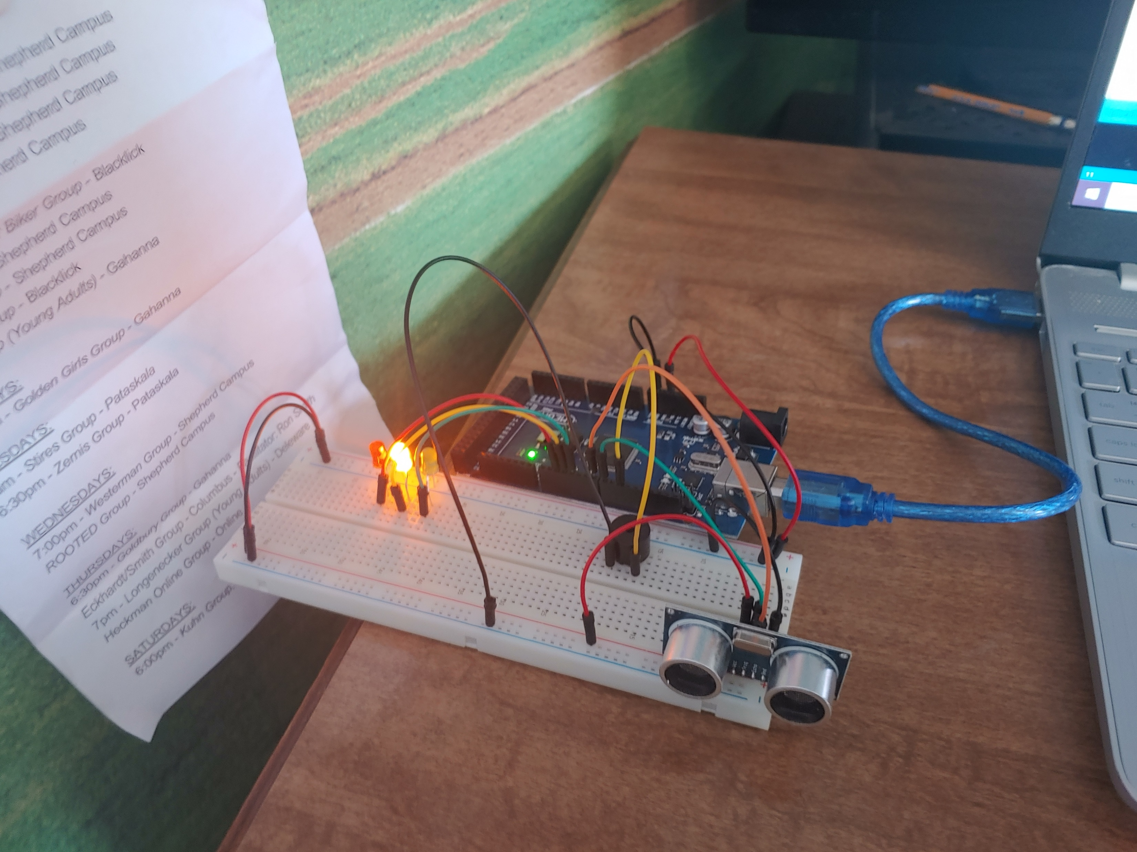
Circuit with yellow LED on (picture)

Slide 17
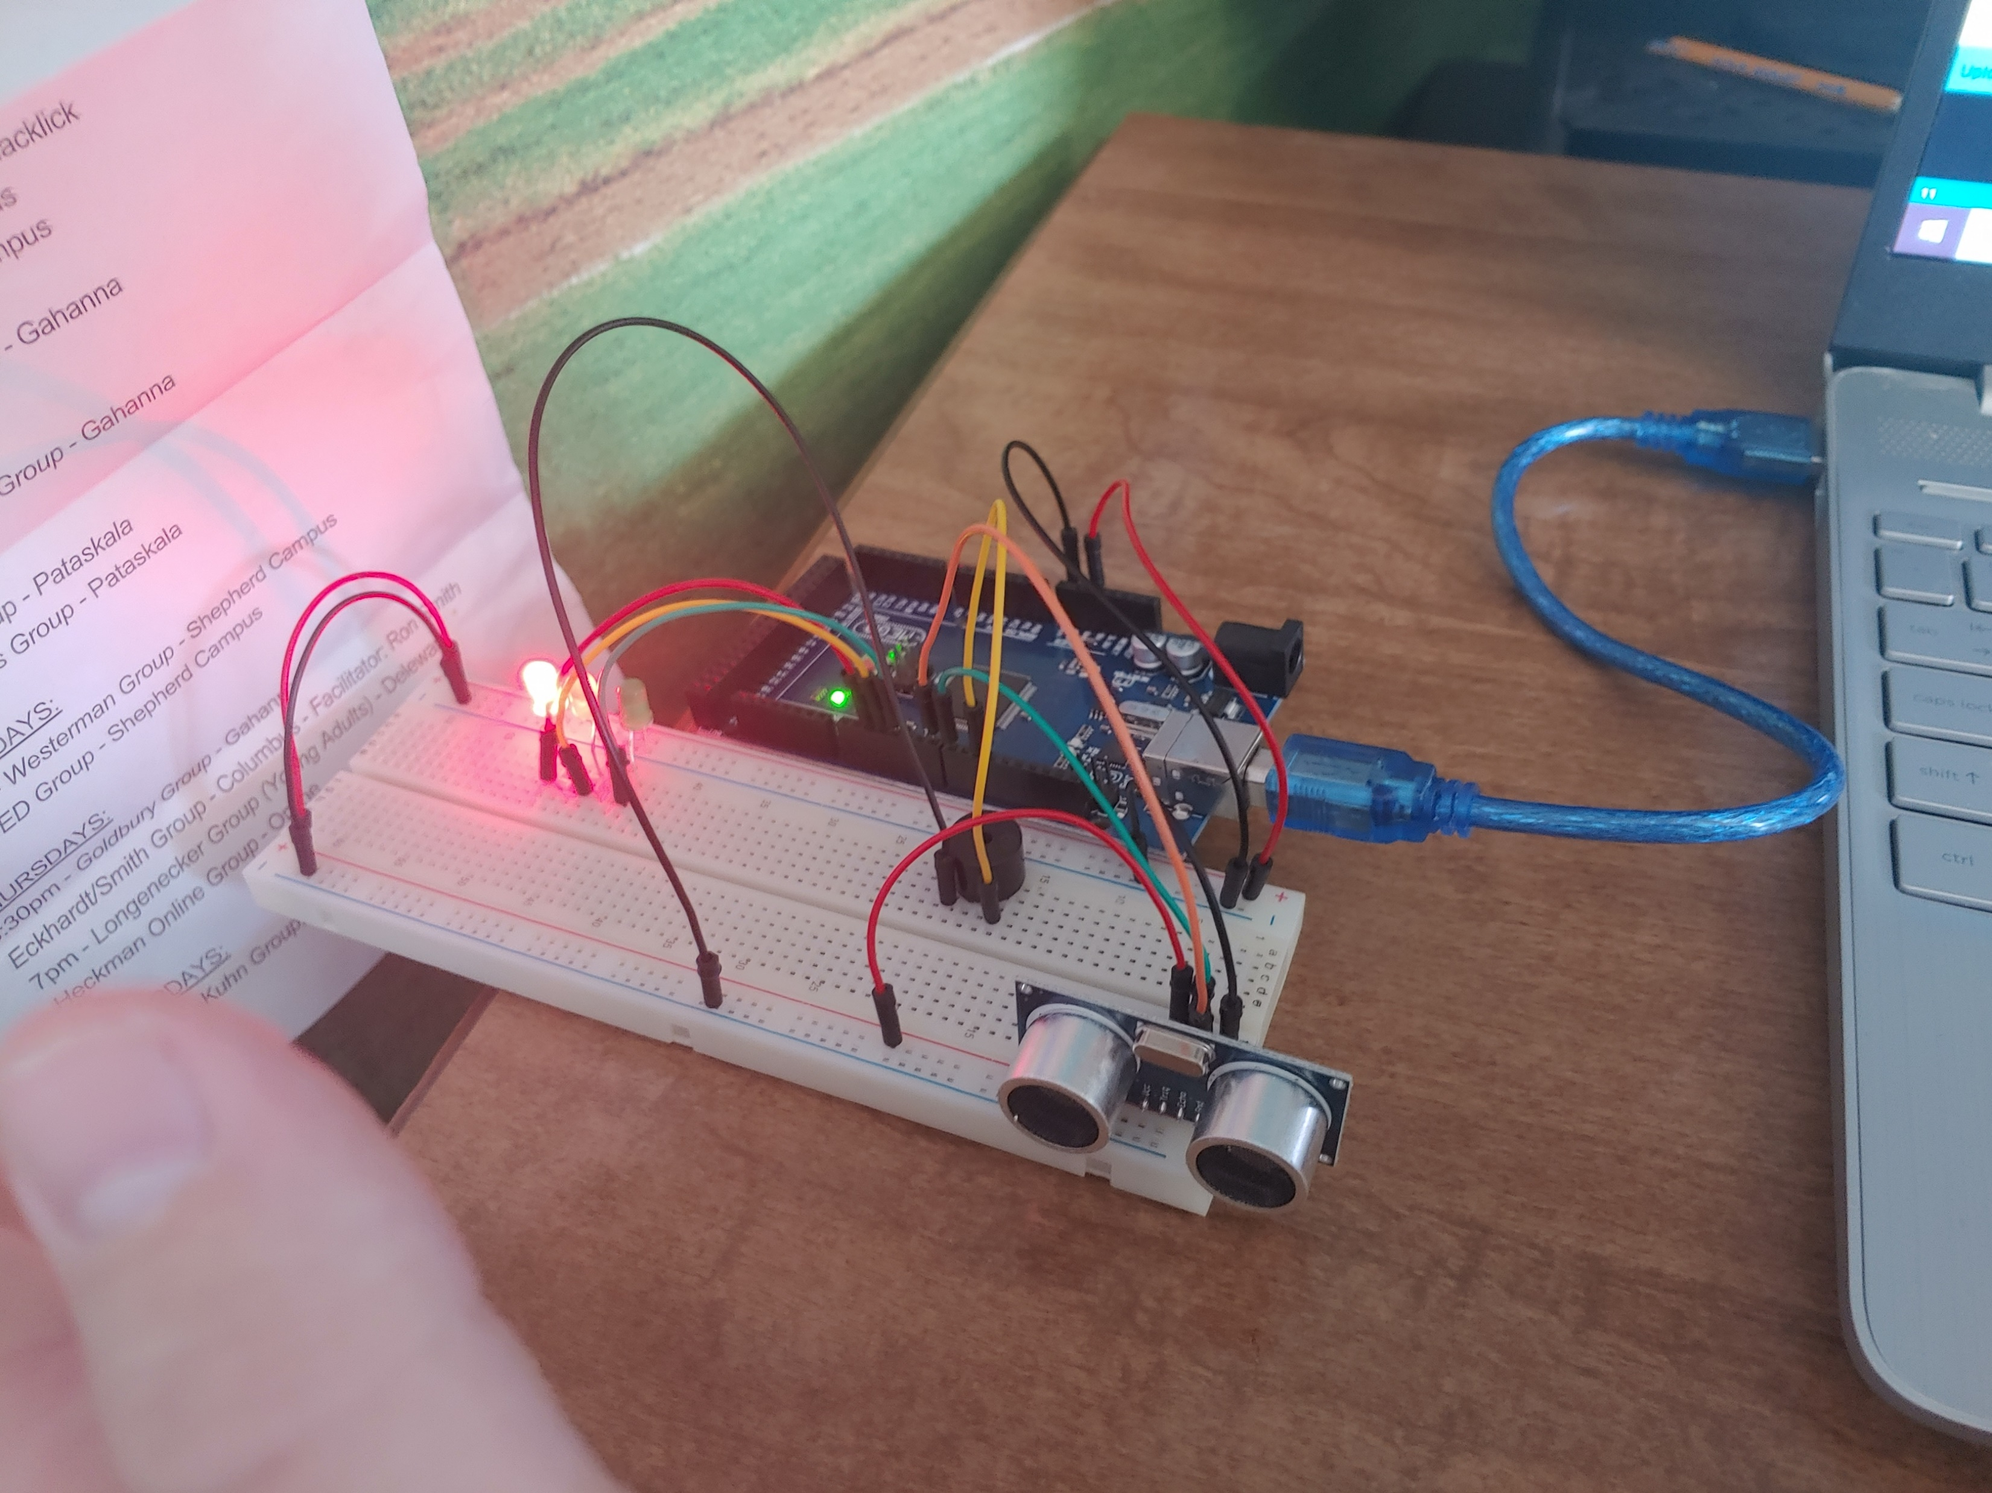
Circuit with red LED on (picture)

Slide 18
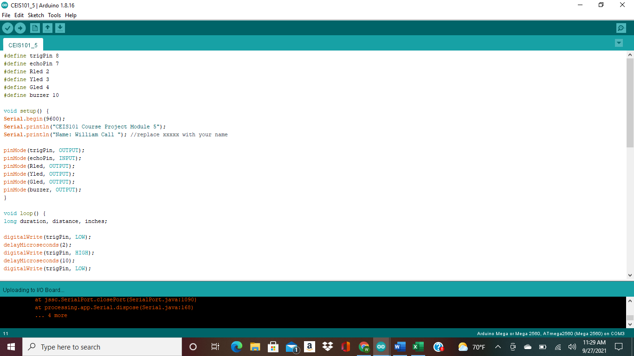
Arduino Code (screenshot)

Slide 19
Plot of data (graph from Excel)

Slide 20
Adding automated light to the smart home security system

Slide 21
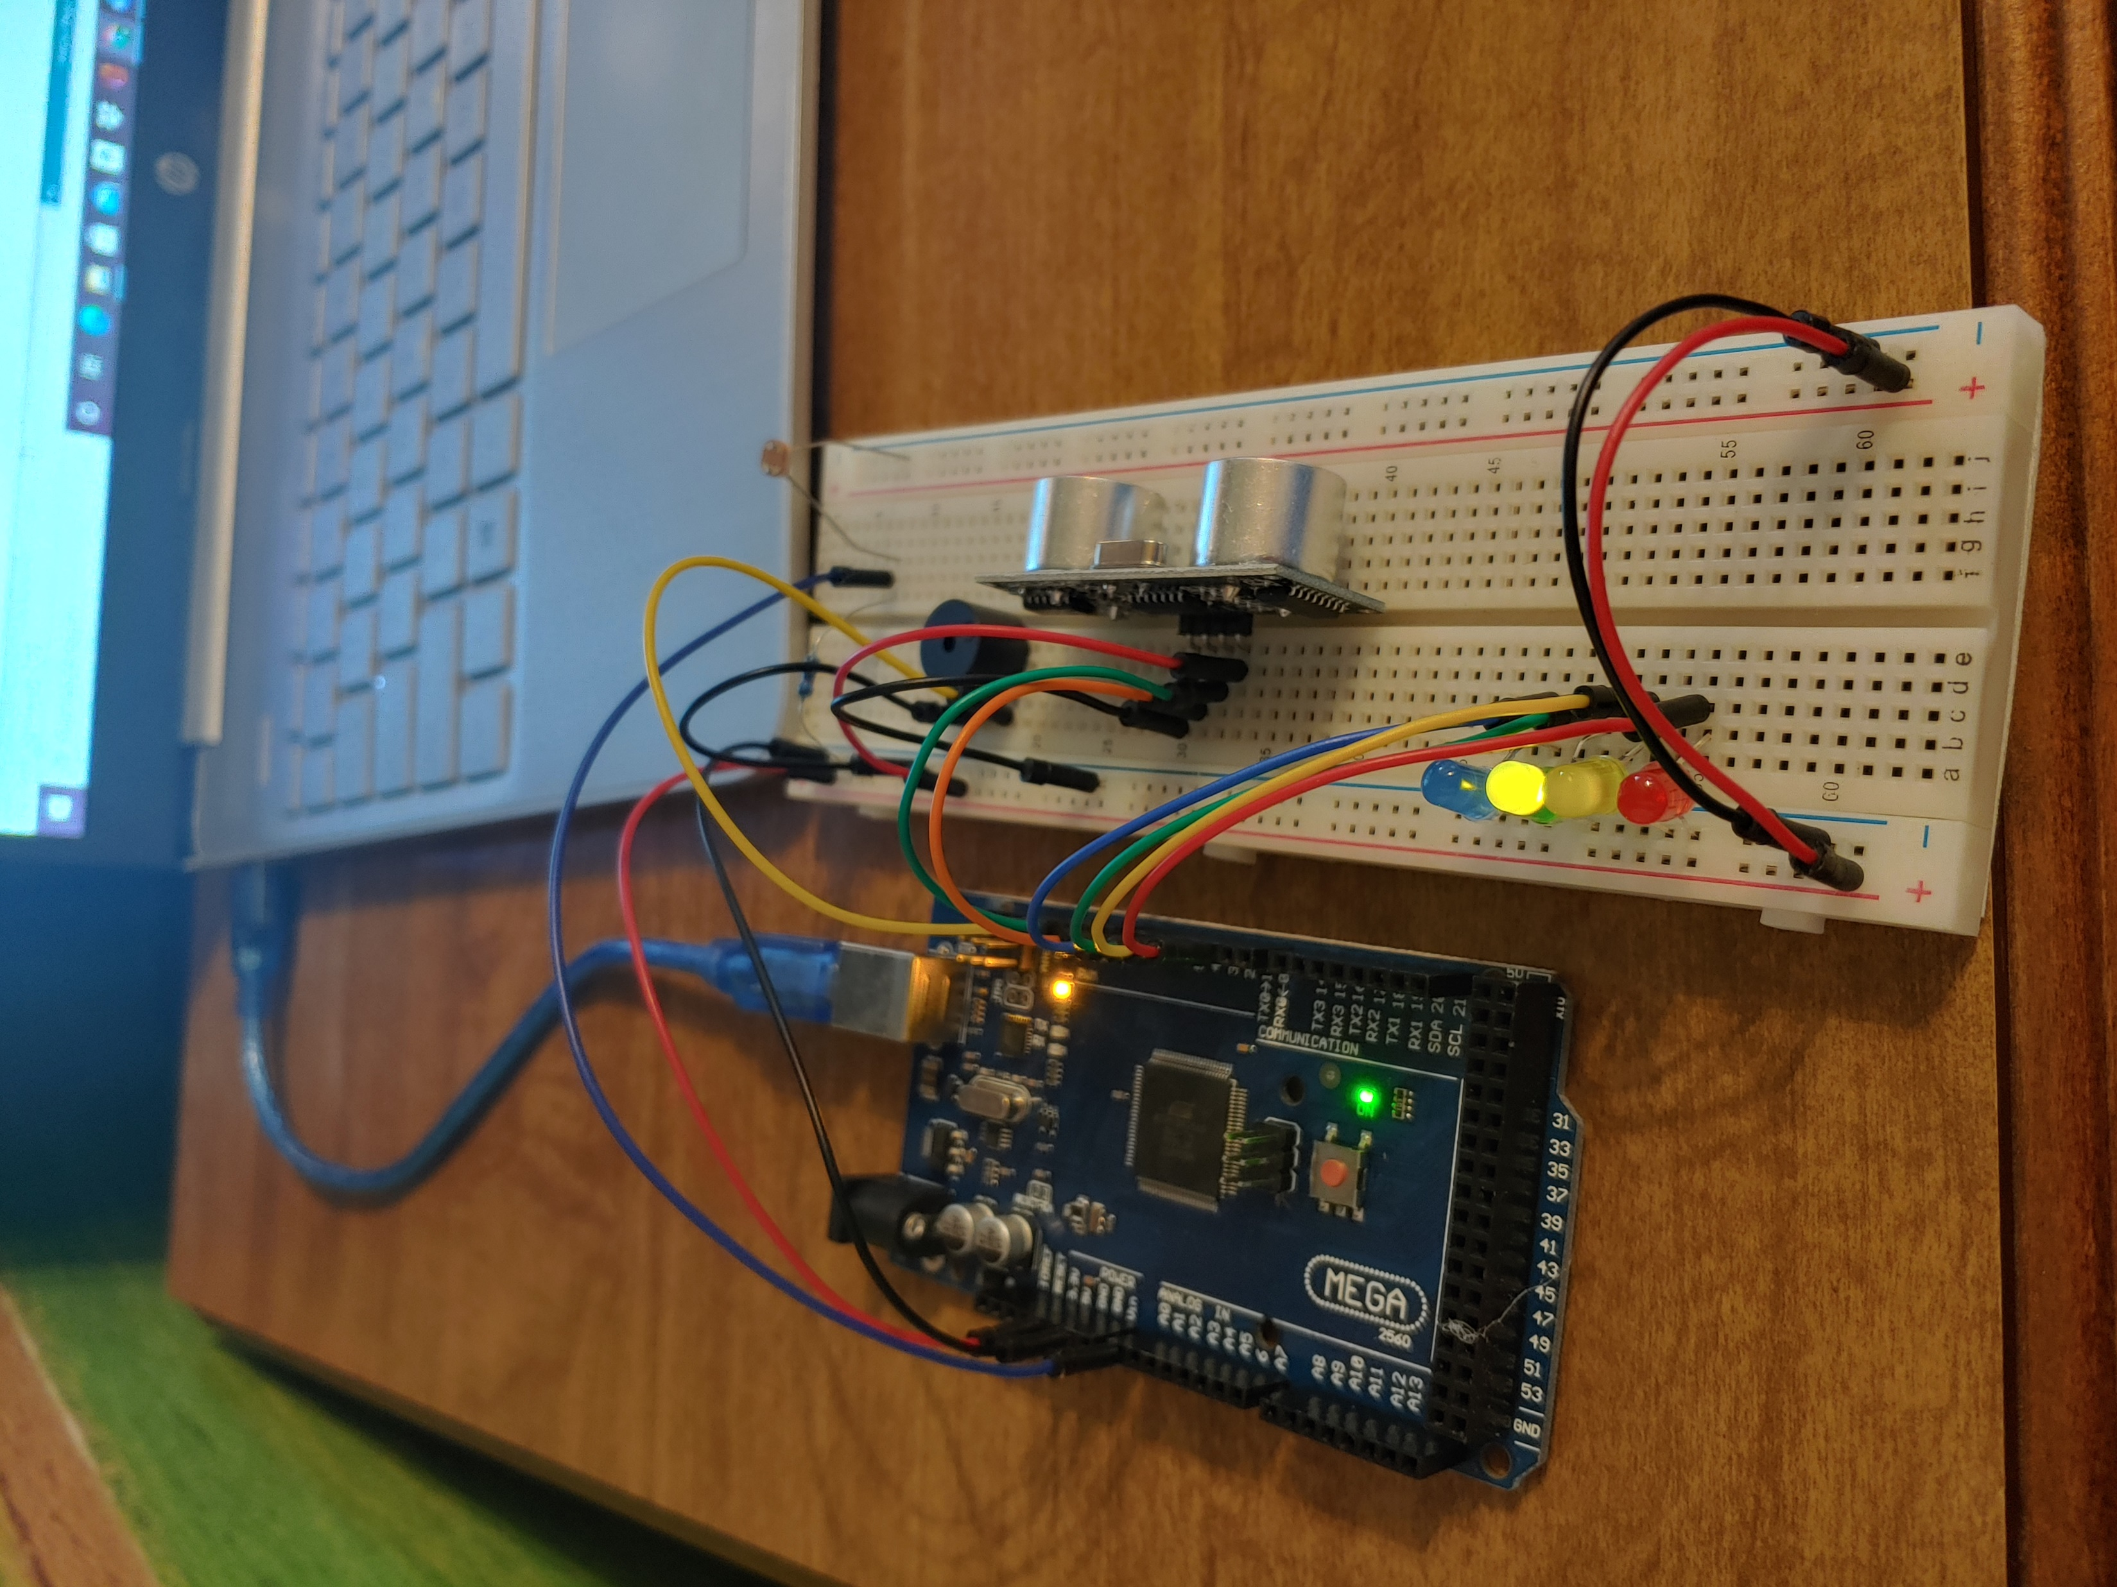
Circuit with automated LED off (picture)

Slide 22
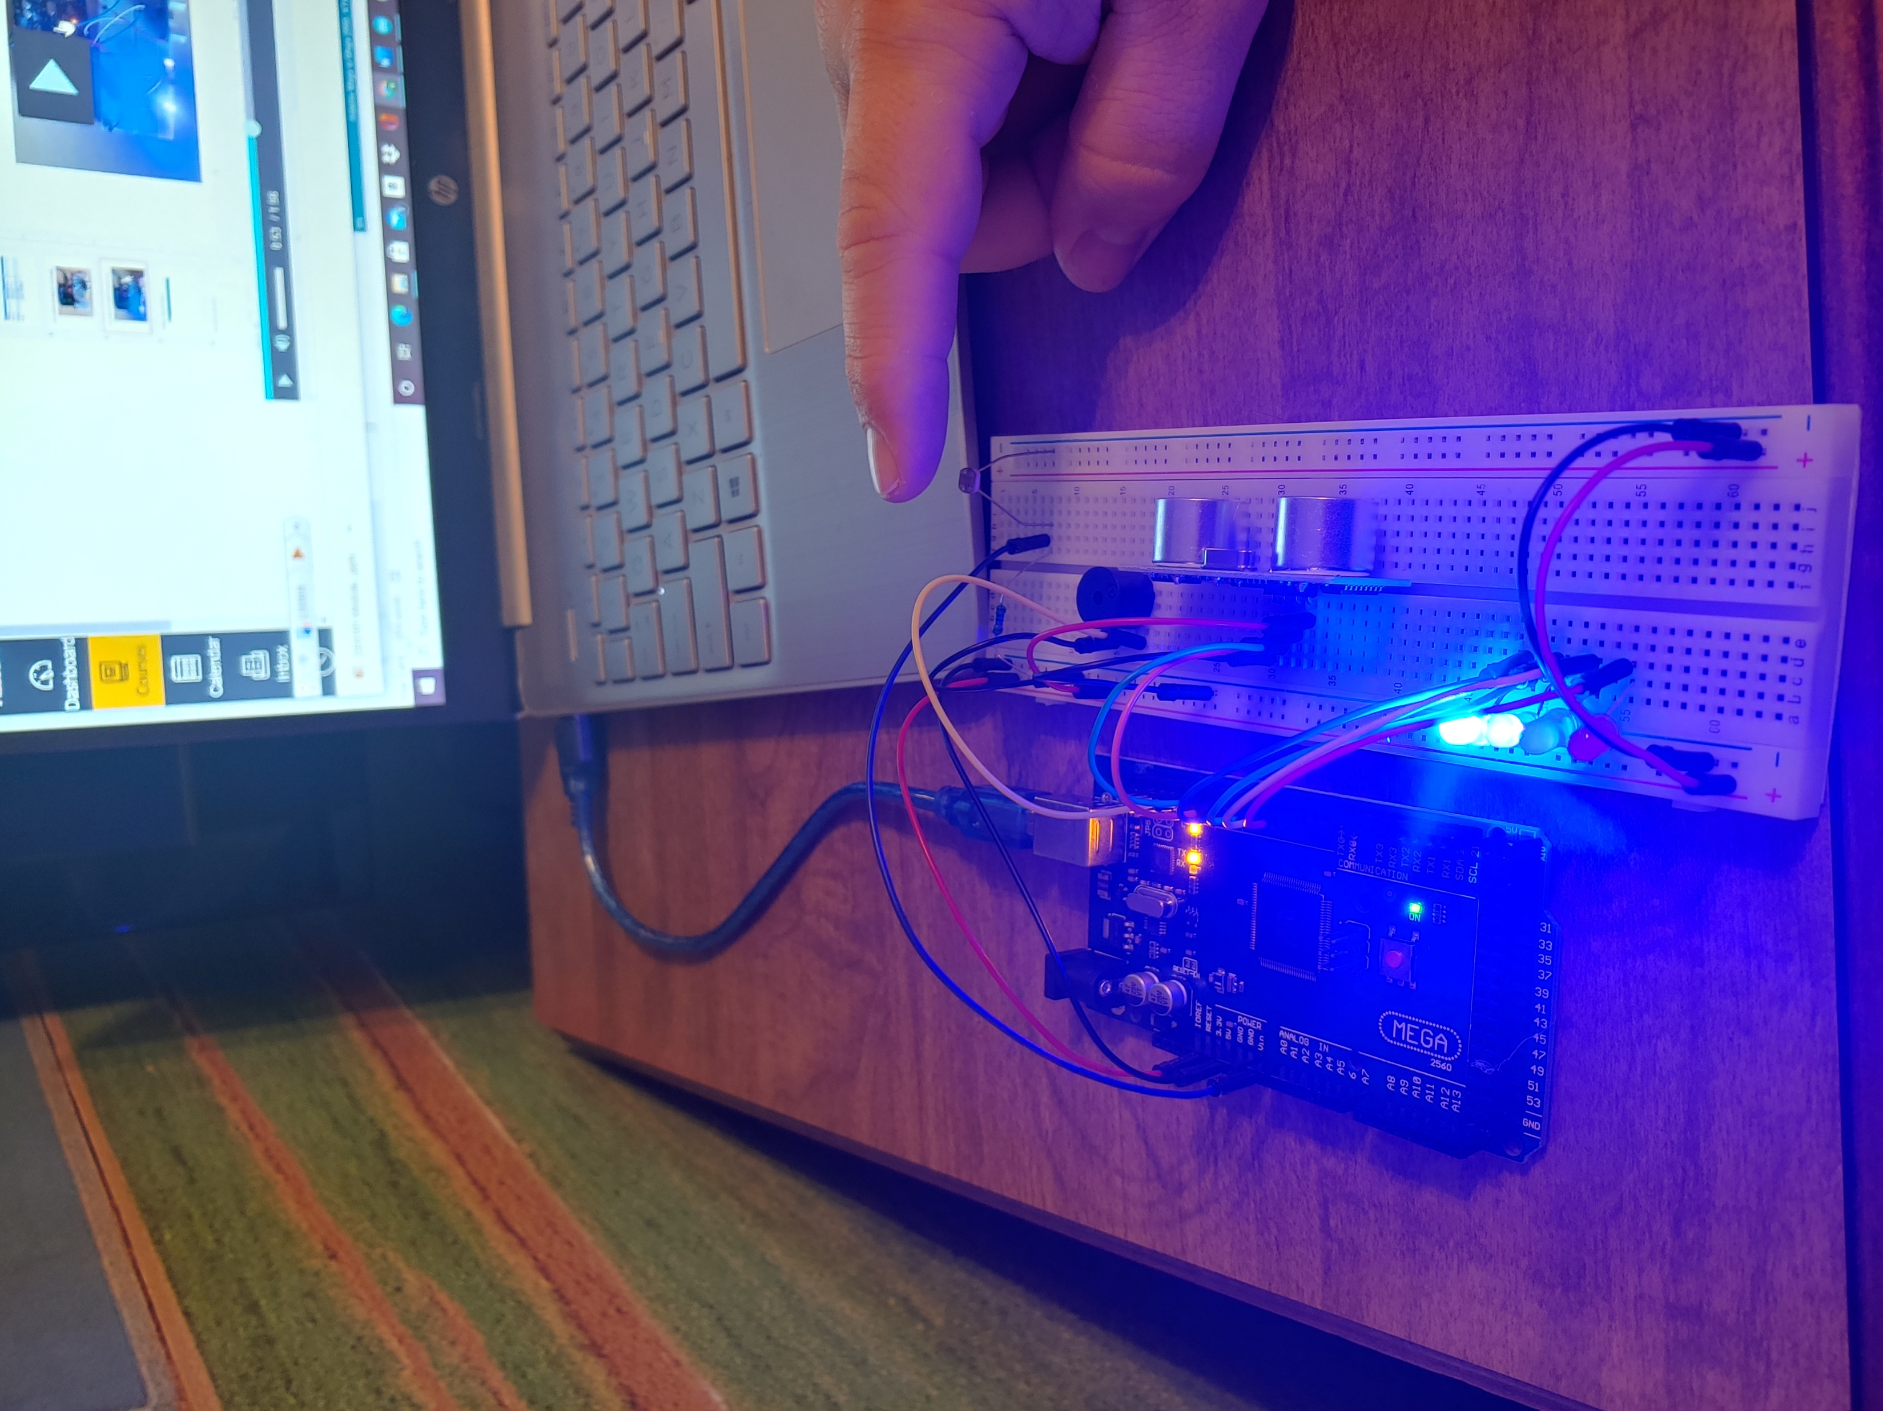
Circuit with automated LED on (picture)

Slide 23
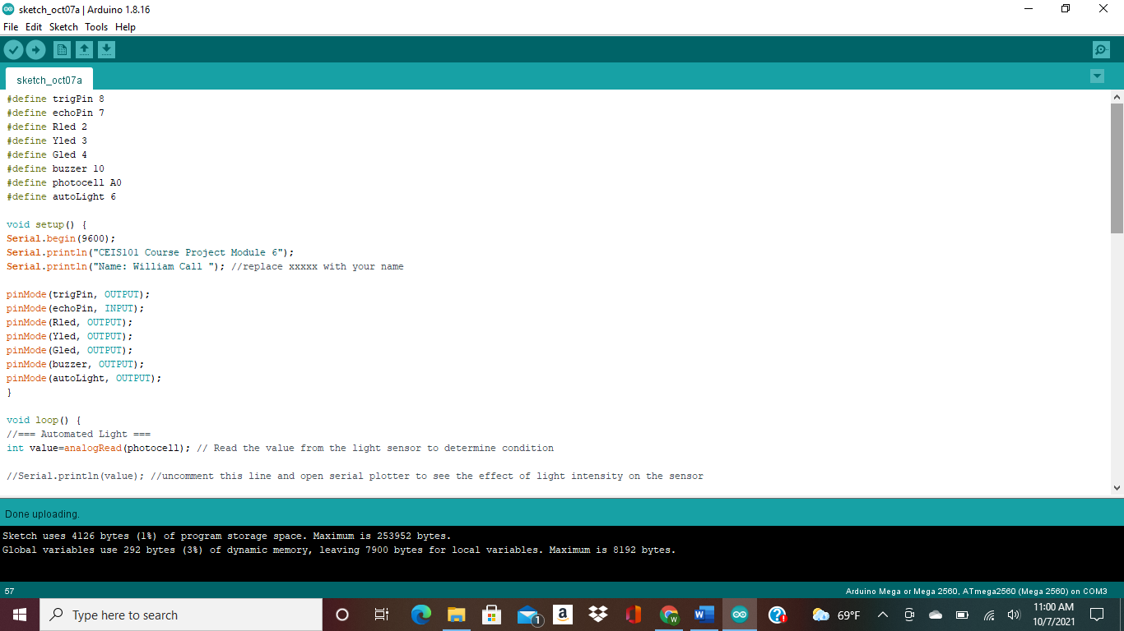
Arduino Code (screenshot)

Slide 24
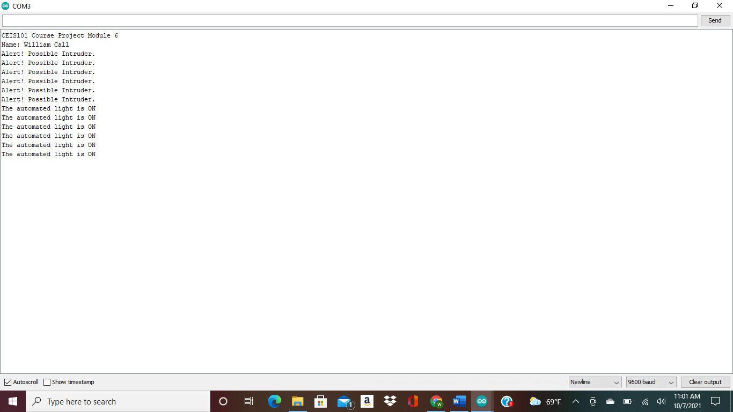
Serial Monitor (screenshot)

Slide 25
Challenges
There was a few challenges I had while build the home system. Like figure out the best way to wire it where I would not have a lot wires every were so that you would not be able the light or anything else and understanding the code I was putting into to the Arduino.

Slide 26
Career skills acquired
Hardware/device knowledge
Networking/connectivity ability
Coding/ programming
understanding IOT
Operating system fundamentals
Basic business intelligence and data analytic knowledge
Automation
Security awareness (at a minimum awareness)

Slide 27
Conclusion
During this class I was able to see the world in a different light after just the first day of class I start thinking of what ways I could help the world with apps and help keep other people information safe while they are using the internet. We are growing as a world so there will be more ways for information to get taken away from people but we will come up with new ways to stop that from happening.

