Slide 1

CEIS 106 Final
William L. Call

Slide 2
Navigate the Linux filesystem tree
1. What is the pwd command an acronym for? What about the cd command?
Answer here: pwd (print work directory)
Cd (change directory)
2. Explain the differences between a relative path and an absolute/full path in Linux.
Answer here: Absolute will come from the root of the directory while relative is coming from the current directory you are using.
References:
1.
2.

Slide 3
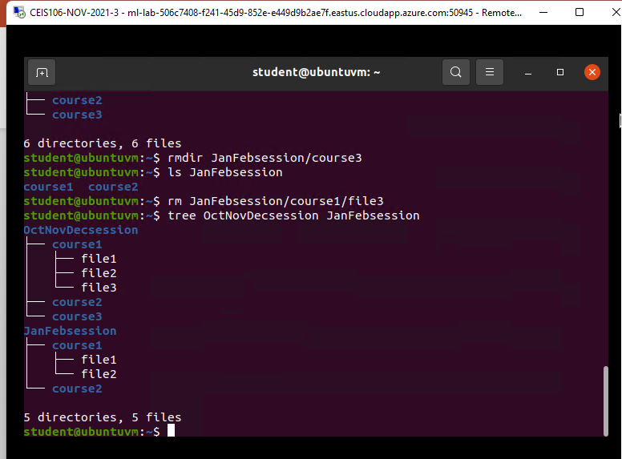
Create directories and files
Take a screenshot of the output in Steps 5 and 6.

Slide 4
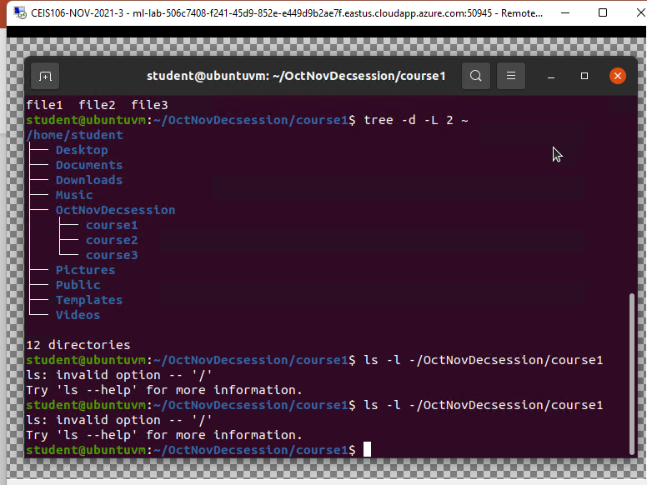
Copy and remove directories and files
Take a screenshot of the output in Step 3.

Slide 5
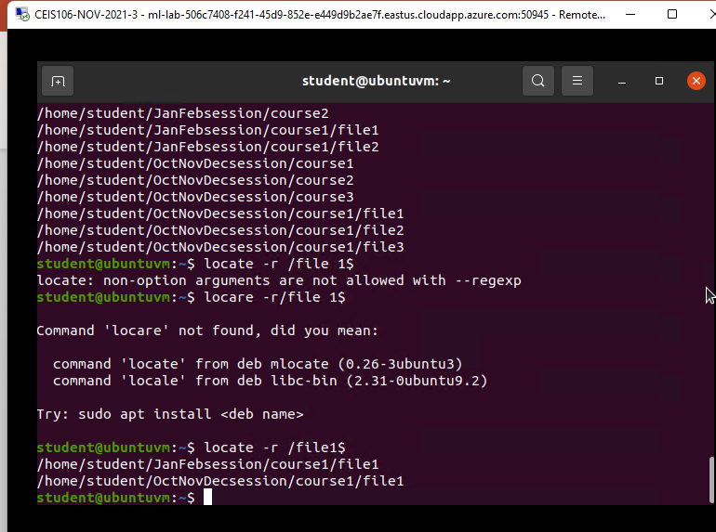
Locate directories and files
Take a screenshot of the output in Steps 5 and 6.

Slide 6
Create a shell script
1. What are the file permissions of the script?
Answer here:533
2. What’s the name of the user-defined variable in the script?
Answer here: todolist
3. Which redirection meta-character is used in the script? What does it do?
Answer here: nano
References:
1.
2.

Slide 7
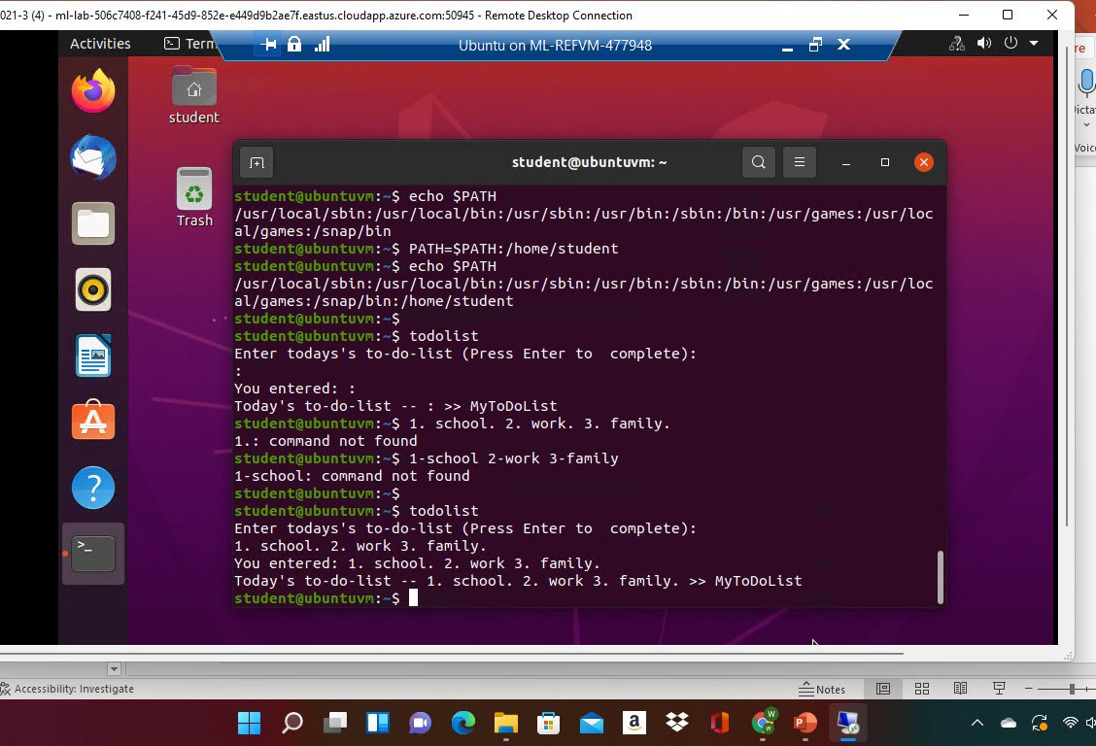
Set the PATH variable
Take a screenshot of the output in Step 6.

Slide 8
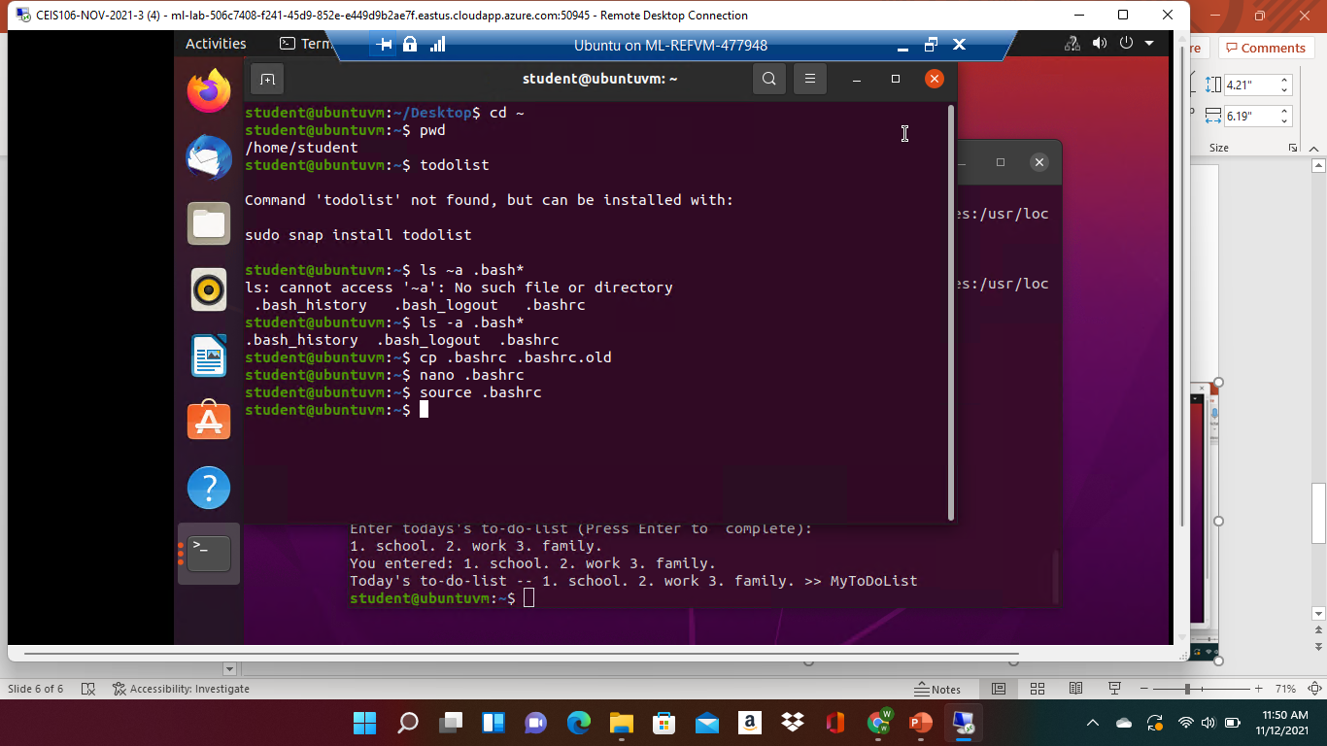
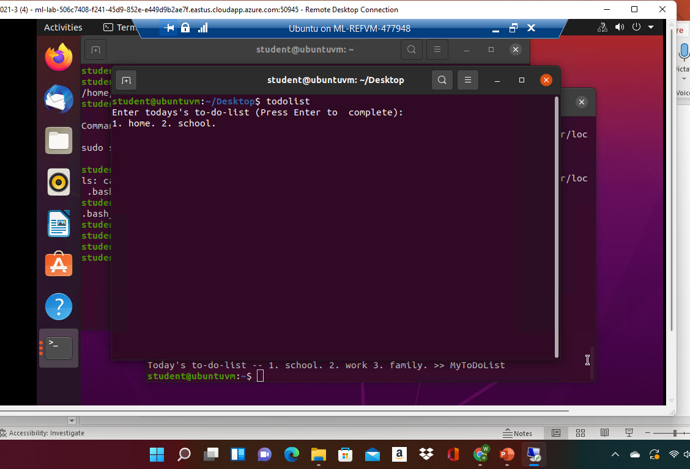
Make the PATH variable permanent
Run the todolist script before and after making the PATH variable permanent. Take a screenshot of both Terminal windows.

Slide 9
Add users and groups in CLI
1. What does the –m option in the useradd command do?
Answer here: Will create a home folder.
2. What does the -3 option in the tail command do?
Answer here: It will give the last 3 lines.
3. Which line of the /etc/group file lists members of the “students” group? Copy it here.
Answer here: The 2nd and 3rd line shows the members of the group.
References:
1.
2.

Slide 10
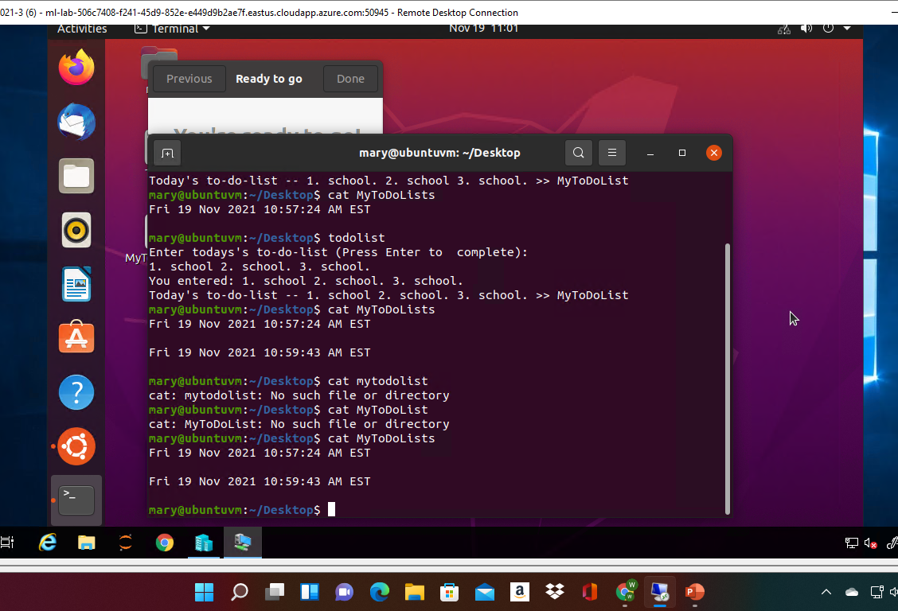
Test user and group settings
Take a screenshot of the output in Step 6.

Slide 11
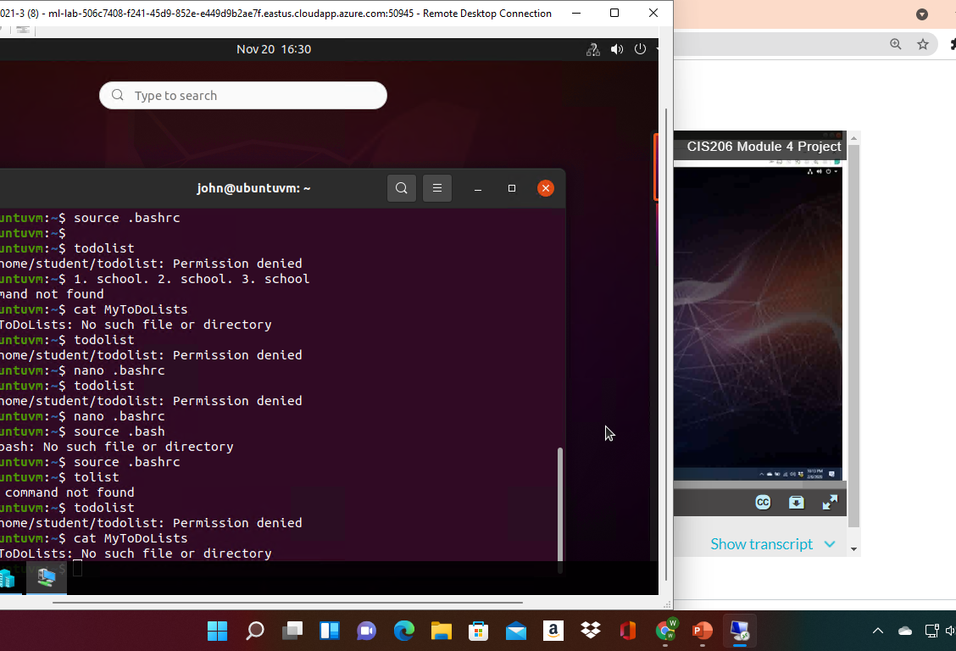
Add users in GUI
Take a screenshot of the output in Step 9.

Slide 12
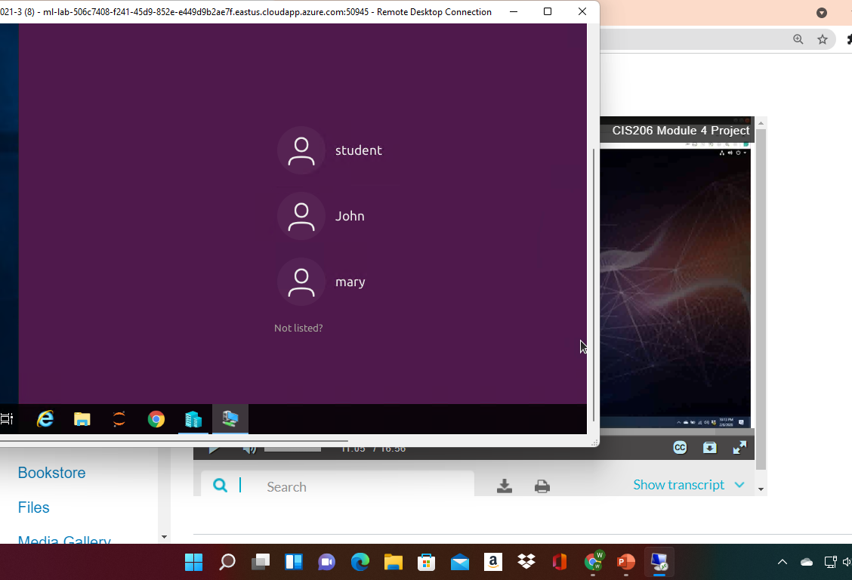

Remove users and groups
Take a screenshot of the log on page with three user accounts.
Take a screenshot of the log on page with only your user account (i.e., student).

Slide 13
Manage network interfaces
1. Which DHCP message is shown in the output of the sudo dhclient –v –r eth0 command? [hint: the message name is in uppercase.]
Answer here: DHCPRELEASE
2. Which four DHCP messages are shown in the output of the sudo dhclient –v eth0 command? [hint: the message names are in uppercase.]
Answer here: DHSP Discover, offer, request, pack
References:
1.
2.

Slide 14
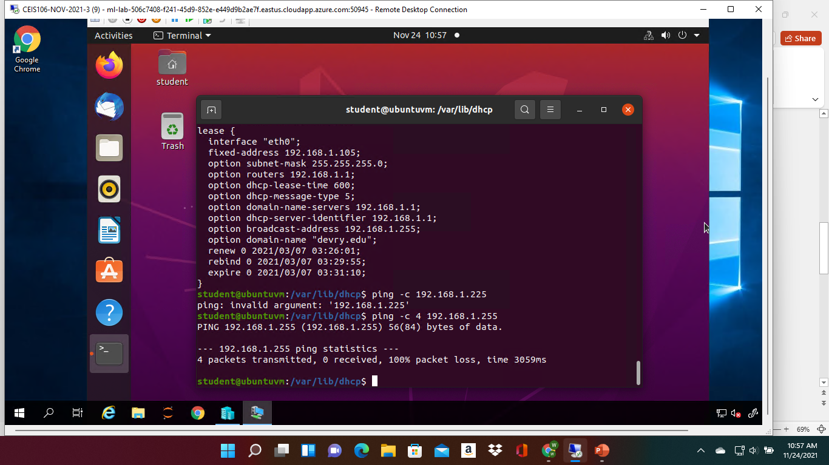
Discover host IP configurations
1. What is the IP address of your Ubuntu machine?
Answer here: inet 127.0.0.18
2. What is the IP address of its default gateway?
Answer here: via 10.0.01
3. What is the IP address of its DHCP server?
Answer here:192.168.1.255
4. What is the IP address of its DNS server?
Answer here:192.168.86.1
Take a screenshot of the output in Step 6.

Slide 15
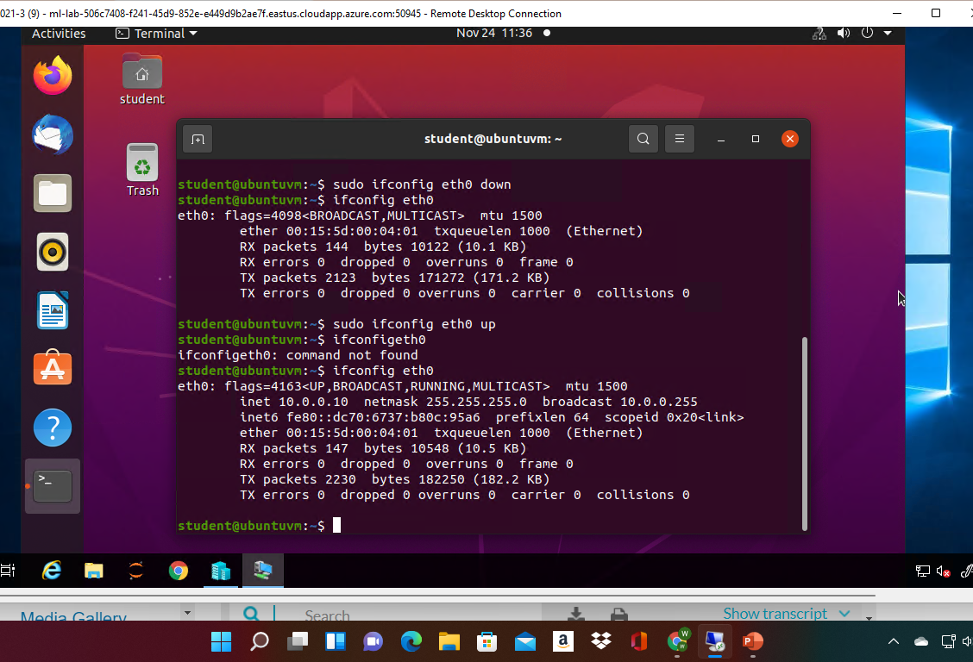
Use network utilities
Take a screenshot of the output in Step 5.

Slide 16
Monitor Linux processes
1. What is the default action of the 15 SIGTERM kill signal?
Answer here: it is to terminate a program.
2. In the System Monitor window, click on % CPU to sort the processes by CPU load. Which process shows the highest percentage of CPU usage?
Answer here: gnome-shell
References:
1.
2.

Slide 17
Monitor user activities
Issue the sudo accton on command to turn on GNC accounting. Run the sudo updatedb command. Enter lastcomm updatedb to check if the updatedb command was executed before. Remember to turn off GNC accounting (sudo accton off) after answering the questions.
1. What flag value is displayed in the output?
Answer here: .85
2. Why is the name of the user who ran the processes shown as root, not student?
Answer here: S
References:
1.
2.

Slide 18
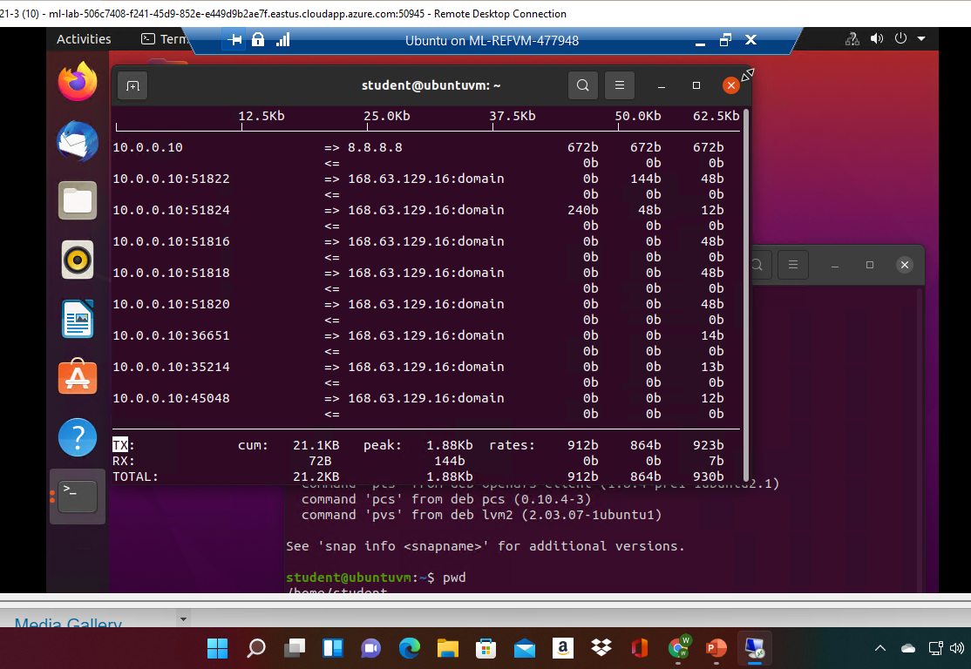
Monitor network bandwidth usage
Take a screenshot of the output in Step 4.

