Slide 1
Final for SEC 290
By William L. Call

Slide 2
Introduction
Hello my name is William L. Call I took SEC 290 Fundamentals of infrastructure security while at DeVry university. I will be going over the projects I accomplished during this course. Infrastructure Security

Slide 3
1st project
For this project we learned basic protocol analysis, using filters to extract data, common attacks, and basic attack analysis.

Slide 4
Basic attack analysis
Look at captures no. 20 and 22. (You can use the “Go” link at the top of the Wireshark screen to quickly go to a specific capture) Both packets are ICMP traffic but there are subtle differences between them. Compare the time-to-live and data field sizes in the two packets. What differences do you see?
  20 has 98 bytes while 22 has 47 bytes.
Do a little Internet research to discover which operating systems use the specific values in their ping commands. What operating system generated the echo request in capture 20?
  The host system.
Review packet no. 37 and beyond, what do you think is taking place here?
  They start getting flagged
Look at capture 22846. What is suspicious about the flag settings in this packet?
  It should be red flagged but it is not
What is the IP address of the host being targeted?
  192.168.177.47

Slide 5
2nd project
In this project we explored manual open SSL analysis by creating an SSL/TLS file.

Slide 6
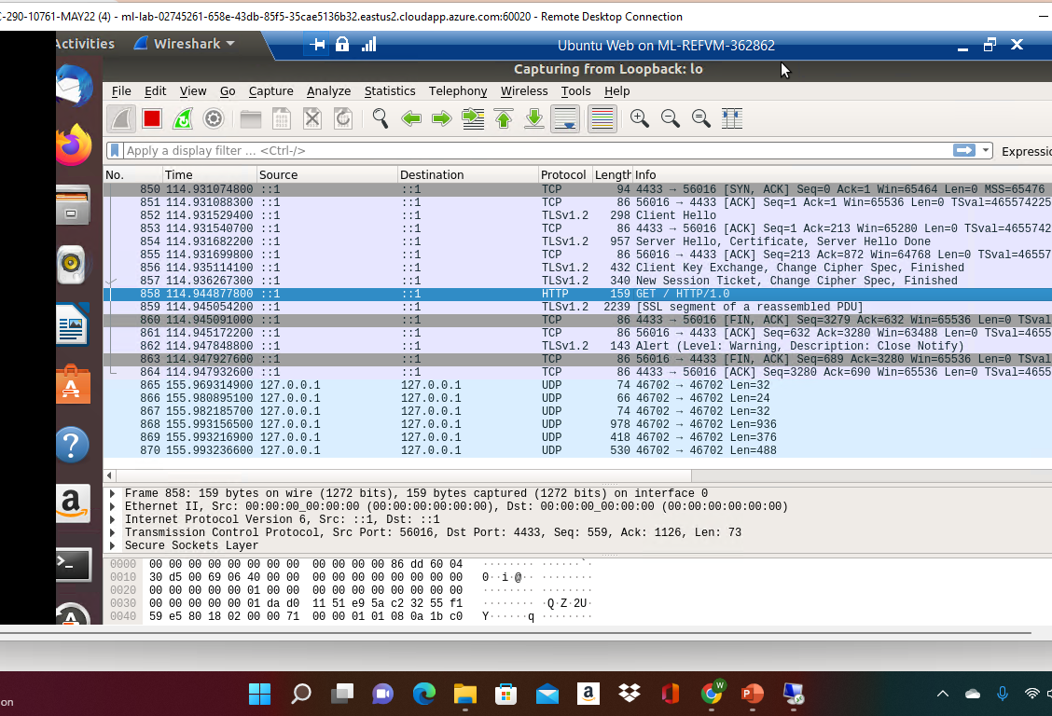
Creating and testing an SSL/TLS file
Take a screenshot of the output in Step 17.
It should show the GET request in the Info column.

Slide 7
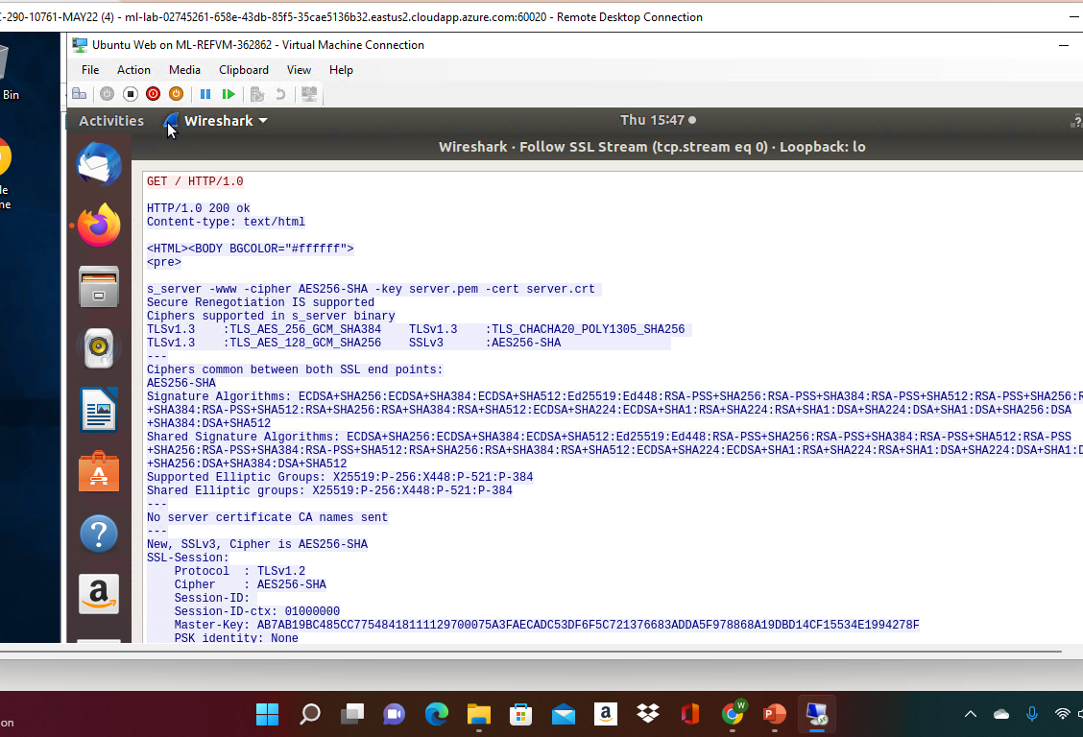
Creating and testing an SSL/TLS file cont’d
Take a screenshot of the output in Step 20.
It should show the decrypted SSL stream.

Slide 8
3rd project
During this project we explored snort an open-source network intrusion detection testing and creating snort rules.

Slide 9
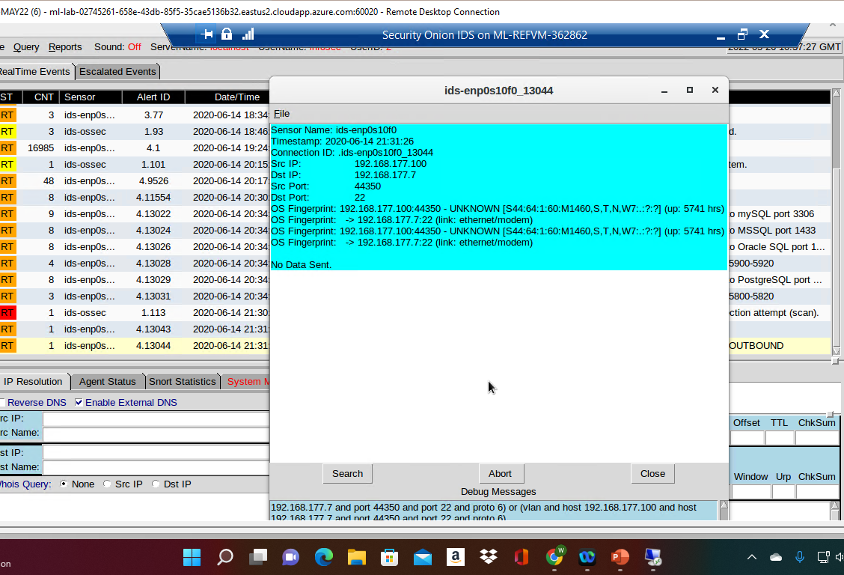
Testing Snort rules
Take a screenshot of the output in Part 1 Step 8.
It should show the transcript of the XMAS scan alert.

Slide 10
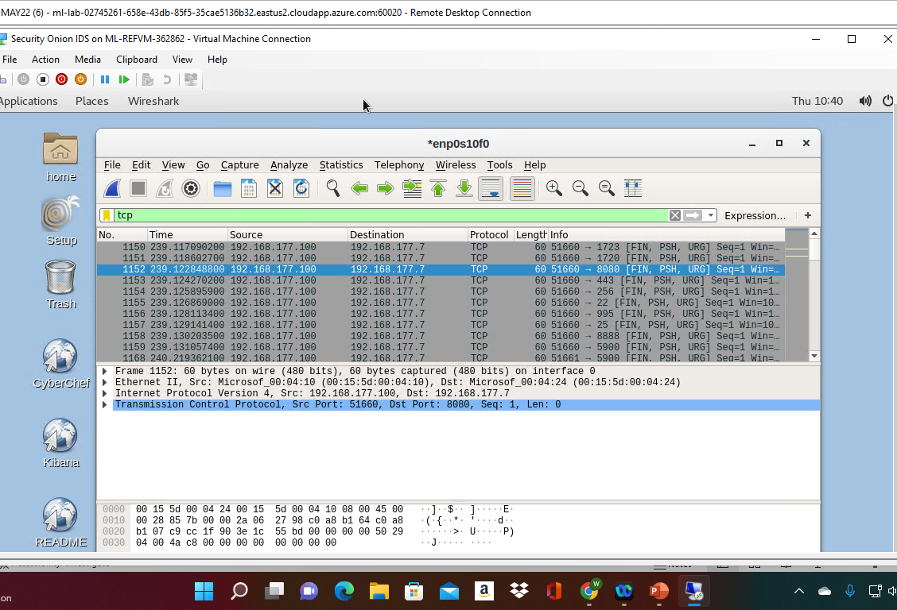
Testing Snort rules cont’d
Take a screenshot of the output in Part 1 Step 10.
It should show the TCP packets generated by the XMAS scan.

Slide 11
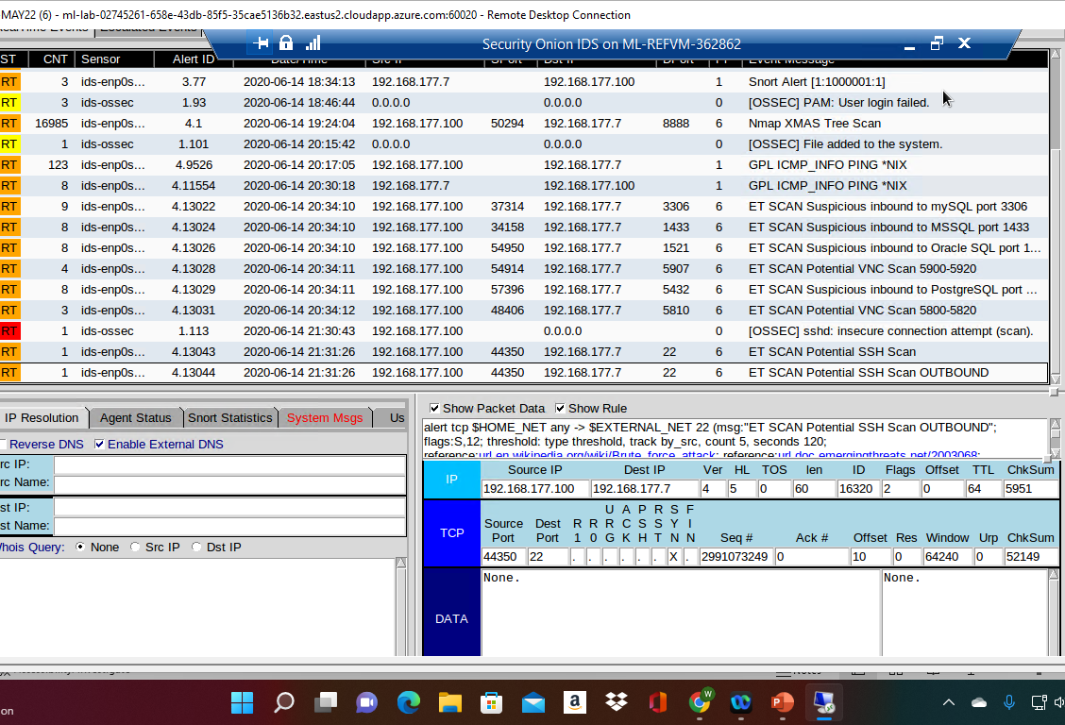
Creating Snort rules
Take a screenshot of the output in Part 2 Step 5.
It should show the ping activity alert.

Slide 12
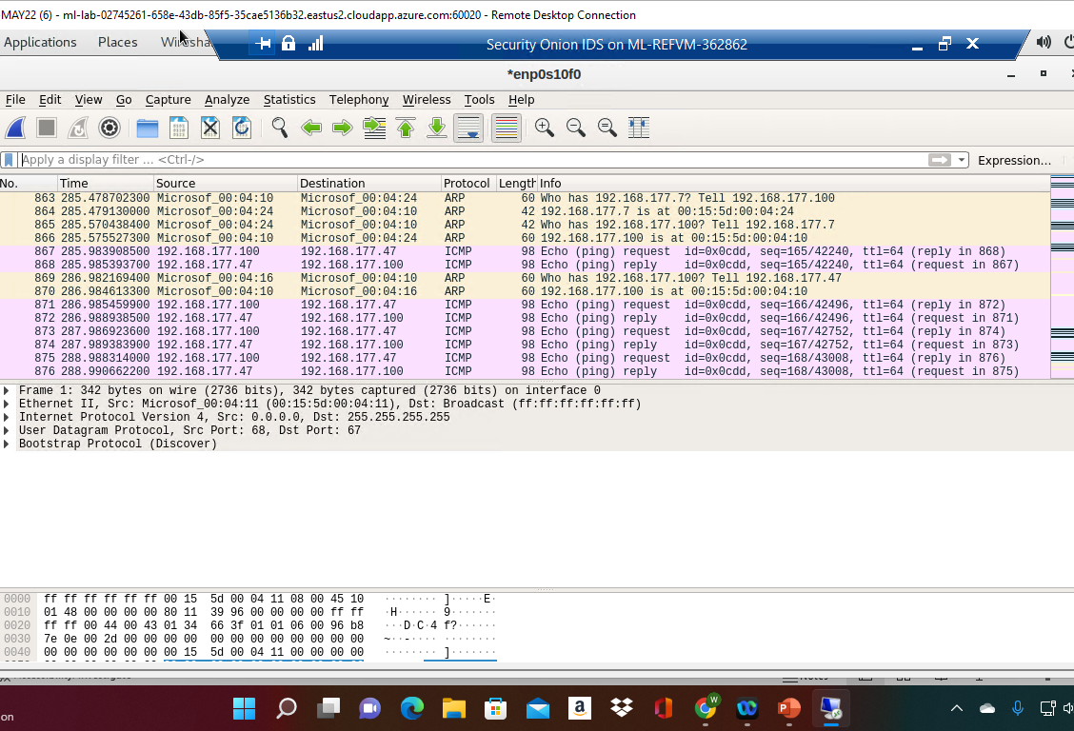
Creating Snort rules cont’d
Take a screenshot of the output in Part 2 Step 6.
It should show the ICMP packets generated by the ping activity.

Slide 13
4th project
In this project we gained familiarity with Linux and Microsoft tools that allow us to conduct live memory analysis, including topic like Linux processes, Process hacker, Process monitor, and volatility.

Slide 14
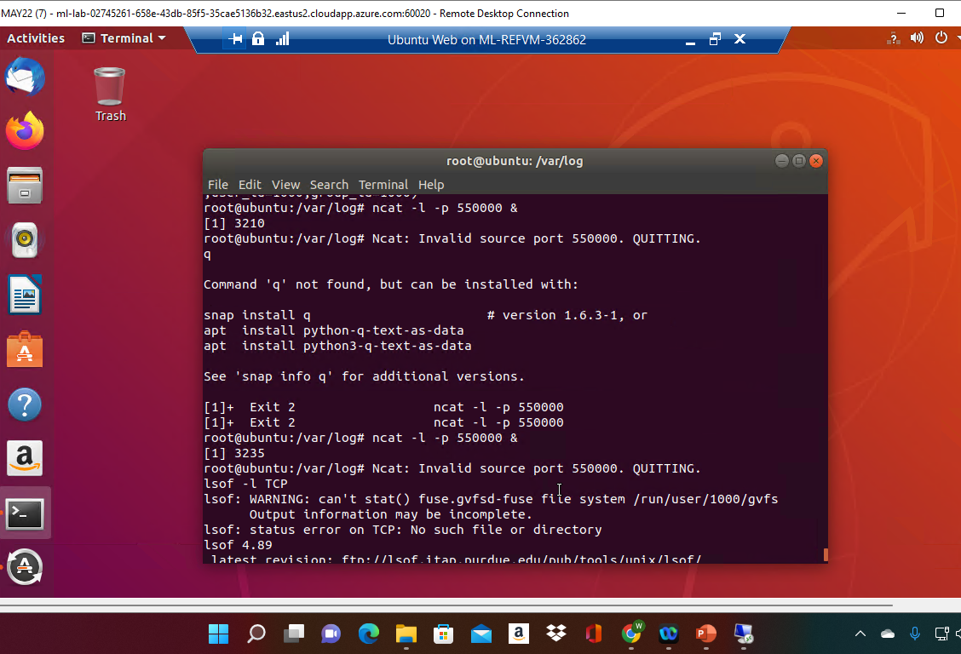
Linux Processes
Take a screenshot of the output in Part 1, Step 13.
It should show port 55000 open for both IPv4 and IPv6.

Slide 15
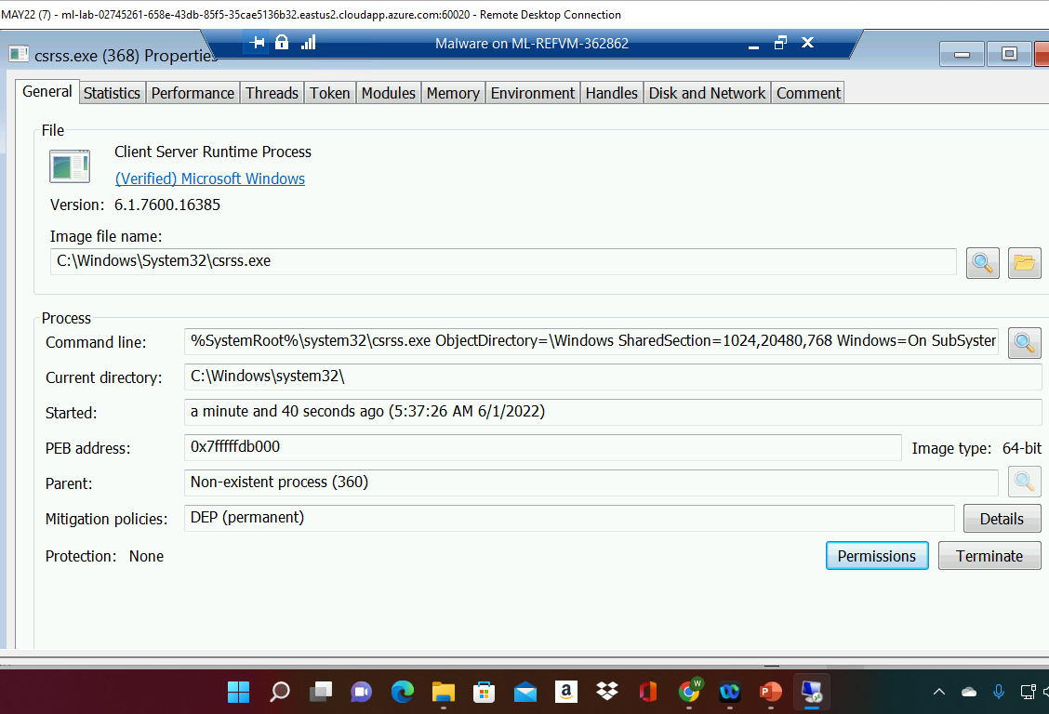
Process Hacker
Take a screenshot of the output in Part 2, Step 5.
It should show properties of a chosen process.

Slide 16
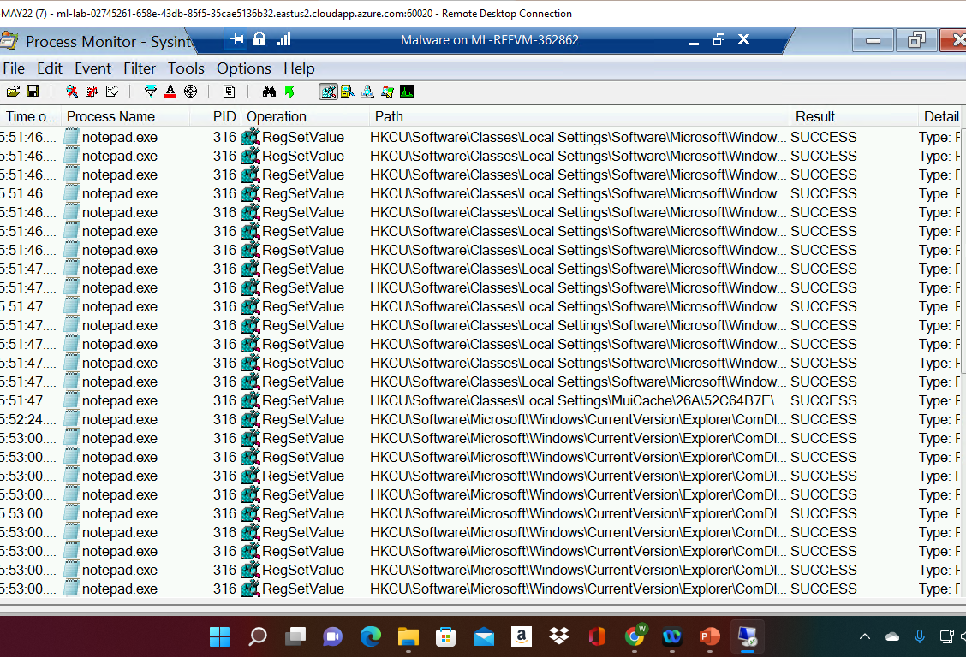
Process Monitor
Take a screenshot of the output in Part 3, Step 12.
It should show ifFaceName in the Path column and Data: Roman in the Detail column.

Slide 17
Final project
In this project we configure iptables for network defense in six scenarios Time-based access, Blackhole routing, Bogon filtering, Stateful firewall, Dynamic NAT, Brute forcing of SSH logins

Slide 18
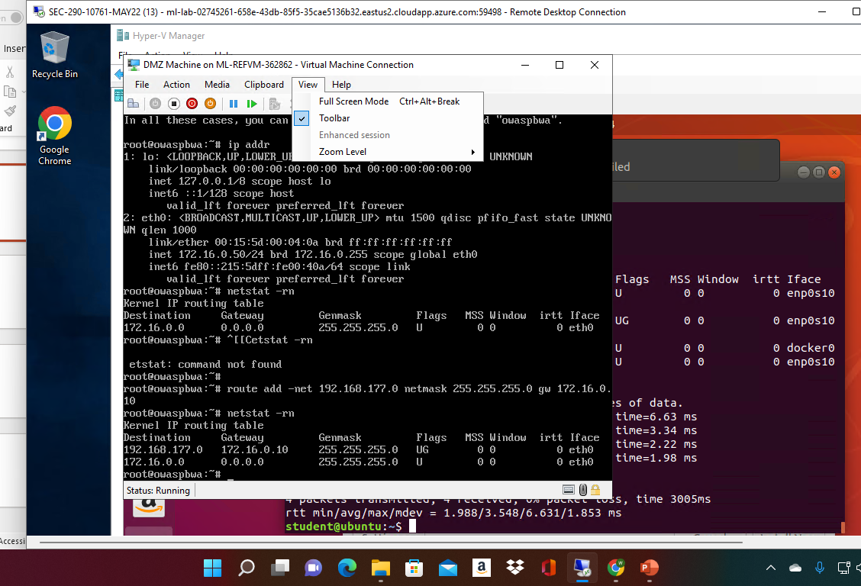
Time-based Access
Take a screenshot of the output in Part 1 Step 18.
It should show the output of the DMZ Route Table.

Slide 19
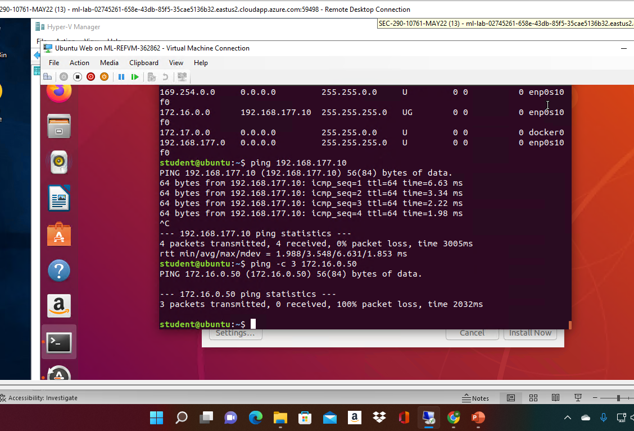
Time-based Access
Take a screenshot of the output in Part 1 Step 23.
It should show a successful ping from the Ubuntu Web VM and the DMZ VM.

Slide 20
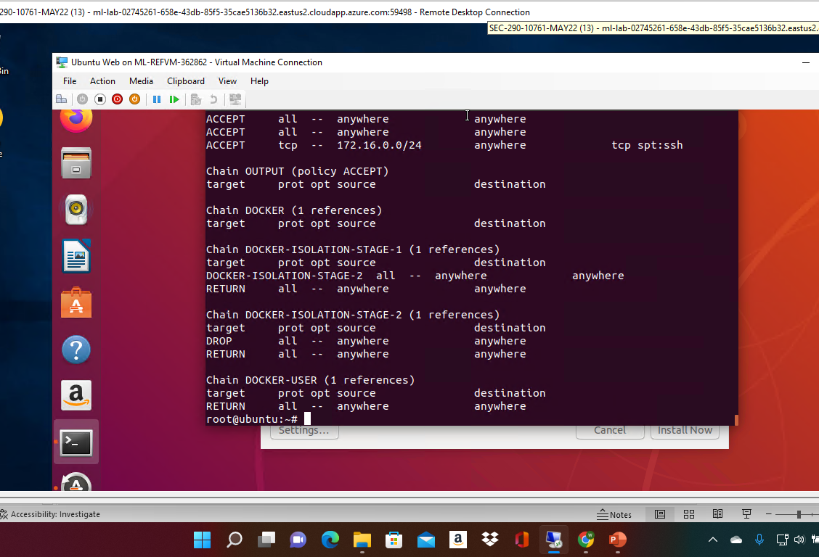
Time-based Access
Take a screenshot of the output in Part 1 Step 33.
It should show two time-based access rules in the FORWARD chain

Slide 21
Conclusion
While taking this class I did have to deal with some issues like our virtual machine not working at time making sure I’m on the right program before entering a commanded. Overall, I did learn that this is a field that taught me patience and to make sure you are putting in everything right the first time.

