Slide 1
SEC285 Final
By William L. Call

Slide 2
Introduction
Hello my name is William Call I took SEC285 fundamentals of information system security at DeVry during the months of March and April of 2022. In this side show I will bw showing you what I learned during this class.

Slide 3
First Project
During this first project we were tasked to Asymmetric Key Encryption in our virtual machine.

Slide 4
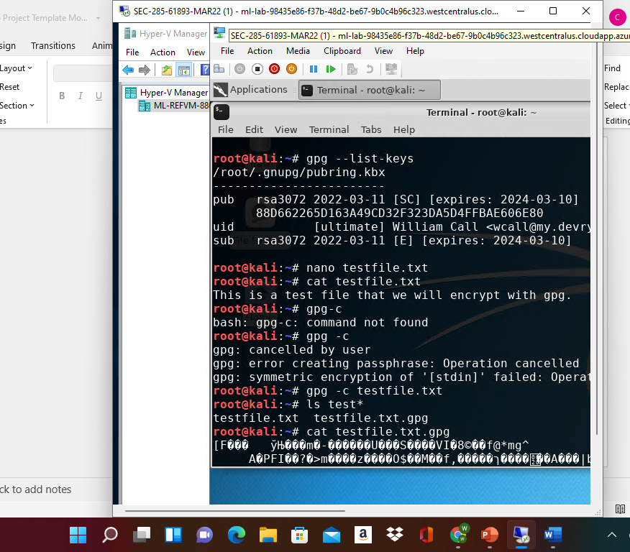
File Encryption
This screenshot should show the following.
Content of the plaintext file
Content of the encrypted file

Slide 5
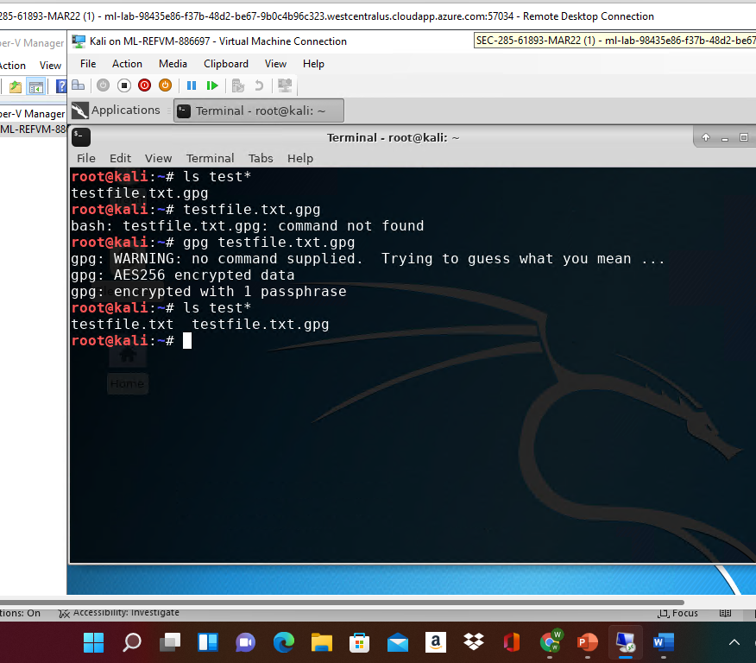
File Decryption
This screenshot should show the following.
The encrypted file being listed by itself
The decrypting process
Both the encrypted file and the original plaintext file being listed

Slide 6
Second Project
For our second project we was working with Stateful Firewall. In our virtual machine and we also had a question to answer as well.

Slide 7
Question
What effect does the sudo iptables --policy INPUT DROP command have on the access to computing resources?
Answer here: it will drop everything from coming into the Linux server.
References:

Slide 8
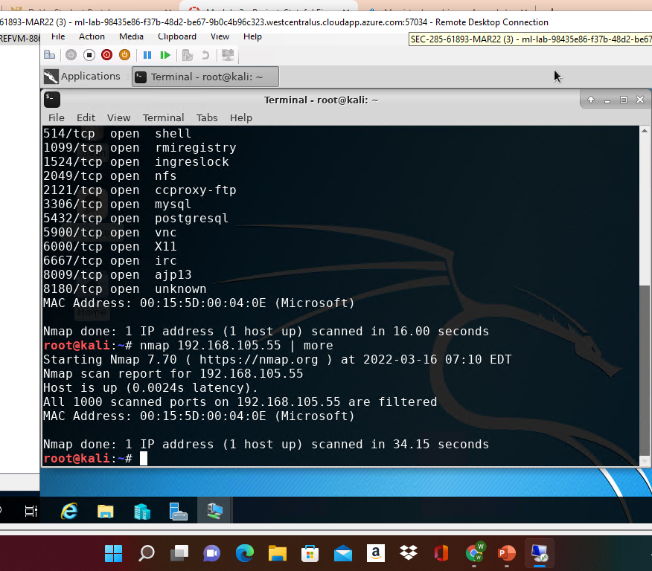
Nmap Scan
This screenshot should show the Nmap scan result of the Linux Server VM.

Slide 9
Third project
In our third project we just to write up a simple security policy for a company for our coworker wanting to connect personal electronics to our network.

Slide 10
BYOD Security Policy
This slide should have the complete security policy template inserted as an object.

Slide 11
Fourth project
For our fourth project we must connect to the google authenticator from our virtual machine.

Slide 12
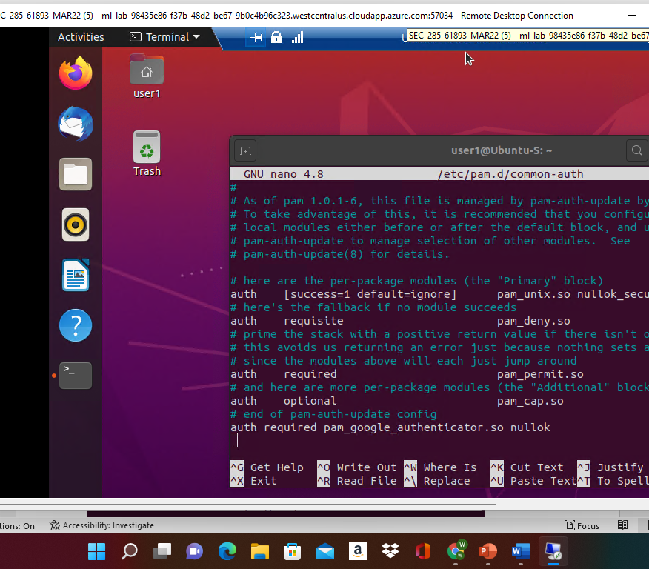
Common-auth Configuration File
This screenshot should show the entry that indicates the use of the Google Authenticator module.

Slide 13
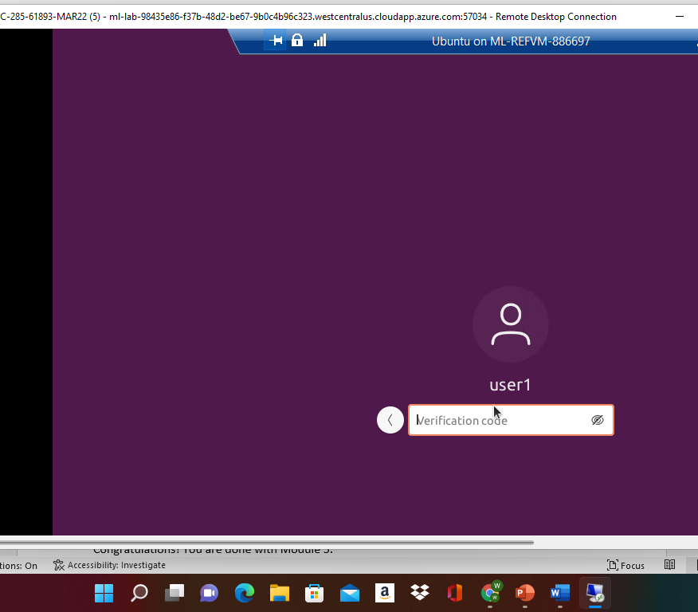
MFA Logon Screen
This screenshot should show the logon screen where a verification code is required.

Slide 14
Final project
For our final project we must work a Vulnerability Assessment in the last few slides you will see what we had to do.

Slide 15
SEC285
Module 6
Vulnerability Assessment

Slide 16
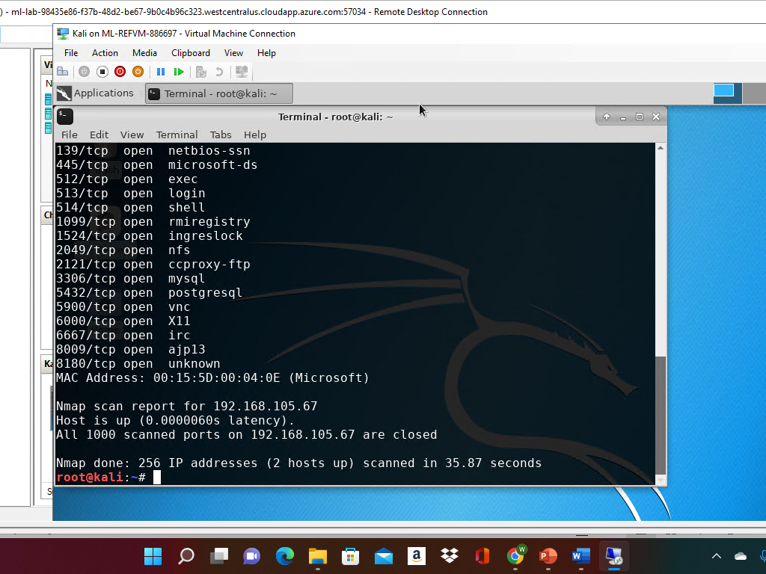
Nmap
This screenshot should include the scan result showing both the Kali and Linux Server VMs.

Slide 17
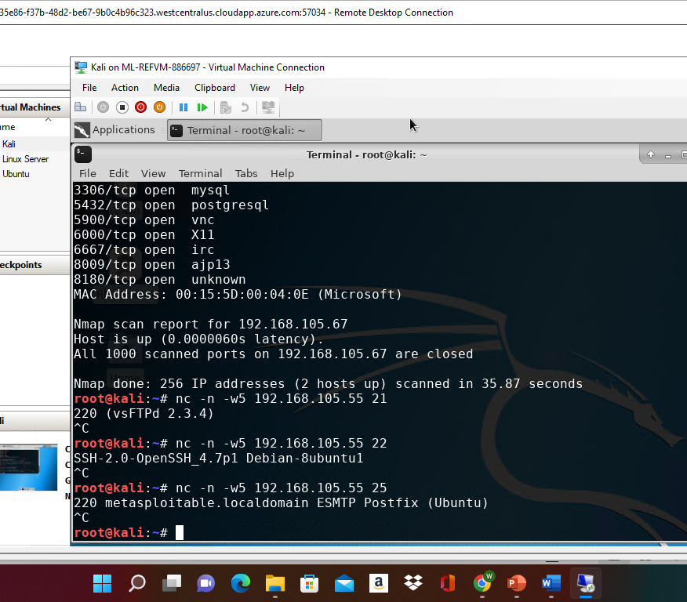
NetCat
This screenshot should include the scan result showing both the Kali and Linux Server VMs.

Slide 18
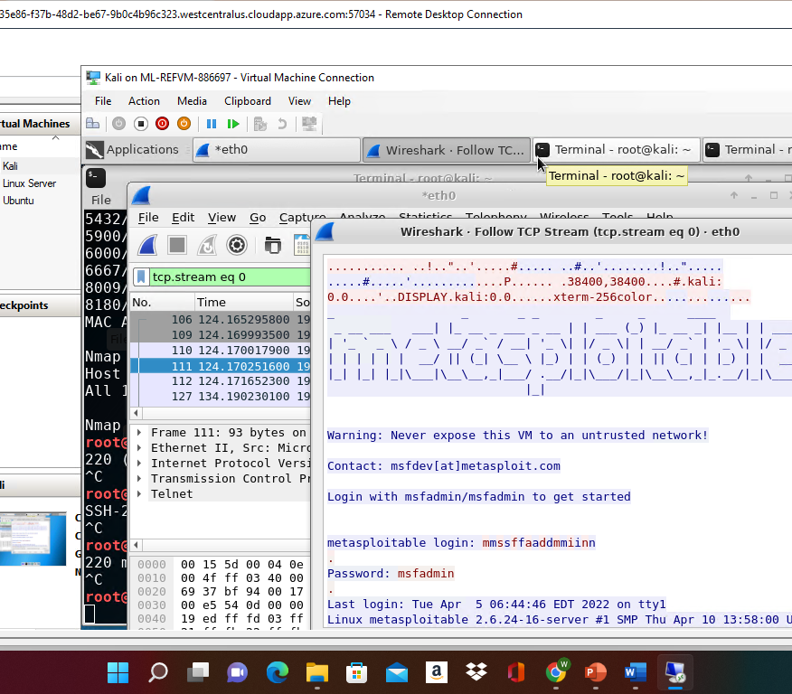
Wireshark
This screenshot should include the Wireshark—Follow TCP Steam window showing the Telnet username and password.

Slide 19
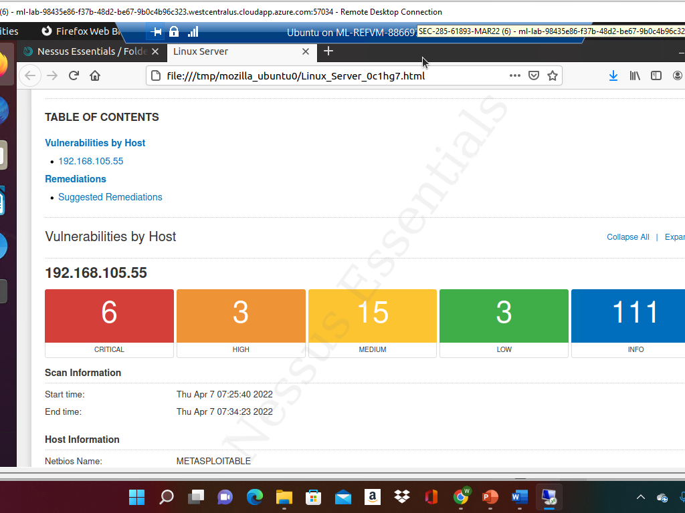
Nessus
This screenshot should include the high-level view of the Nessus vulnerability scan report (showing categories of vulnerability in different colors).

Slide 20
Conclusion and challenges
I really didn’t have a challenges during this class it felt very strait forward and the projects where easy to understand and interstation to work on.

