Slide 1

CEIS 110 Programming with Data
William L. Call

Slide 2
Introduction
Data is growing exponentially
This project uses a cloud-based system to gather temperature and humidity data.
Then the data is analyzed using programming and data analytics

Slide 3
Software inventory
Before developing this programming with data project, all software must be downloaded and installed.
Software needed included SQ Lite studio, Excel, and python IDE-anaconda

Slide 4

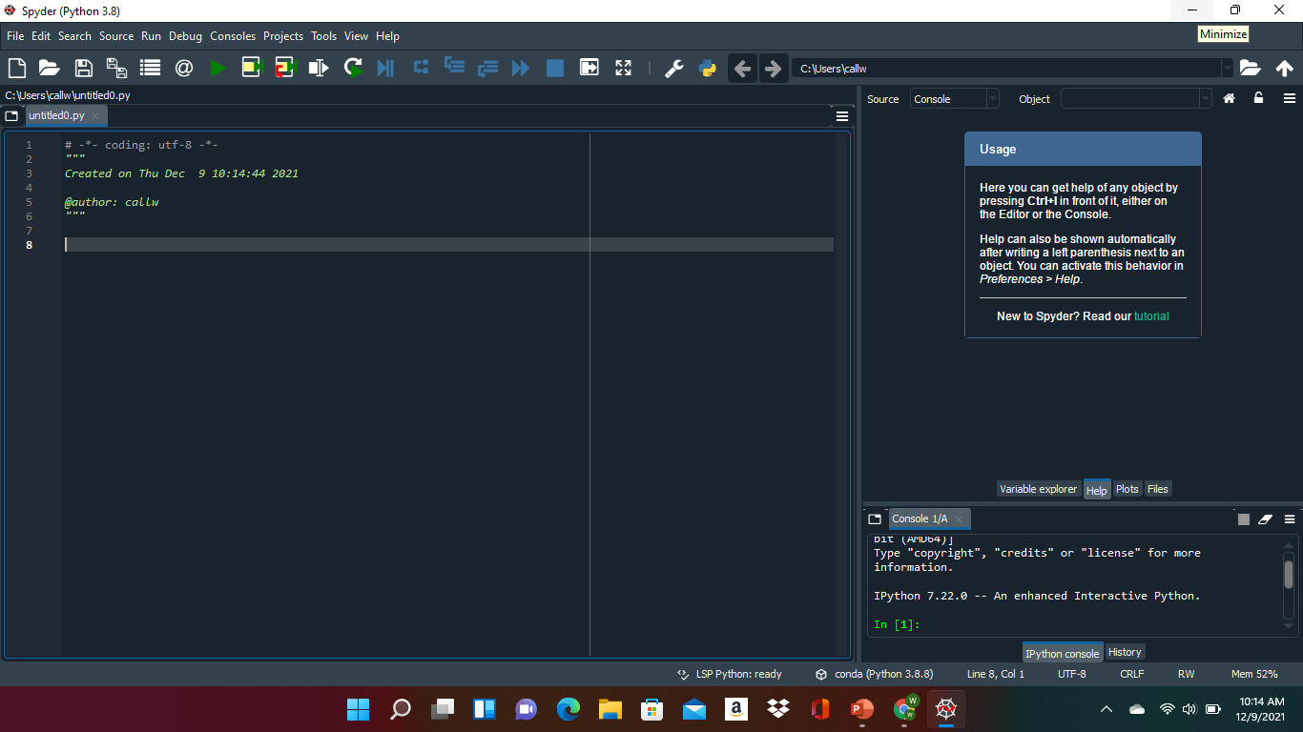
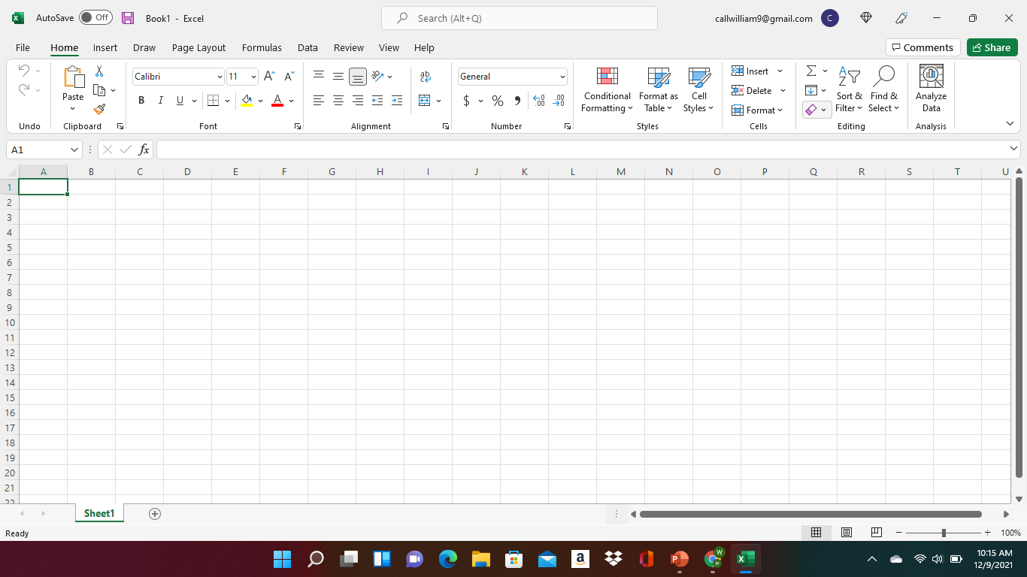
Software
The software need for this project includes SQ Lite studio, Excel, and Python.

Slide 5
Planning and Design
After performing an inventory of the software needed for the project , a plan was created for the temperature data project.
To plan the design of the project, a flowchart was generated.
Planning and design of the project are crucial steps to understanding the development process.

Slide 6
What are Flowcharts?
Flowcharts are graphical representations of the workflow that I used to from the start of the project to the end of the project .

Slide 7
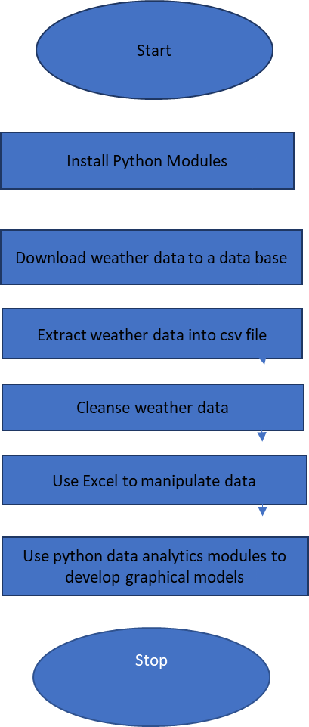
The flowchart I followed

Slide 8
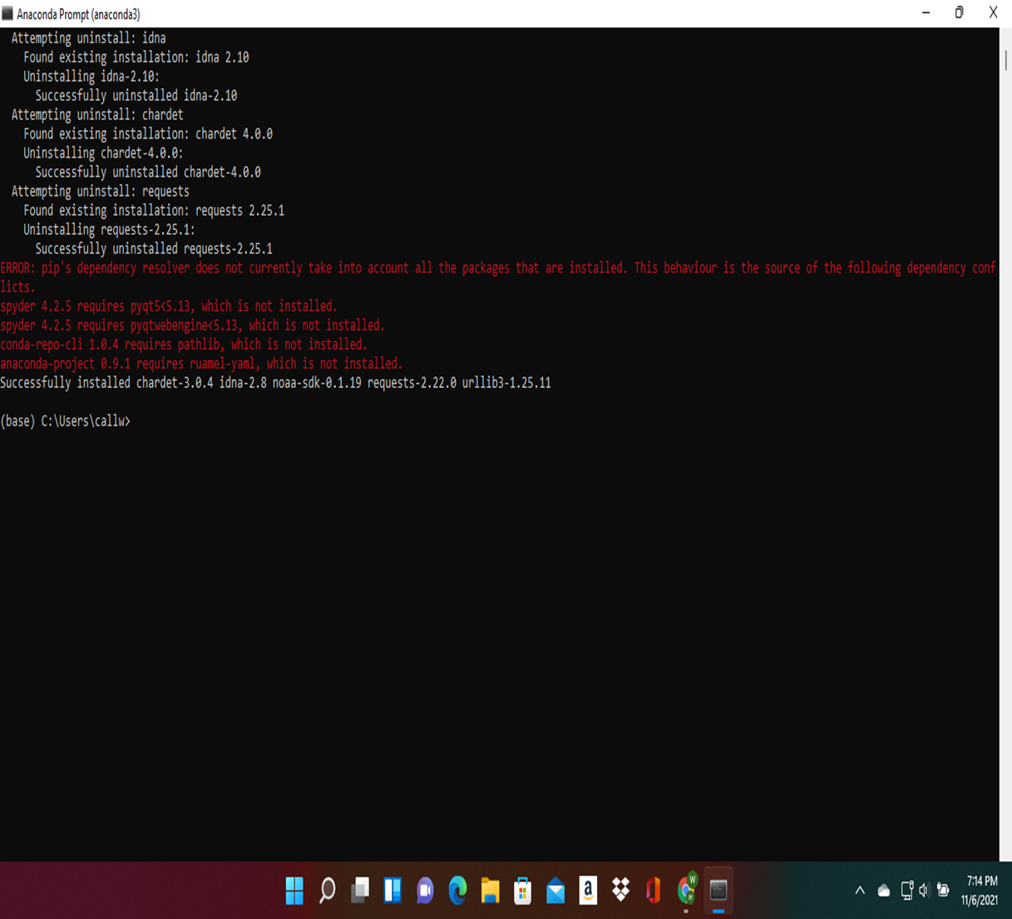
Adding Library
For the python to connect to the government National Oceanic and atmospheric administration (NOAA) weather data service using a cloud-based Application Programming Interface (API), a library module must be installed to use this service.

Slide 9
Gathering Temperature and humidity data.
After planning and design, the code was developed to download a set of weather observations.
This data was stored on a local database in a table for later analysis.

Slide 10
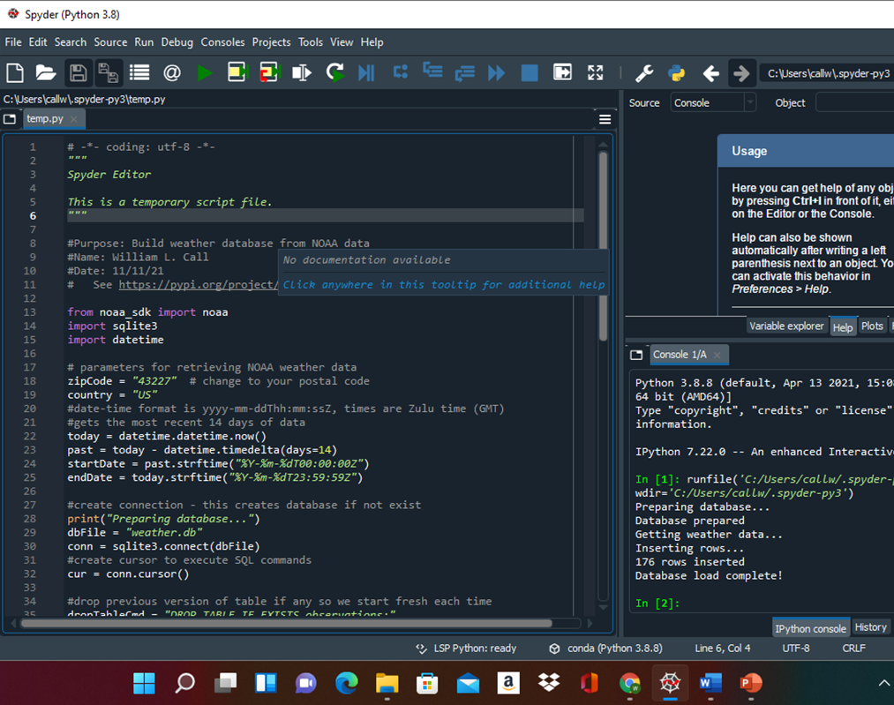
Build weather Db.py code
This is the code I used to connect to the NOAA so that I was able to get the temperature, wind speed and humidity for my area.

Slide 11
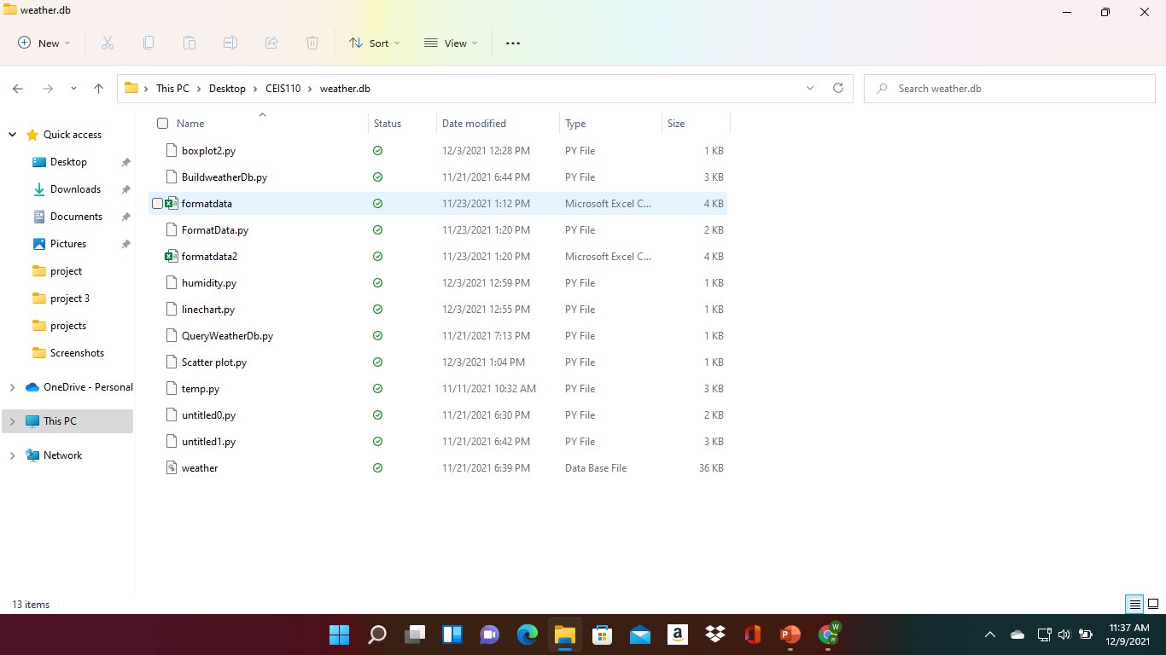
Weather. dB file

Slide 12
Querying the database
Structured Query Language (SQL) is a programming language used for working with relational databases.
SQ lite studio was used to query the database and view the results.

Slide 13
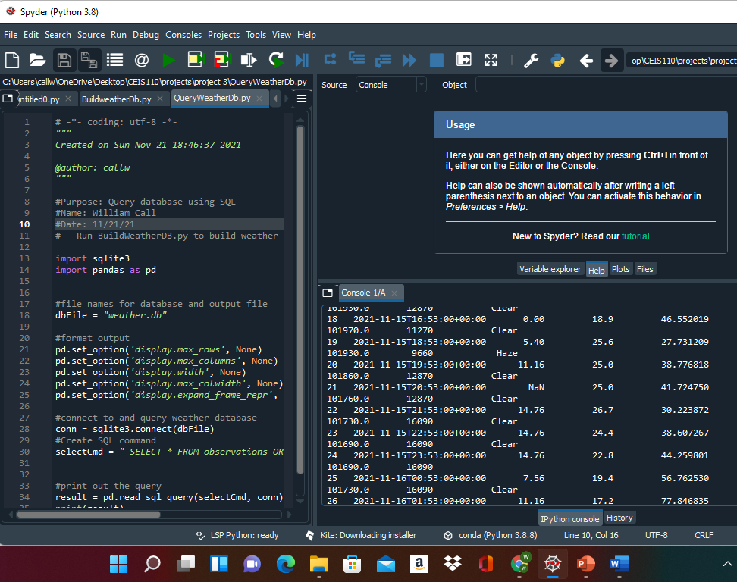
Query to retrieve all columns all rows
The SQL command “select” from observation was executed to retrieve all rows and columns from the observation table

Slide 14
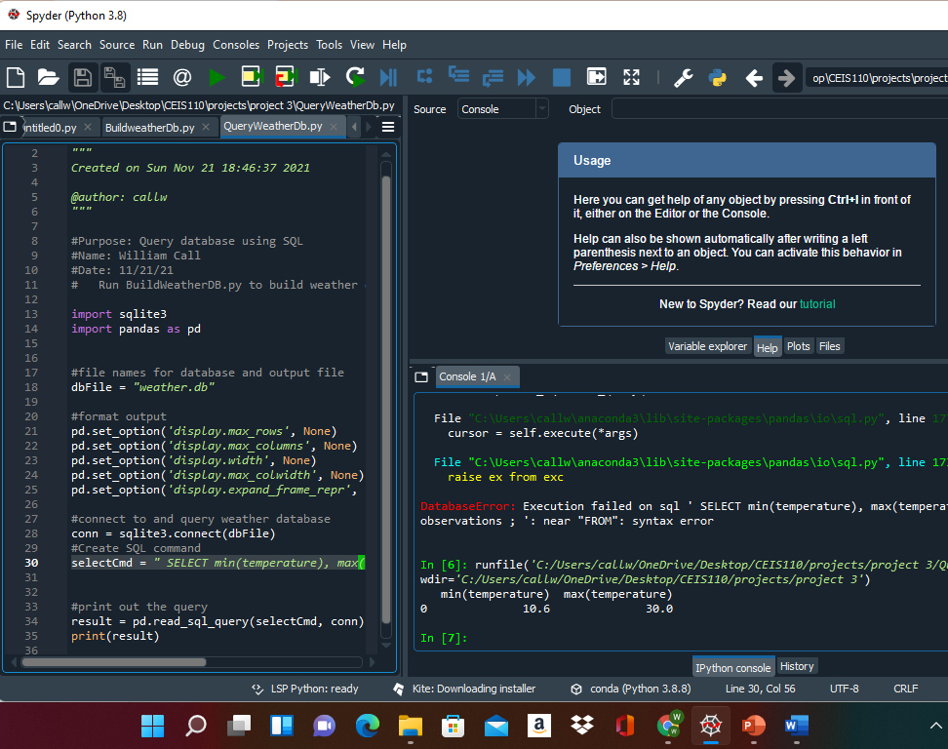
Query to retrieve lowest and highest temperatures
The min and max temperatures were retrieved. These temperatures are captured based on the Celsius scale.

Slide 15
Query to retrieve lowest and highest humidity
Another query was performed to retrieve the lowest and highest relative humidity. The relative humidity column was used to retrieve this information.

Slide 16
Data cleansing
Data output from machines have errors or extraneous data. When cleaning the data, programs cam automatically put it in the format needed to be read by other programs.
A python program is reading in the data output by the python program and saving it in a csv file so that it can be rea by Excel.
Often data must be cleansed of spurious or missing values in a dataset. The data must be complete, valid, and stand standardized.

Slide 17
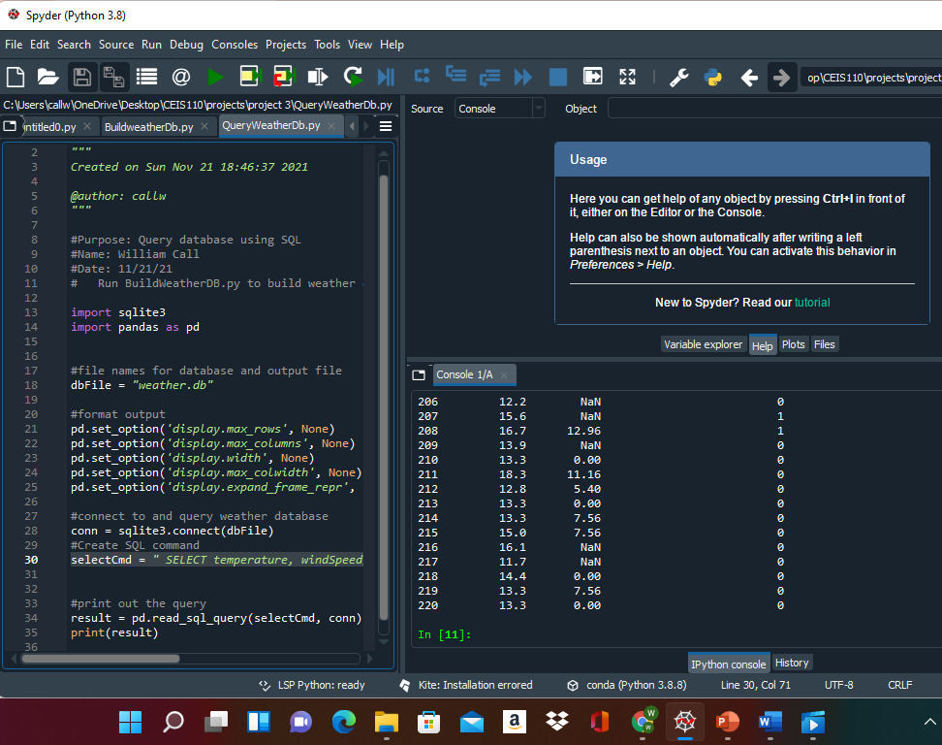
Extracting temperature and humidity using python code
The weather.db database may contain null or missing values. The code used retrieves only the temperature and humidity values and writes them to a comma separated values (cvs) file. Two files are created- a formatedata.csv and a formatdata2.csv that each contain half of the rows. Missing or invaldes are not written to the files.

Slide 18
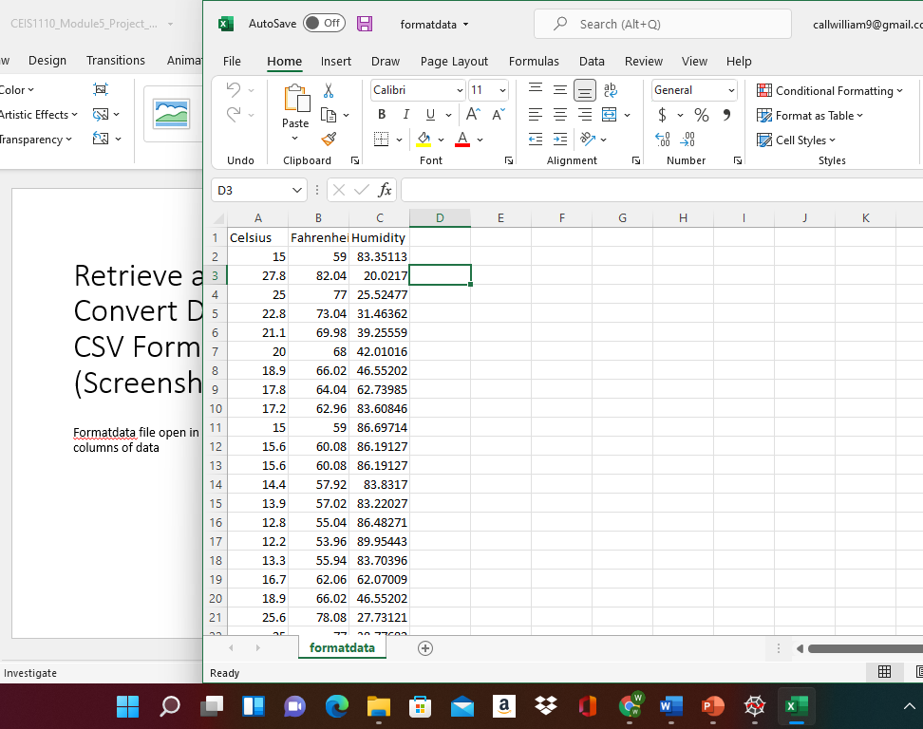
Data formatted in a excel spread sheet
The python program created a formatdata.csv file
This file contains 3 columns: Celsius, Fahrenheit, and humidity
Statistics can be performed on this spreadsheet

Slide 19
Data Visualization
A line chart was developed in Excel showing the temperature and humidity over period 1

Slide 20
Data Analytics
Python data analytics modules allows users to develop charts and graphs depicting data. The data sets can be manipulated as well and saved into tabular format. The data analytics modules are available as part of anaconda. Several plots were generated looking at humidity and temperature. Then prediction was made about the data.

Slide 21
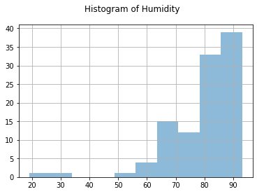
Histogram of humidity
#Purpose: Create a histogram of humidity data from the second period
#Name: William Call
#Date: 12/3/21
import pandas as pd
import matplotlib.pyplot as plt
df1 = pd.read_csv("formatdata.csv")
df2 = pd.read_csv("formatdata2.csv")
df2['Humidity'].hist(bins=10, alpha=0.5); plt.suptitle('Histogram of Humidity')
plt.show()

Slide 22
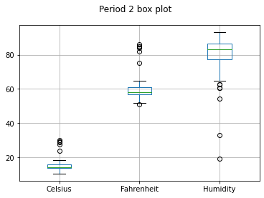
Period 2 Box Plot
#Purpose: Create box plot for period 2 data
#Name: William Call
#Date: 12/3/21
import pandas as pd
import matplotlib.pyplot as plt
df2 = pd.read_csv("formatdata2.csv")
df2.boxplot(); plt.suptitle('Period 2 box plot')
plt.show()

Slide 23
Analysis
The next step in analysis is developing a question and reviewing the data to answer the question. A chart can be used to look at the data.
My question in period 2 what change more? Temperature or humidity?
I created 2-line plots for trial 2. One with Fahrenheit vs humidity

Slide 24
Code
import pandas as pd
import matplotlib.pyplot as plt
df1 = pd.read_csv("formatdata.csv") #baseline data is period 1 (older)
df2 = pd.read_csv("formatdata2.csv") #data for period 2 (more recent)
plt.figure(); df1.Celsius.plot(label = 'period '); df2.Celsius.plot(label = 'period 2'); plt.legend(loc='best'); plt.suptitle('Celsius')
plt.show()

Slide 25
Predication
The humidity will stay the same for the next few days but in the next few weeks the humidity will start to decrease and the weather will get colder and snow will come.

Slide 26
Challenges
Some of the challenges I faced was learning what coding does and why we need it and what great value it has in our lives with computers.
You must be very careful writing code because the smallest mistake and the code will not work.
When creating the python program, it needed to be in the same directory as weather.db

Slide 27
Career Skills
Database development
Trouble shooting errors in the code and data cleansing
Analysis- Review charts and graphs to male predictors on the data.

Slide 28
Conclusion
This project covered the fundamental topic of programming with data by using data gathered from a cloud services to perform data analytics operations.
Building this project provided a hands-on learning opportunity to put into practice the topics covered in the course.

