Slide 1
NETW211 Final
By William L. Call

Slide 2
Introduction
Hello my name is William Call, and I took this class NETW211 during the months of March and April of 2022. During this course we had the opportunity to learn on how to create virtual machines and how they work. I will be showing you the projects we did through out these two months.

Slide 3
First project
For this first project it was simple we just had to create a virtual machine and connect to it and then delete.

Slide 4
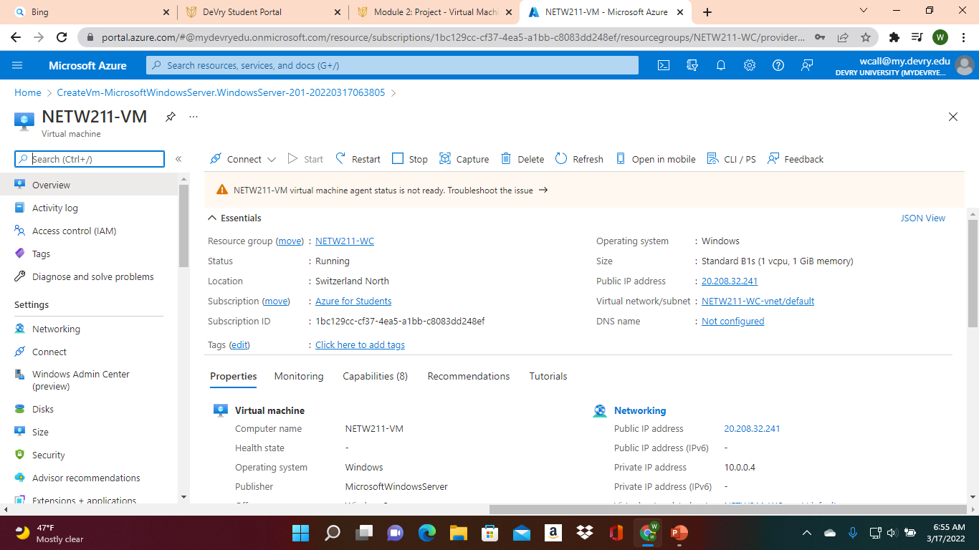
Deploying a VM in Azure
This screenshot should show the NETW211VM page with information such as the resource group name, subscription, public IP address, etc.

Slide 5
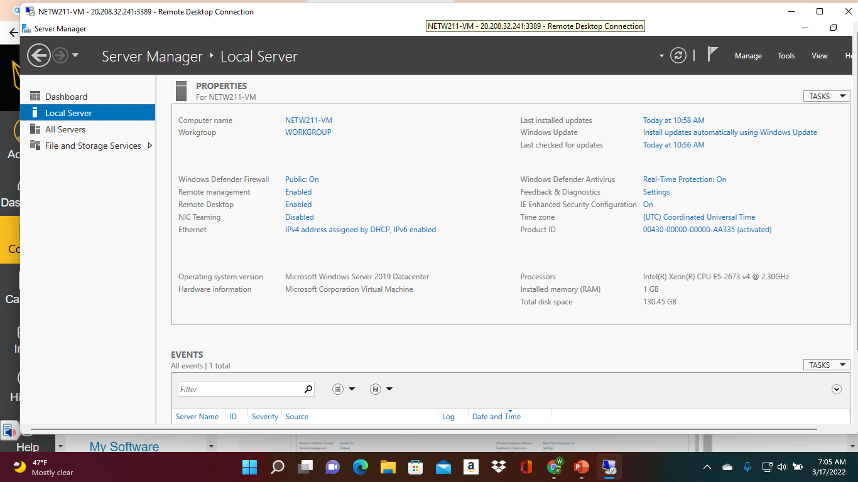
Connecting to the VM
This screenshot should show the PROPERTIES for NETW211VM page, with the computer name, operating system version, hardware information, etc.

Slide 6
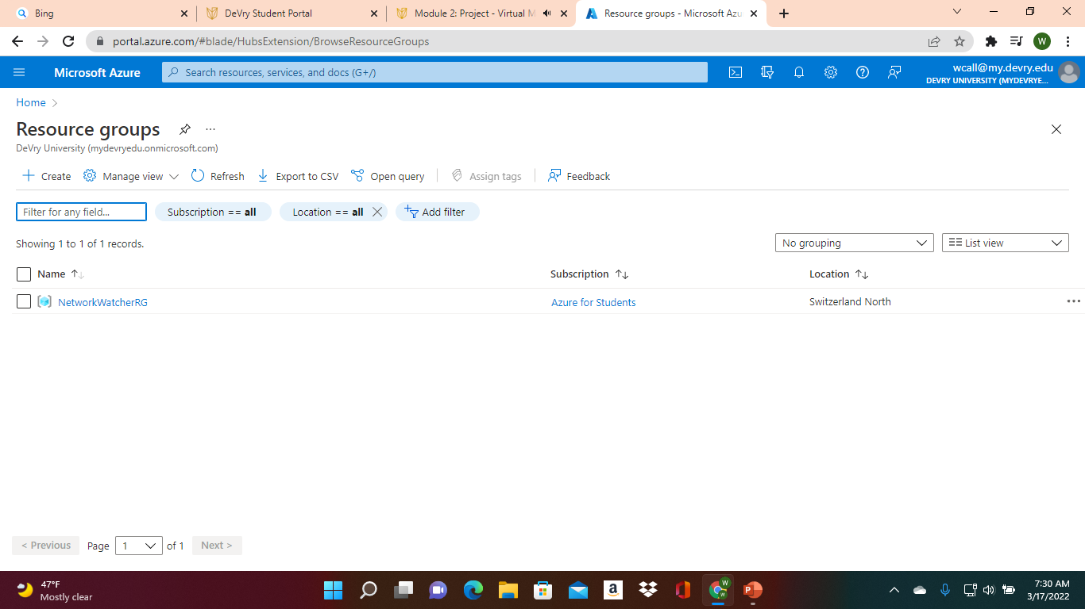
Deleting
the VM
This screenshot should show the Resource groups page, with the Azure for Students subscription selection and the “No resource groups to display” message.

Slide 7
Second project
For this second project we had a question to answer along with work subnetting with our virtual machine

Slide 8
Creating a VNet with Two Subnets
With a /24 network prefix, how many usable IPv4 host addresses are there?
Answer here: 254
2. Why is the number of available IP addresses for Subnet0 (10.0.0.0/24) or Subnet1 (10.0.1.0/24) shown as 251?
Answer here: They us IPv4 address because they ran out of room in the usa so they have to use the IPv4 address because it has more room out of state.
References:
1.
2.

Slide 9
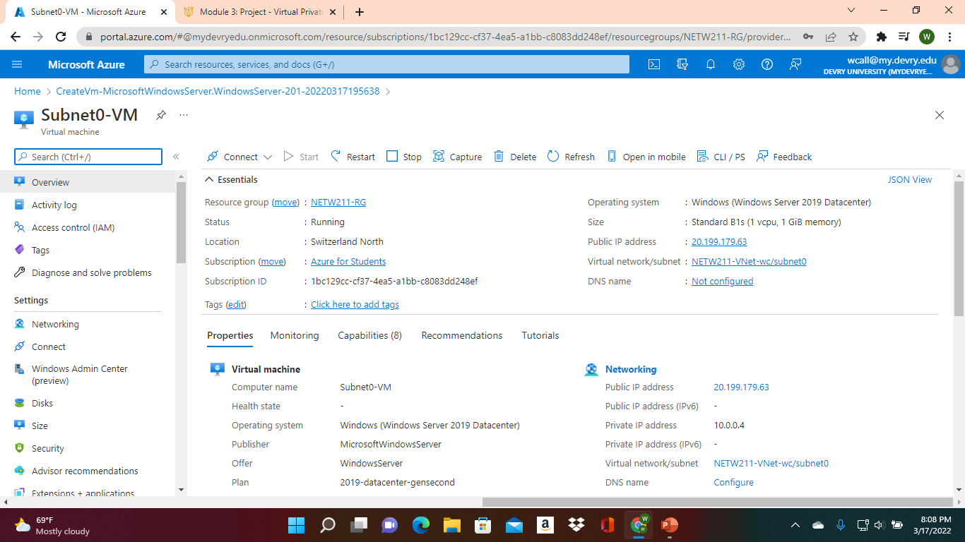
Deploying VMs into Subnets
This screenshot should show the Properties section of the Subnet0-VM page, showing the networking and size information of the VM.

Slide 10
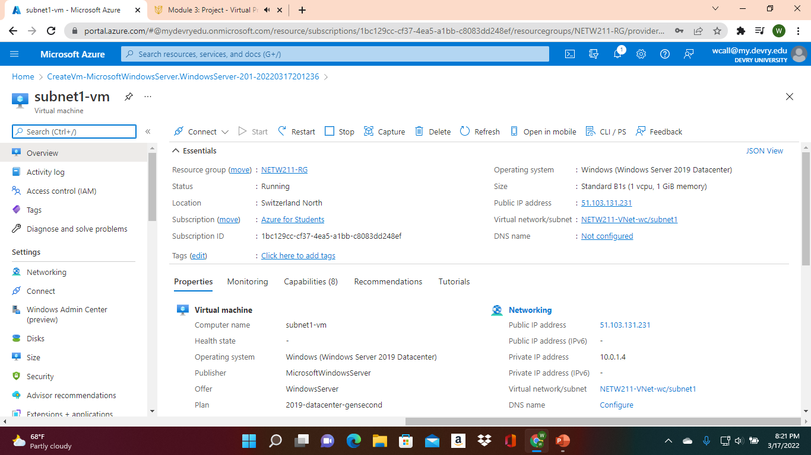
Deploying VMs into Subnets cont’d
This screenshot should show the Properties section of the Subnet1-VM page, showing the networking and size information of the VM.

Slide 11
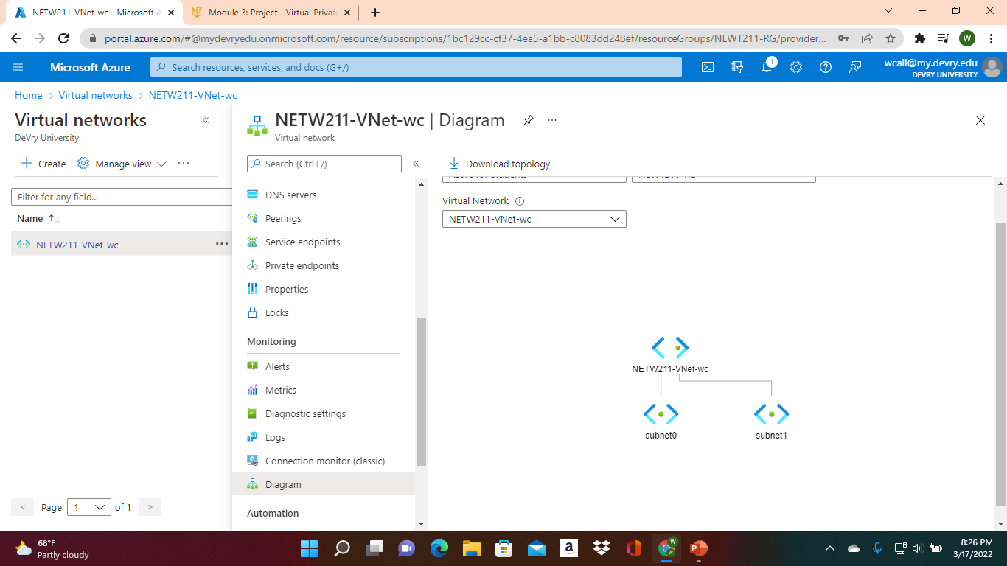
Deploying VMs into Subnets cont’d
This screenshot should show the topology diagram of your VNet (NETW211-VNet-Your Initials) with two subnets (Subnet0 and Subnet1) and one VM in each subnet (Subnet0-VM and Subnet1-VM).

Slide 12
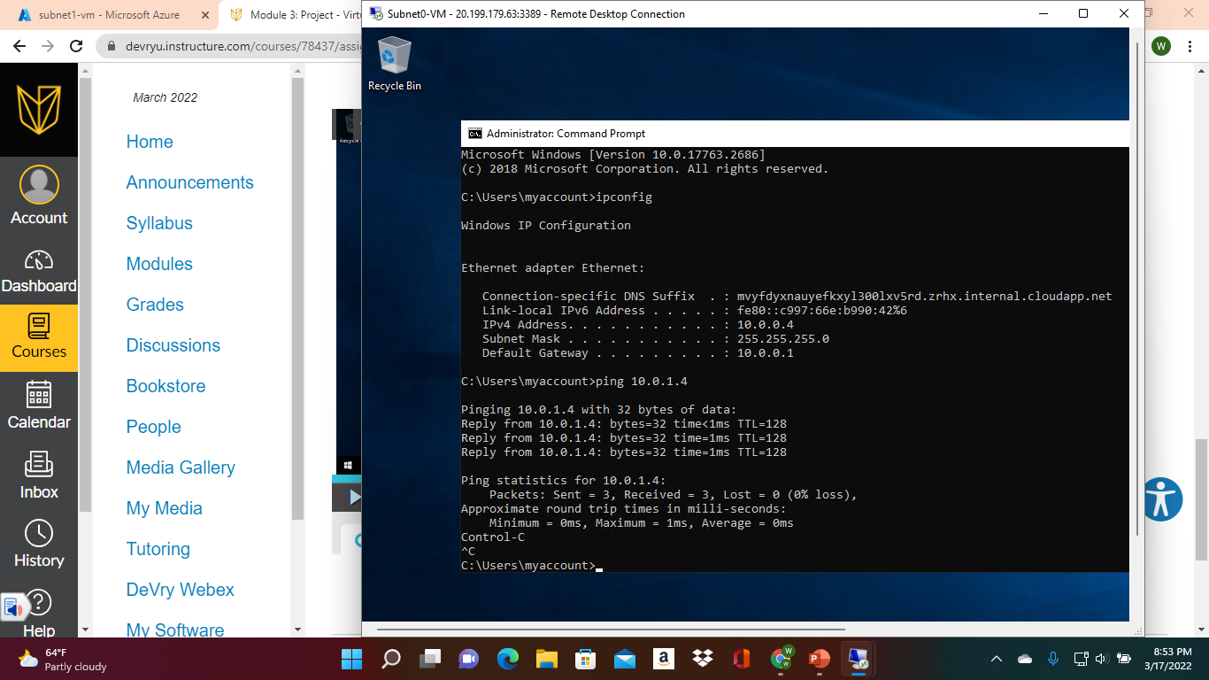
Verifying Connectivity between VMs
cont’d
This screenshot should show the ipconfig and ping x.x.x.x results in the command prompt window, including the Subnet1-VM – x.x.x.x – Romote Desktop Connection window title.

Slide 13
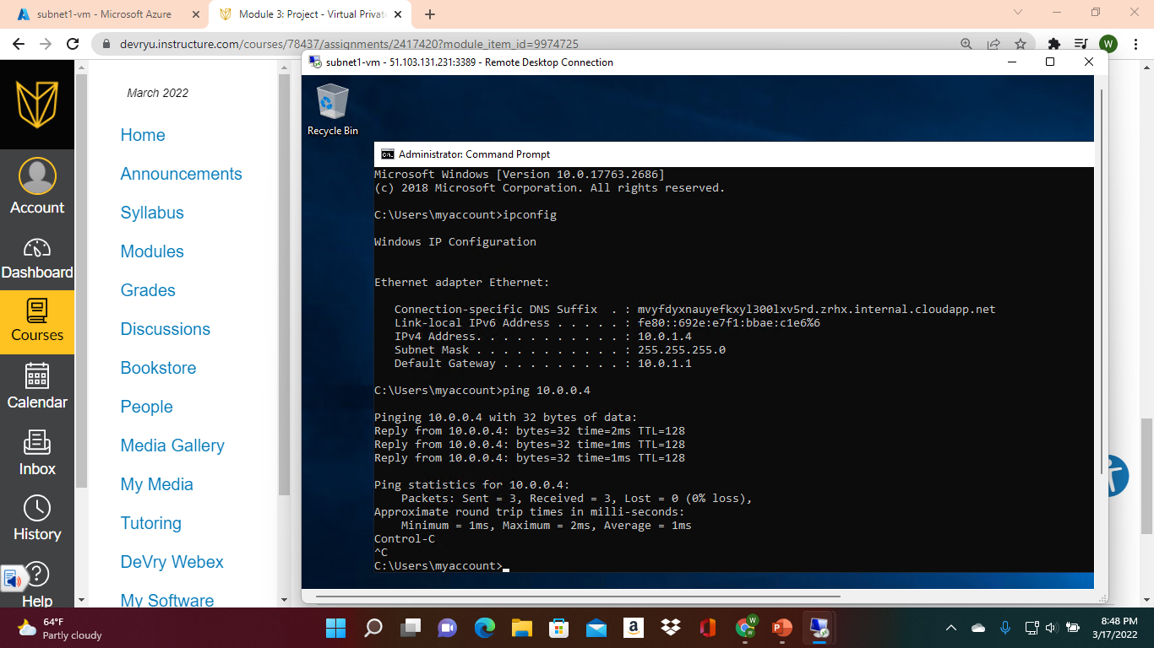
Verifying Connectivity between VMs
This screenshot should show the ipconfig and ping x.x.x.x results in the command prompt window, including the Subnet0-VM – x.x.x.x – Romote Desktop Connection window title.

Slide 14
Third project
For this third project we had to learn to work with cloud storage

Slide 15
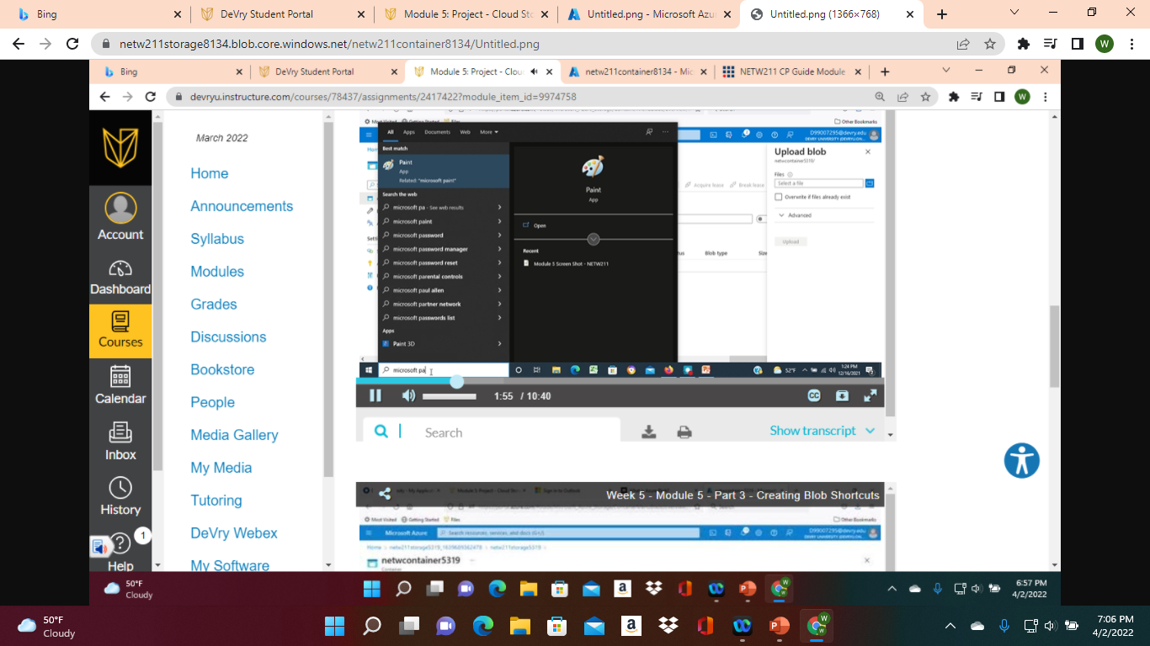
Uploading and Accessing a File
This screenshot should show the browser window with the image uploaded from your local computer and the URL on top of the window.

Slide 16
Question
What does the access tier setting do? What are the Azure blob storage access tiers?
Answer here: There are three tiers Hot, Cold, and Archive. They are the three different kind of storage systems you can have with Azure.
References:
1. https://docs.microsoft.com/en-us/azure/storage/blobs/access-tiers-overview
2.

Slide 17
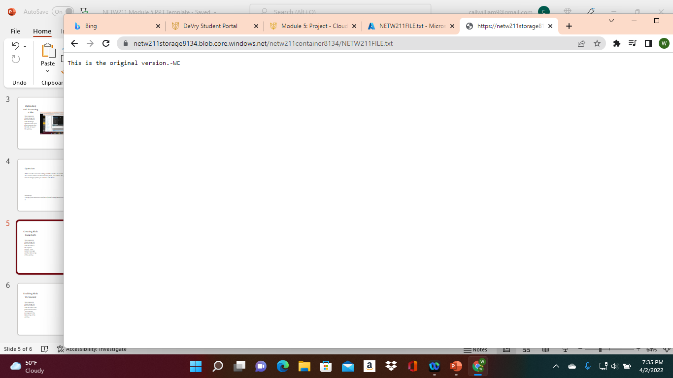
Creating Blob Snapshots
This screenshot should show the browser window with the “This is the original version. –Your Initials” message and the URL on top of the window

Slide 18
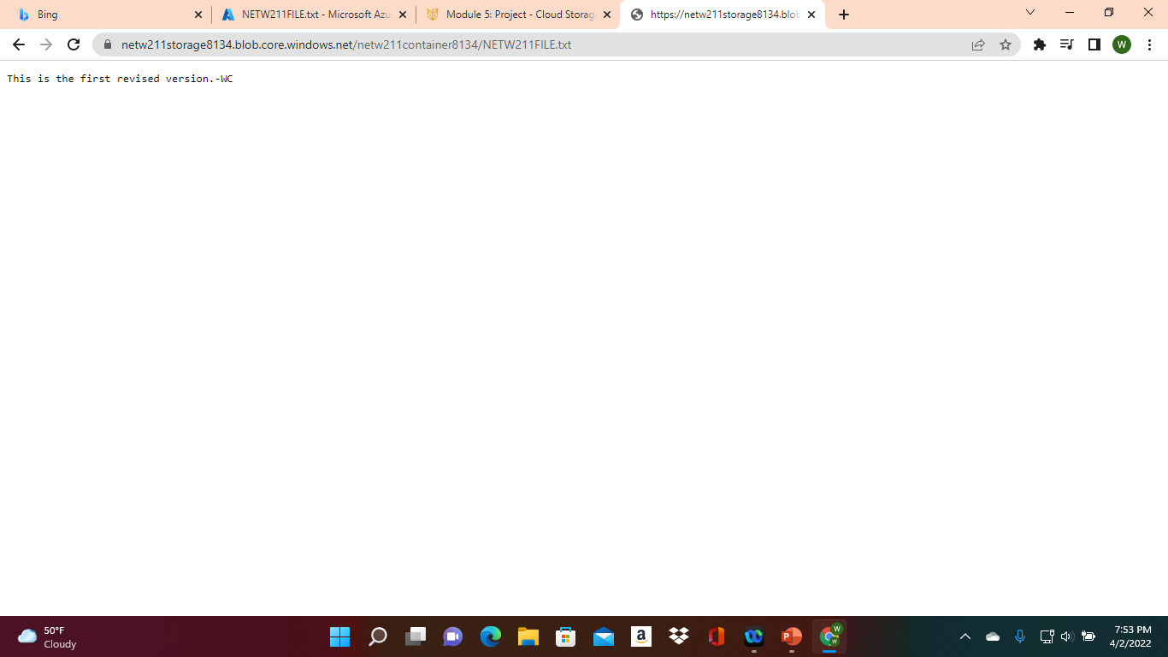
Enabling Blob Versioning
This screenshot should show the browser window with the “This is the first revised version. –Your Initials” message and the URL on top of the window.

Slide 19
Final Project
For our last project we had to setup action groups and alerts for our virtual machine that we have been working on.

Slide 20
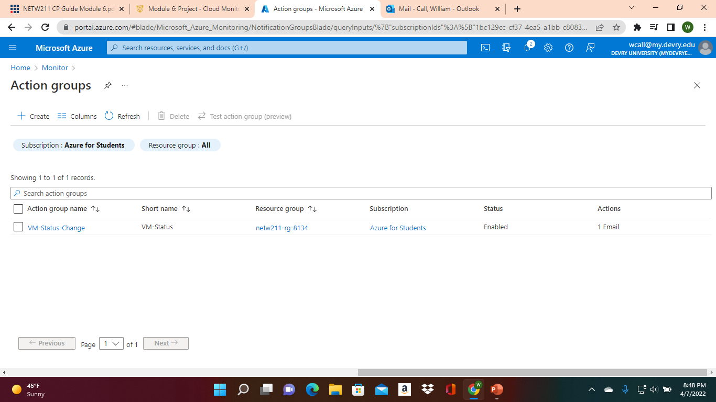
Setting up an Action Group and Notifications
This screenshot should show the “VM-Status-Change” action group on the Manage actions page.

Slide 21
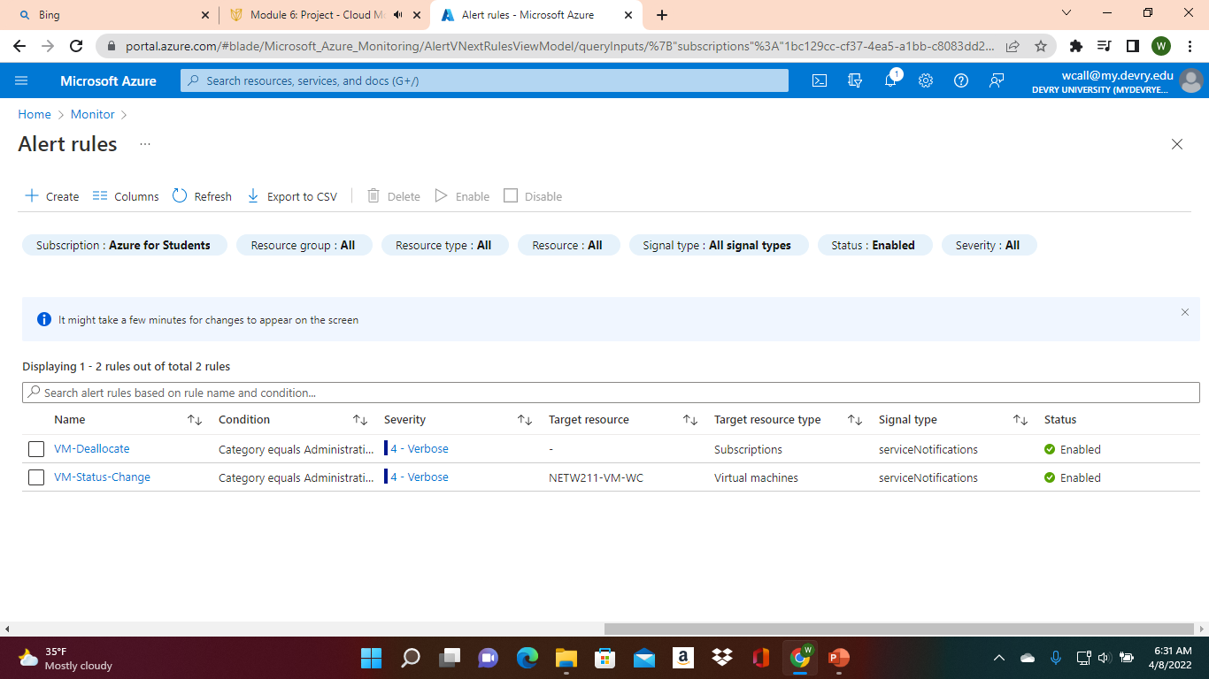
Setting up Alert Rules
This screenshot should show the Alert rules window showing the VM-Deallocate and VM-Restart rules.

Slide 22
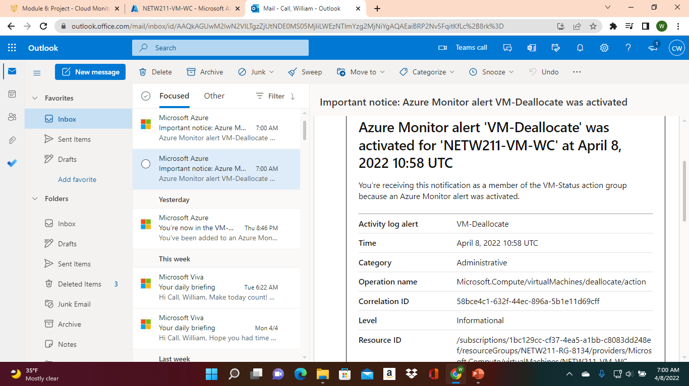
Testing Alerts
This screenshot should show the ‘VM-Restart’ was activated email message with the date and time of the alert.

Slide 23
Testing Alerts cont’d
This screenshot should show the ‘VM-Deallocate’ was activated email message with the date and time of the alert.

Slide 24
Challenges and Conclusion
There where some challenges while taking this class we had a problem with the one of the settings when creating the virtual machine where we had to change our location to another country just so it would work. But overall, it tough me to realize you will never know what could happen in a normal workday in the I.T. world.

