Slide 1

PHYS204 Final
By William Call

Slide 2
Introduction
Hello my name is William Call I am a student at DeVry University where I am a computer sciences major with a specialty in cyber security. I have some what enjoyed this class it was not tuff but it was not and easy class to take.

Slide 3
First project
This first project we need to do was just a basic invitatory of everything we have and to show we also have to right software to do the projects for the class.

Slide 4
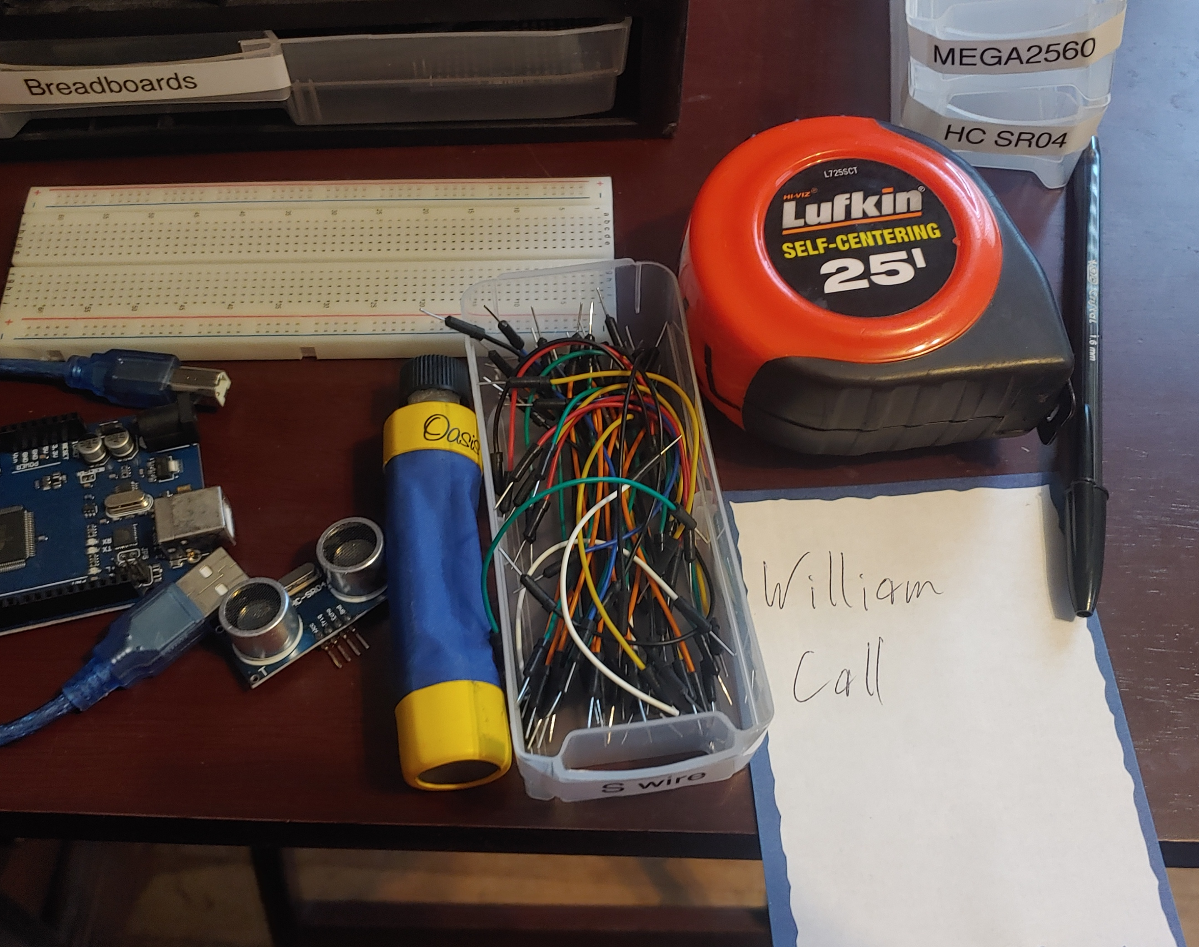
Materials List (Picture)
Arduino Mega 2560
Ultrasonic sensor HC-SR04
Male to Male Wires
Breadboard
USB cable to connect Arduino
Ruler or tape measurer
Object to act as obstacle and/or undergo free-fall

Slide 5
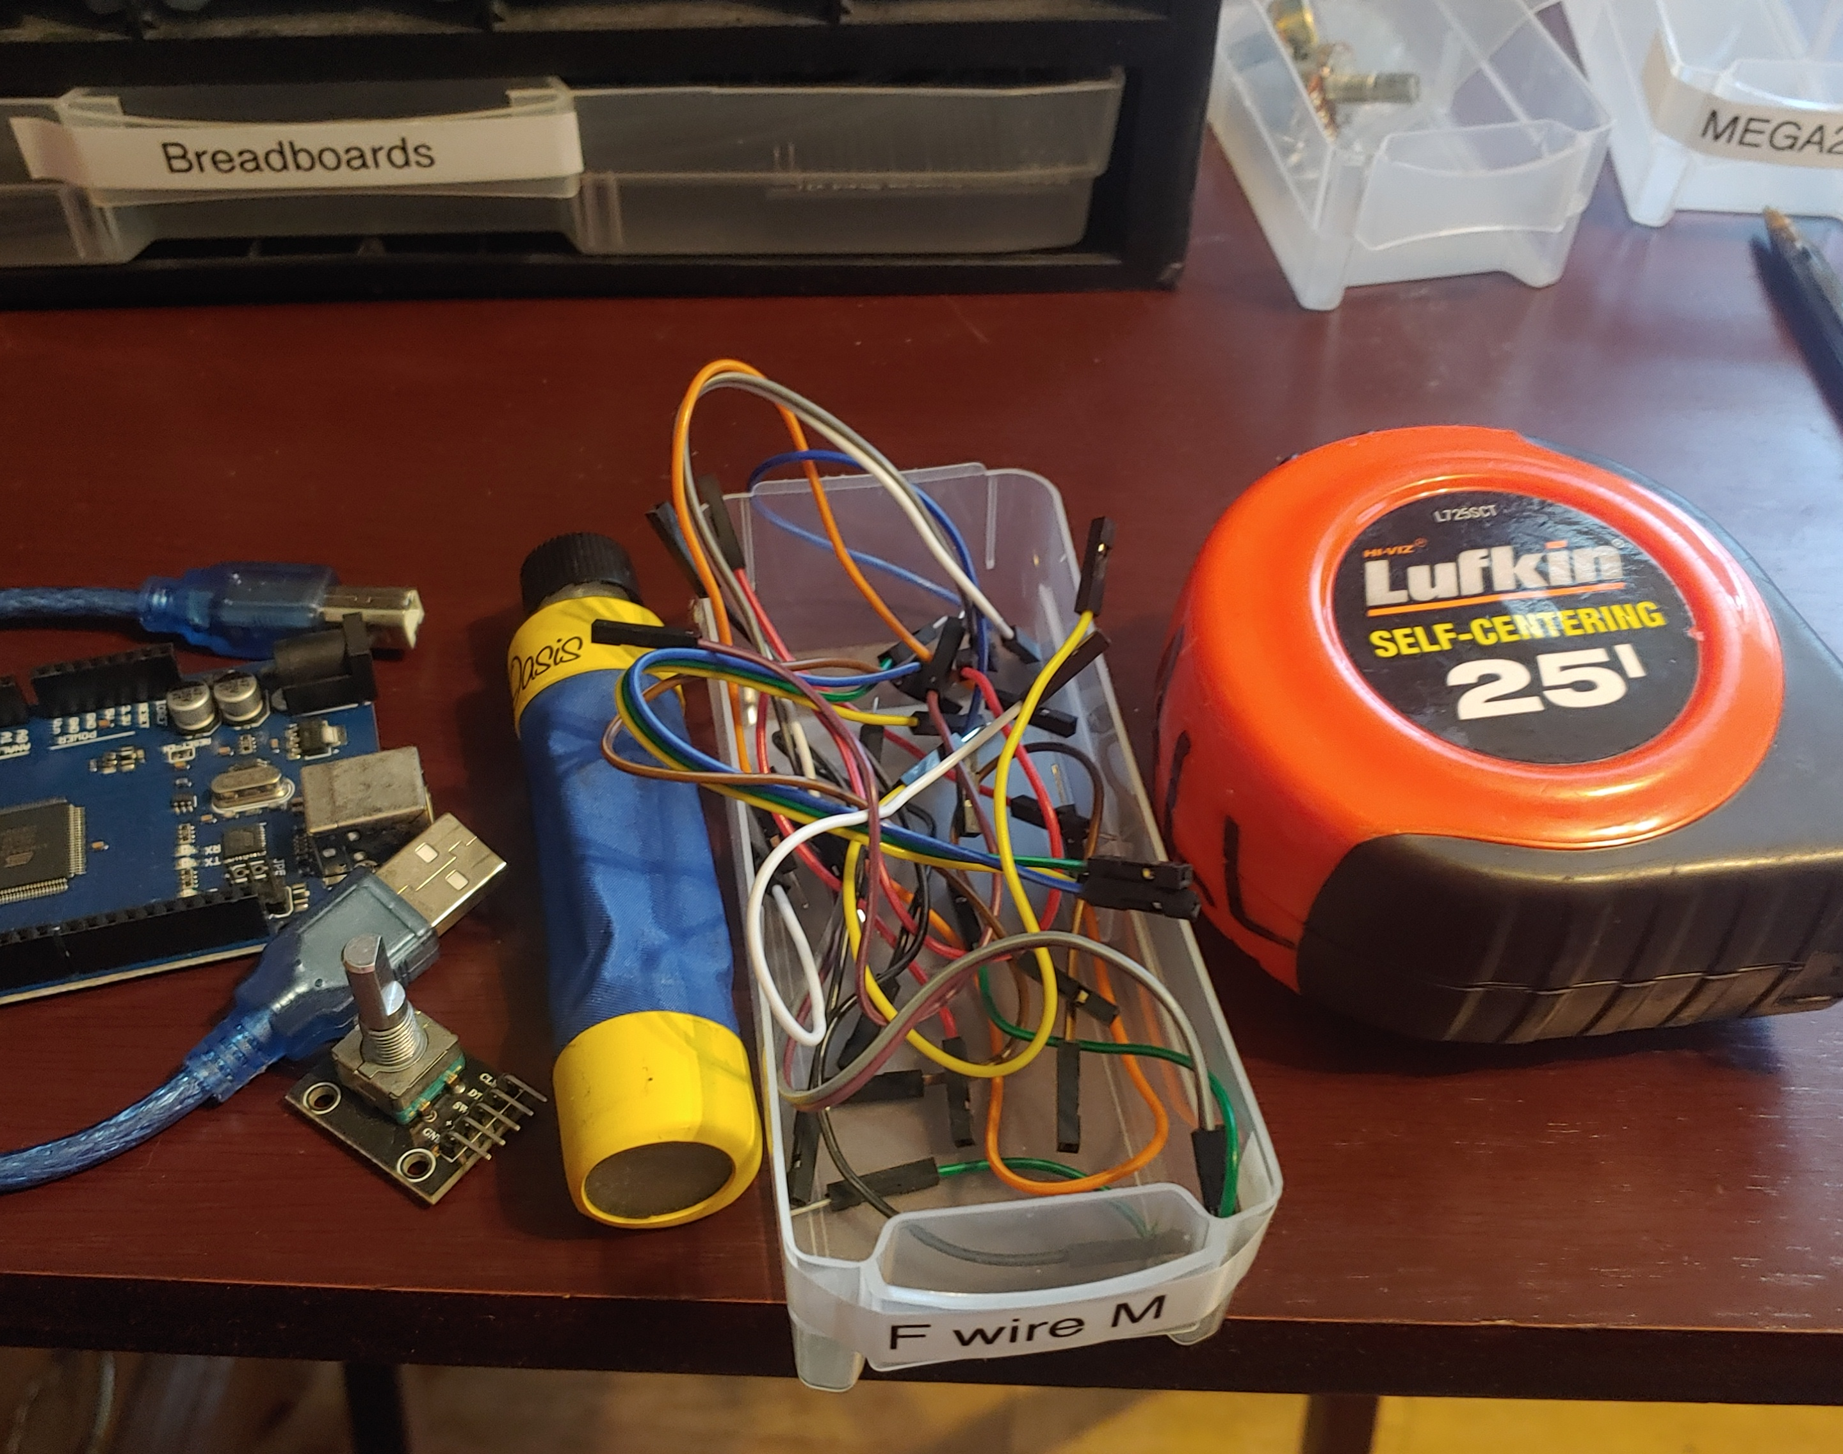
Materials List (Picture)
Arduino Mega 2560
Rotary Encoder Part KY-040
Male to Female Wires
USB cable to connect Arduino
Object to attach onto rotary encoder
Ruler or tape measurer

Slide 6
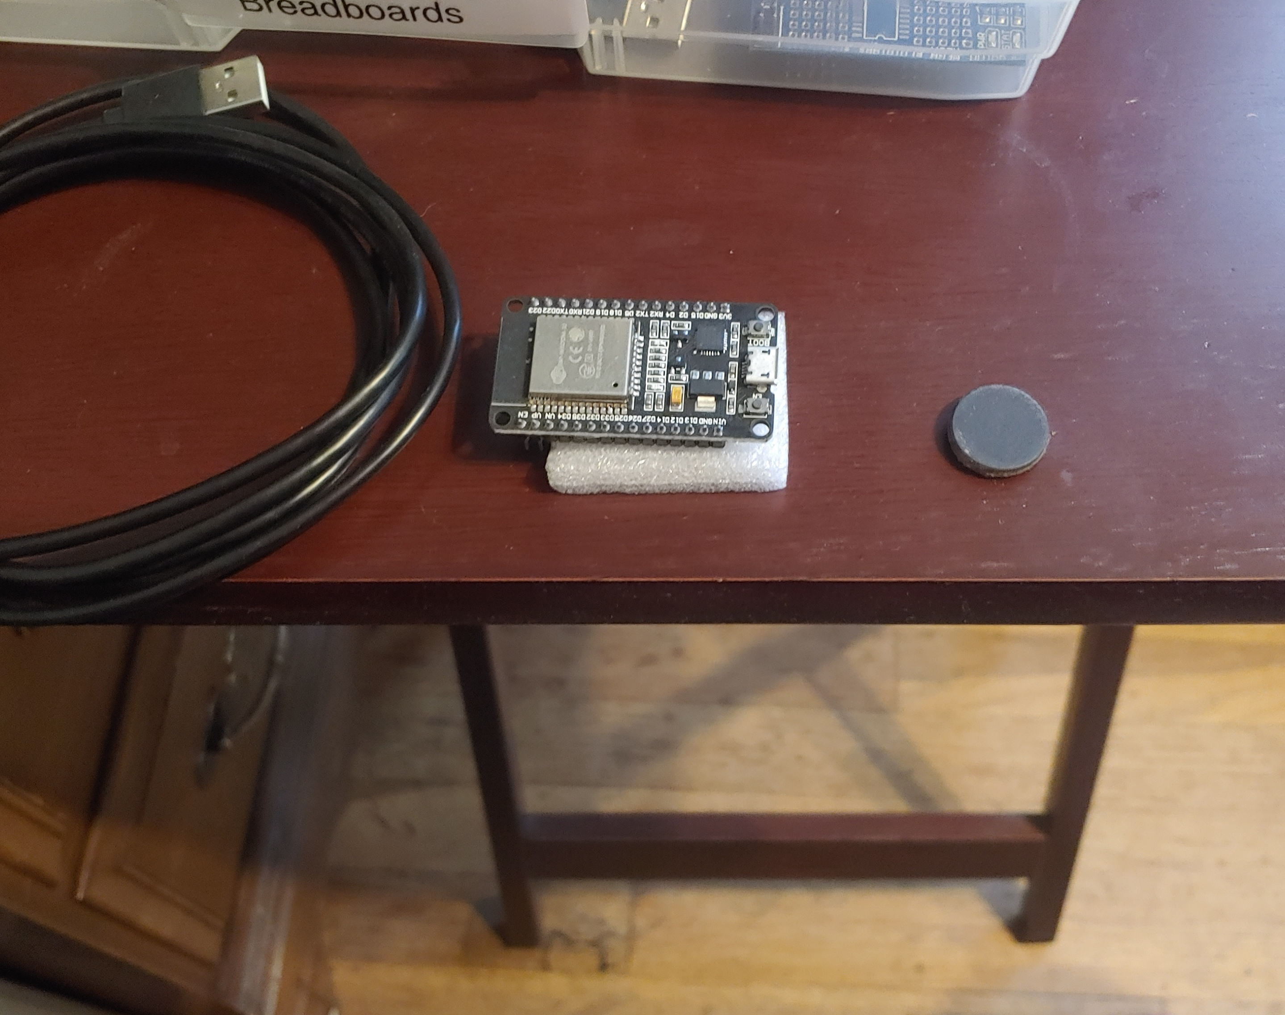
Materials List (Picture)
ESP32 microprocessor
Micro-USB cable
Magnet

Slide 7
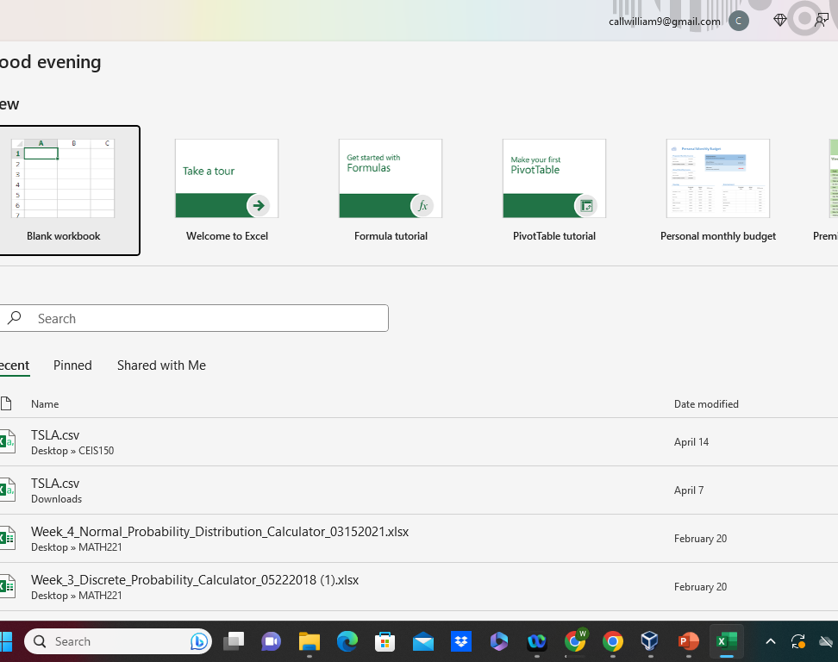
Required Software
(screenshot)
Microsoft Excel installed and running on your computer

Slide 8
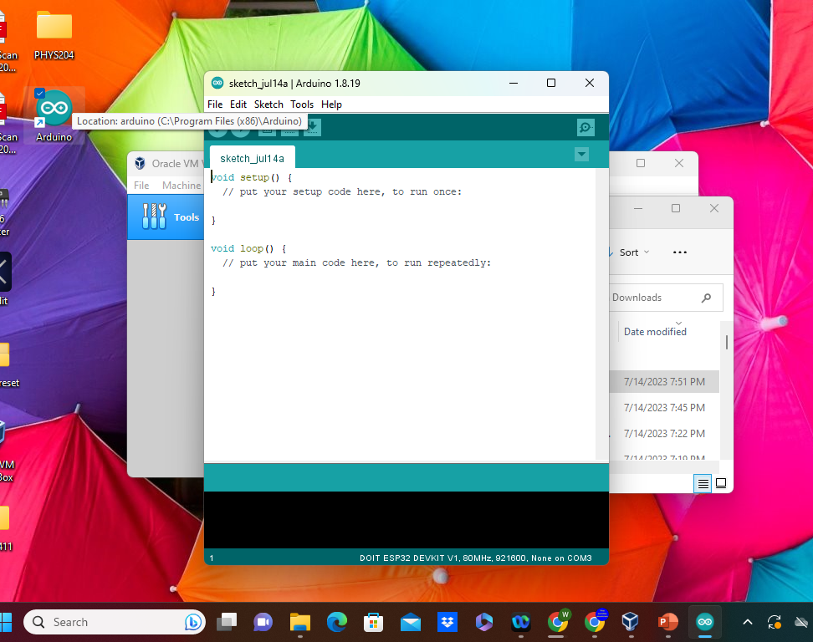
Required Software
(screenshot)
Arduino IDE installed and running on your computer

Slide 9
Second project
In this project we used a sensor wired up to a bread board and MEGA 2560 board to measure the fast the sensor would be pickup on the object, and we would do this from different measurement to see the different results.

Slide 10
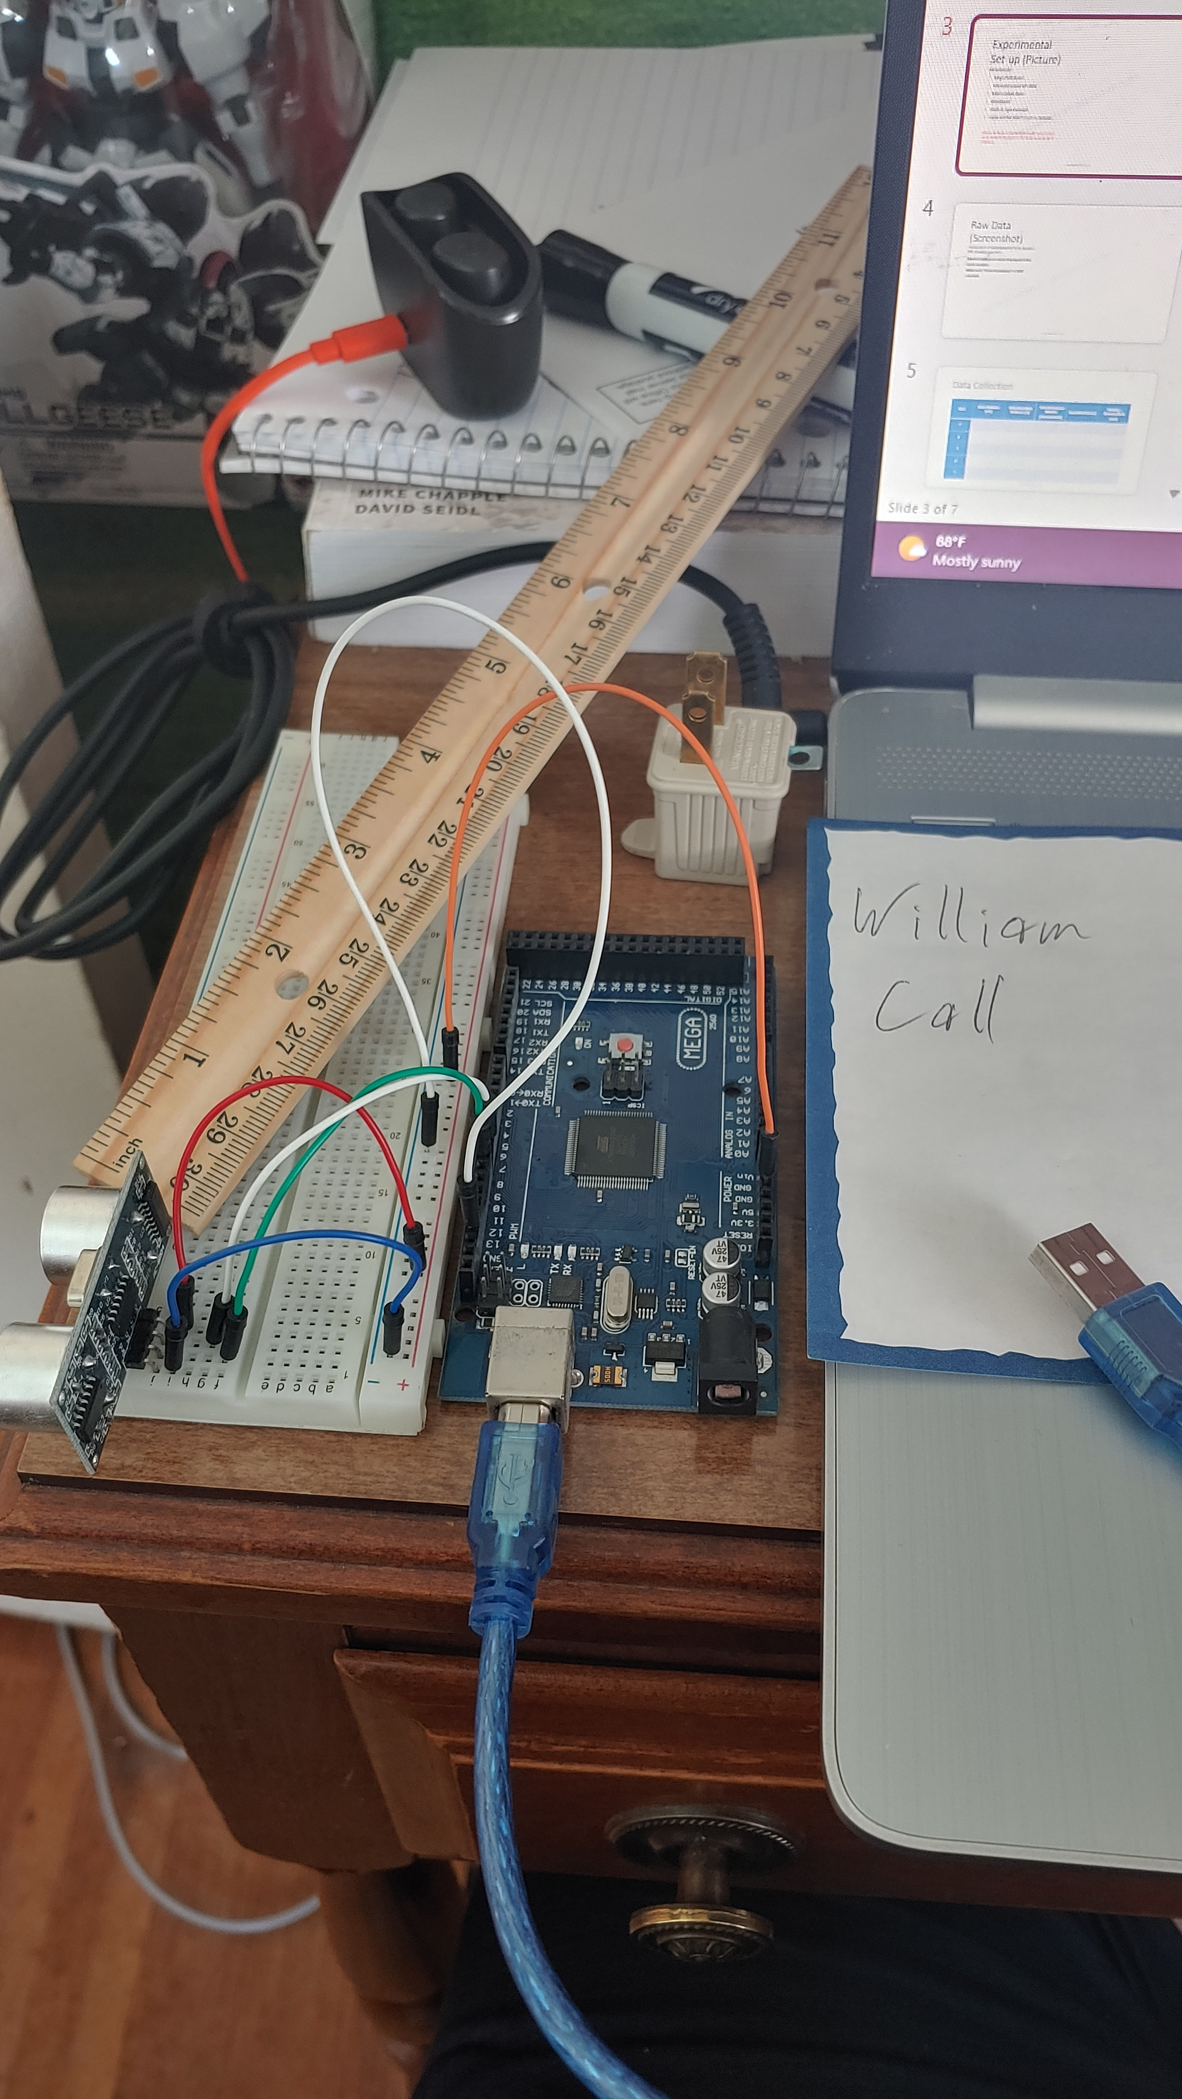
Experimental Set-up (Picture)
Materials List:
Mega 2560 Board
Ultrasonic sensor HC-SR04
Male to Male Wires
Breadboard
Ruler or tape measurer
Large and flat object to act as obstacle

Slide 11
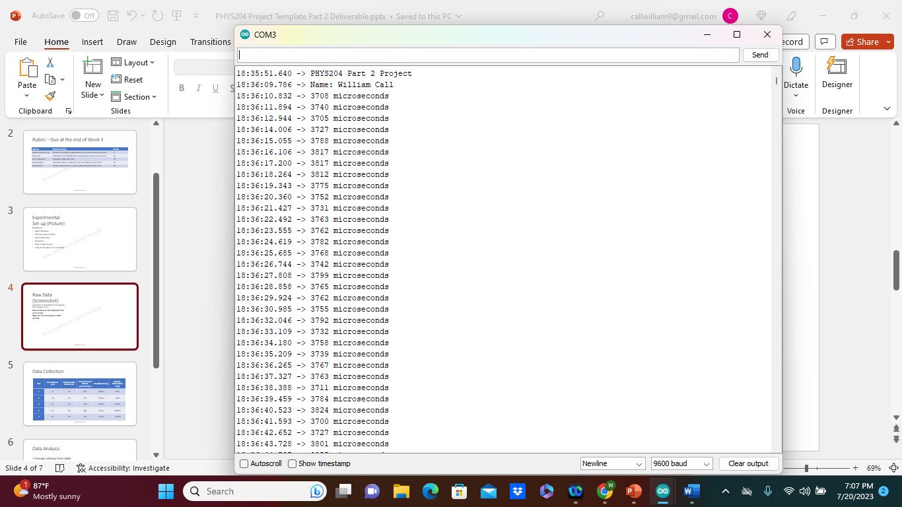
Raw Data (Screenshot)
Screenshot of Serial Monitor from Arduino IDE showing raw data.
Must include your name displayed in the serial monitor.
Make sure “show timestamp” is NOT selected.

Slide 12
Data Collection
Trial | Ruler Distance (cm) | Total Roundtrip Distance (m) | Time from Serial Monitor (microseconds) | Roundtrip time (s) | Velocity = distance/time (m/s)
1 | 8 | .16 | 580 | 5.80e-4 | 275.9
2 | 10 | .20 | 725 | 7.25e-4 | 275.9
3 | 12 | .24 | 816 | 8.16e-4 | 294.1
4 | 14 | .28 | 840 | 8.4e-4 | 333.3
5 | 16 | .32 | 930 | 9.3e-4 | 344

Slide 13
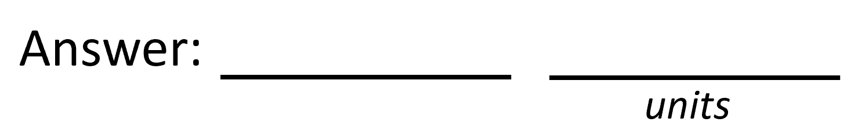

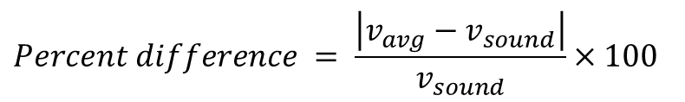

Data Analysis
Average velocity from table
1132.1
Percent difference where $v_{sound}=343 m/s$
$$v_{avg}= \frac{v_{1}+v_{2}+v_{3}+v_{4}+v_{5}}{5}$$
m/s
$$Percent difference = \frac{\left|v_{avg}−v_{sound}\right|}{v_{sound}}×100$$
3.3
s/m

Slide 14
Conclusions
Discuss the results and comment on the source of errors.
  Answer: Well one of the source of error I could be getting is the other objects around the sensor. I also had it near the end of a table so that could have also changed some readings.
What is the dependence of temperature, humidity, and atmospheric pressure on the speed of sound? How does it affect the results?
  Answer: Well with less air dense and low humidity sound can move fast. Well if you have the air on in your home than it could change the results of the testing you are doing if the air was off.

Slide 15
Third project
In the project it was close to the same as the last one but instead we would measure a flat object as it falls from different points, and we would take that information and put the in an excel spread sheet and apply a table to see the information in a line graph format.

Slide 16
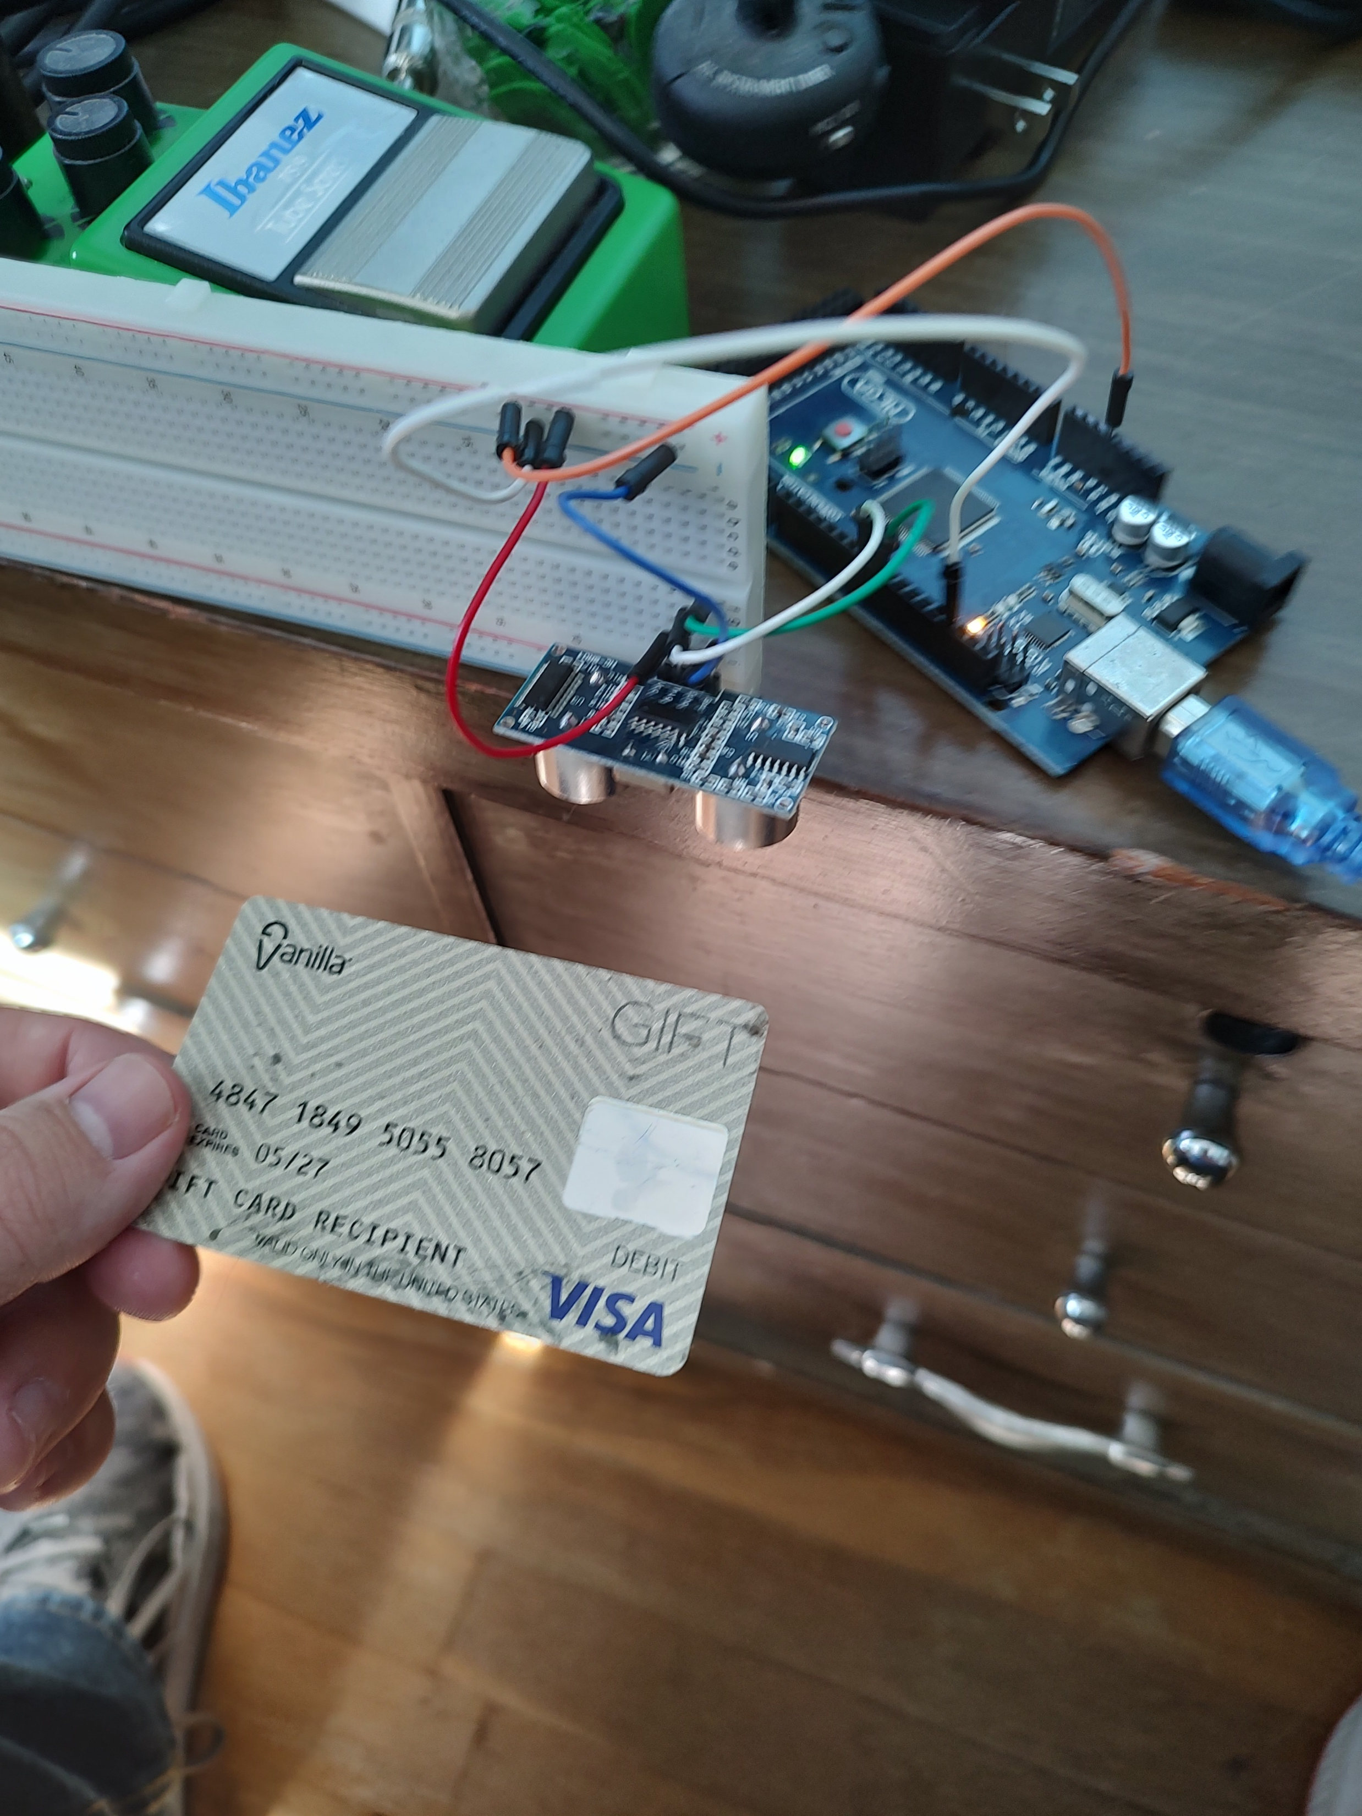
Experimental Set-up (Picture)
Materials List:
Mega 2560 Board
Ultrasonic sensor HC-SR04
Male to Male Wires
Breadboard
Large and flat object that is not susceptible to air resistance to undergo free fall motion

Slide 17
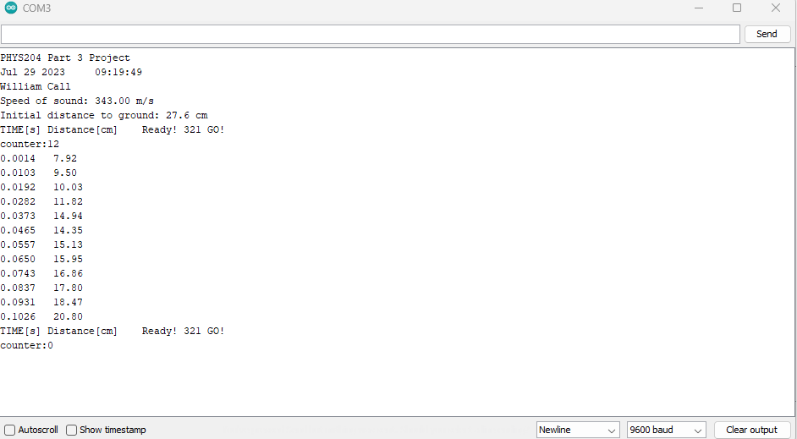
Serial Monitor (Screenshot)
Include screenshot of raw data showing the start of the fall and end of the fall of one trial.
Must include your name displayed in the serial monitor.
Make sure “show timestamp” is NOT selected.

Slide 18
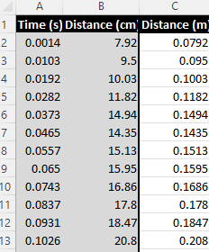
Excel Table
(Screenshot)
Include all values in the Excel table for a single trial showing the fall distance in centimeters and meters as a function of time
Be sure your drop your drop is long enough to experience free-fall.
A good drop is from a height of a table or countertop.

Slide 19
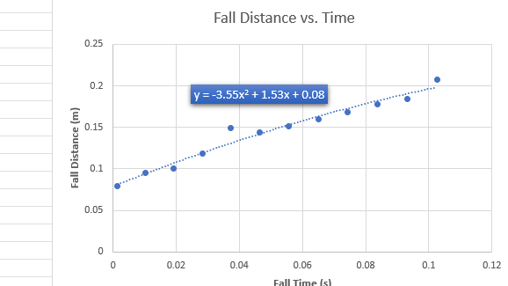
Excel Graph
(Screenshot)
Include Excel graph for a single trial showing the fall distance as a function of time.
Confirm that most data points fall along the curve fitting.
The x² coefficient should be between 2.5 and 7.5 such that its yields an acceleration value between 5 m/s² and 15 m/s²

Slide 20
Data Collection
Trial | x² coefficient value from curve fitting | Acceleration (m/s²) = 2* (x² coefficient)
1 | 3.55 | 7.1
2 | 3.36 | 6.72
3 | 3.62 | 7.24
4 | 3.41 | 6.82
5 | 3.53 | 7.06

Slide 21

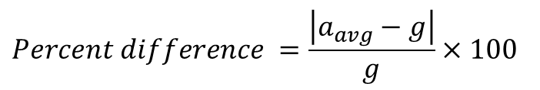
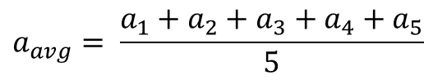
Data Analysis
Average acceleration from table
Percent difference with $g=9.8 m/s^{2}$
$$a_{avg}= \frac{a_{1}+a_{2}+a_{3}+a_{4}+a_{5}}{5}$$
6.9
cm
$$Percent difference =\frac{\left|a_{avg}−g\right|}{g}×100$$
29
cm

Slide 22
Conclusions
Discuss the results and comment on the source of errors.
  Answer: Well one source of error for me would be the bread board kept falling off the table and I was having a harder time getting better readings.
How much variation is there from trial to trial? What does this indicate about the uncertainty of the result?
  Answer: not much it stayed around the same but the way I dropped it might have also done something because of human error.

Slide 23
Fourth project
This is the project I did have some trouble with me a few other students didn’t know we was going to use the old information we got from the last test to us it for this week’s project. But thankfully our prof was able to give us data to use for the project and was able to map out the data on a excel spread sheet with a line graph.

Slide 24
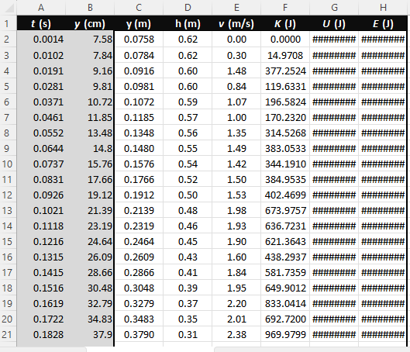
Excel Table
(Screenshot)
Include all values in the Excel table for a single trial showing the fall distance in centimeters and meters as a function of time with the values generated for kinetic energy K, potential energy U, and total mechanical energy E.

Slide 25
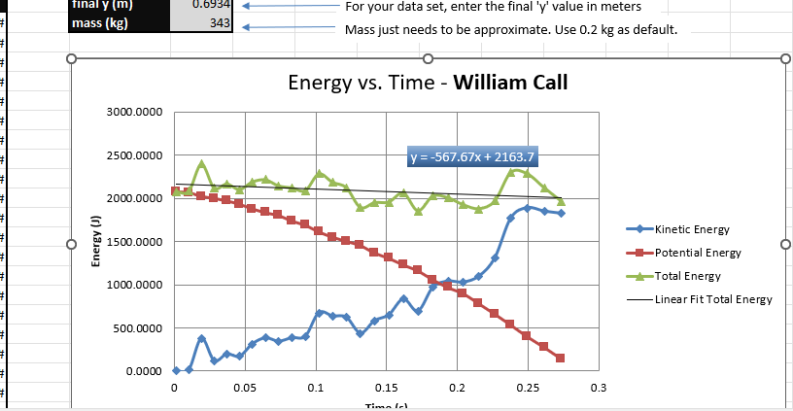
Excel Graph
(Screenshot)
Include Excel graph for a single trial showing the plots of the kinetic energy K, potential energy U, and total mechanical energy E as a function of time.
Must include your name in the title of the graph.

Slide 26

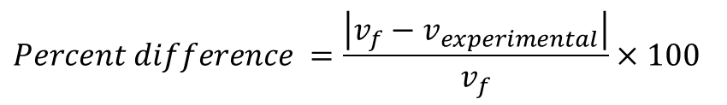


Data Analysis
Theoretical value of final velocity
Final velocity from experimental data (or largest velocity)
Percent difference
$h=y_{final}−y_{initial}=$
.5752
m
$v_{f}=\sqrt{2gh}=$
3.36
m/s
$v_{experimental}$ =
3.26
m/s
$$Percent difference =\frac{\left|v_{f}−v_{experimental}\right|}{v_{f}}×100$$
2.98
%

Slide 27
Conclusions
Discuss the key characteristics of the plot. Consider the points when potential energy U is maximum, U is minimum, kinetic energy K is maximum, K is minimum and when U and K are the same value. What is the significance of these points?
  Answer: Well, when they reach the same value is when it reaches its total mechanical energy.

Slide 28
Conclusions
What is the trend of the best fit line for the total energy E in your data? If the data is accurate, the total mechanical energy should decrease slightly. Why is that?
  Answer: Well, it would be the potential energy it shows that the object is in free fall.

Slide 29
Fifth project
This week’s project we measured the different rotations form one of our sensors. We would use this data to add to another spread sheet to see the data from the experiment.

Slide 30
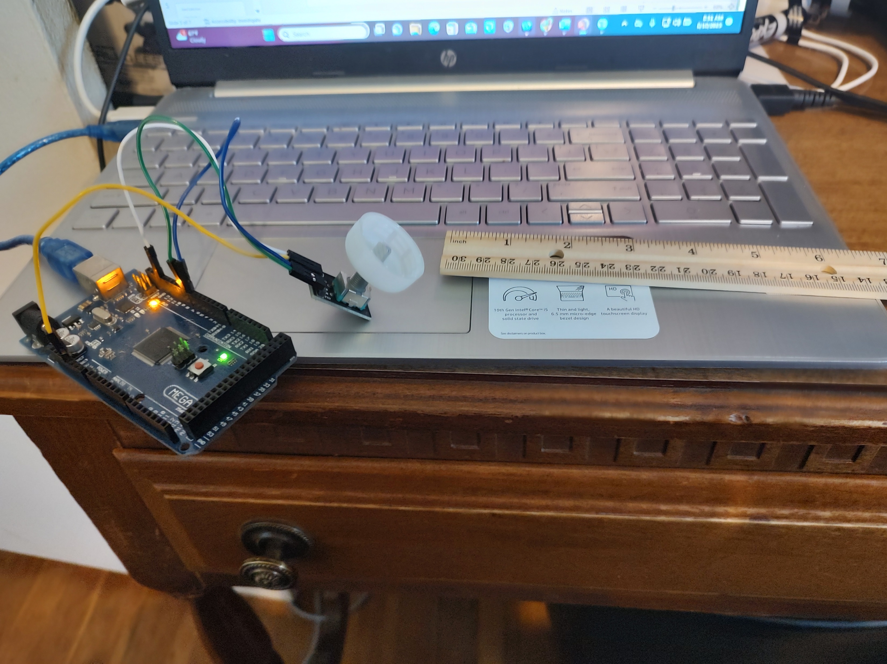
Experimental Set-up (Picture)
Materials List:
Mega 2560 Board
Rotary Encoder Part KY-040
Male to Female Wires
Object to attach onto rotary encoder
(e.g. cork, bottle cap, ball)
Ruler or tape measurer

Slide 31
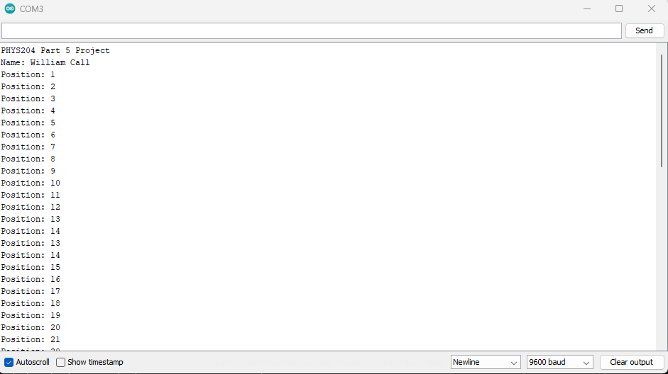
Raw Data (Screenshot)
Screenshot of Serial Monitor from Arduino IDE showing raw data.
Must include your name displayed in the serial monitor.

Slide 32
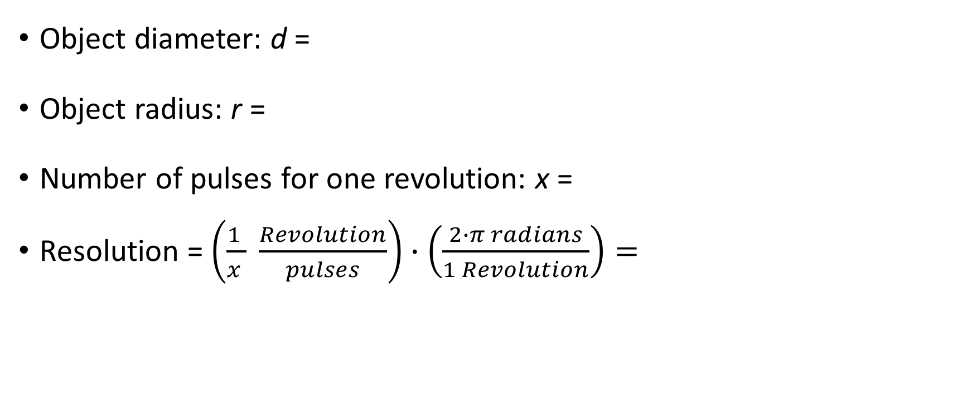
Data Collection
Object diameter: d =
Object radius: r =
Number of pulses for one revolution: x =
Resolution = $\left(\frac{1 }{x } \frac{Revolution}{pulses}\right)∙\left(\frac{2∙π radians}{1 Revolution}\right)=$
3
cm
1.5
cm
38
.25
Radian/pulse

Slide 33
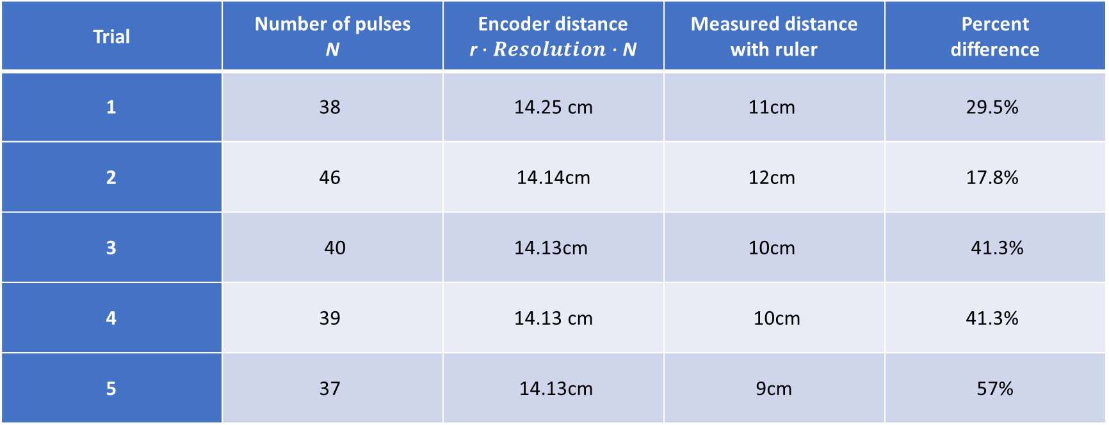
Data Analysis
Trial | Number of pulses N | Encoder distance r$∙Resolution∙$ N | Measured distance with ruler | Percent difference
1 | 38 | 14.25 cm | 11cm | 29.5%
2 | 46 | 14.14cm | 12cm | 17.8%
3 | 40 | 14.13cm | 10cm | 41.3%
4 | 39 | 14.13 cm | 10cm | 41.3%
5 | 37 | 14.13cm | 9cm | 57%

Slide 34
Conclusions
Discuss the results and comment on the sources of error.
  Answer: Well, the results can close to each other but there might have been some error the object I was rolling because of it not being the most ok fit for the measurements.
What are some applications of this measuring technique? Could this measuring system be used to measure surfaces that are not flat?
  Answer: You will be able to see how many rotations you can make on a surface and use that to measure an un-flat surface.

Slide 35
Final project
For our last project what we did was use a sensor to measure the magnetic field of a normal home magnetic. We would see if it was picking up on the positive or negative charge of the magnetic and put the information into a line graph in excel to see the data.

Slide 36
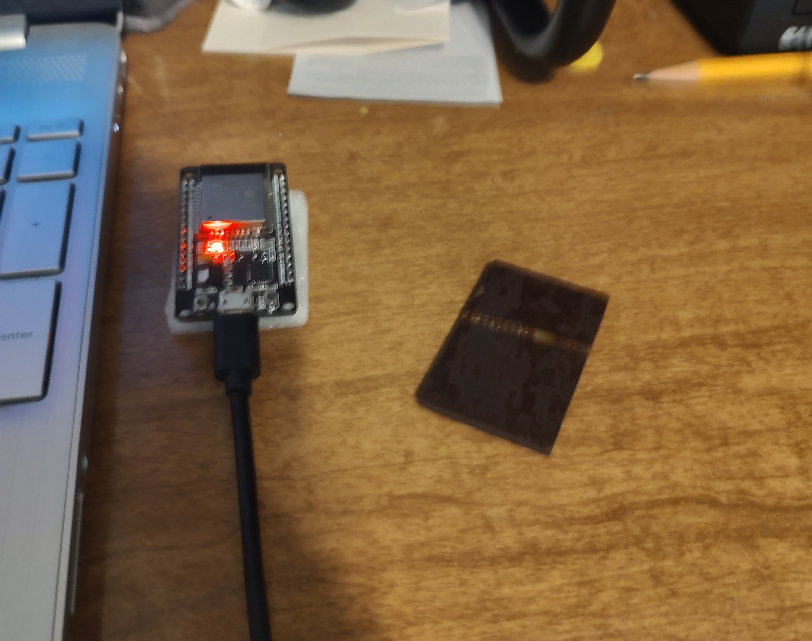
Experimental Set-up (Picture)
Materials List:
ESP32 microprocessor
Micro-USB cable
Magnet

Slide 37
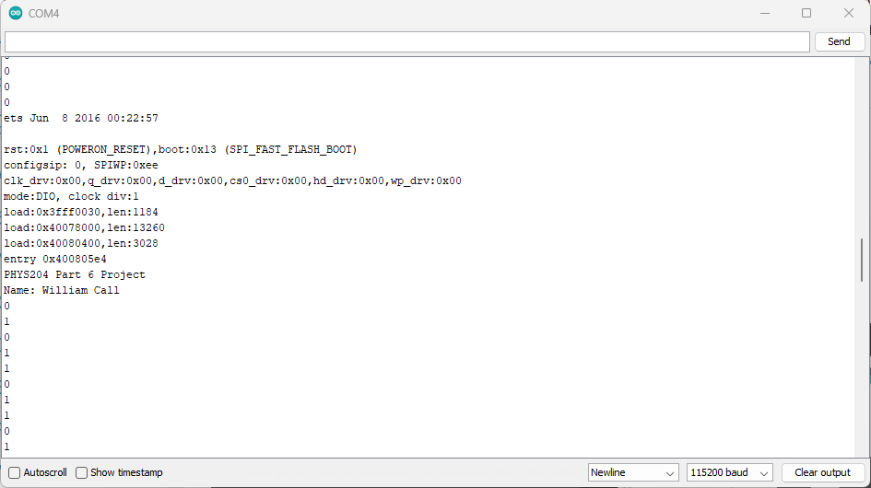
Raw Data (Screenshot)
Screenshot of Serial Monitor from Arduino IDE showing raw data.
Must include your name displayed in the Serial Monitor.
Press EN button to display name.
Unselect “Autoscroll” and scroll all the way up.

Slide 38
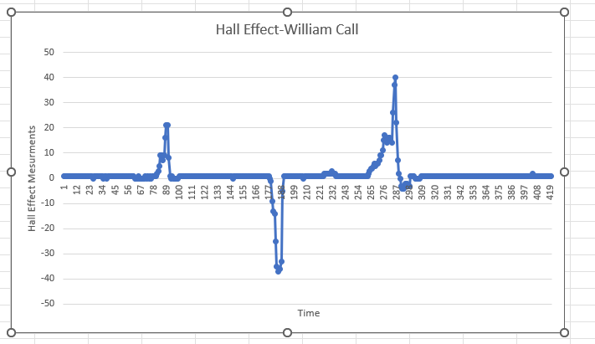
Excel Graph
(Screenshot)
Include Excel graph for a single trial of data plotted as a function of time.
Must include your name in the title of the graph.

Slide 39
Conclusions
Discuss the results and comment on the sources of error.
  Answer: Well, the results not what I thought they would be I think the magnet I was using had both the positive and negative on the same side while the back side did not have anything.
Describe how the Hall sensor works. What are some applications for the Hall effect sensor?
  Answer: Well, it measures the magmatism within the area near the sensor. If it read negative, then it is the polarity when it positive then it is the north polarity.

Slide 40
Career skills
With a lot the project we did it took time to see what was working and what was not it was a lot of trail and error during this class. I pickup up during the class it is ok to ask why something is happening and do research to understand why it did the thing it did.

Slide 41
Trails during this class
There was a lot of trails during this class trying different things during the project to get the data to come out right and see what worked and what didn’t.

Slide 42
Conclusion
This was an harder class for me the math was hard but as soon as I was the formula and understood how it worked it become a little easier but not by much.

