Slide 1
NETW 191 Final
By William L. Call

Slide 2
Introduction
During this class I was learning about I.P. address and how they are created and how you can find your I.P. address
We also learned how networks work and the difference between all the different kinds of networks.

Slide 3
Project 1
In this project the objective of this module is to implement an IPv4 addressing scheme to support a network. We will assign an IPv4 address to the SOHO Router virtual machine.

Slide 4
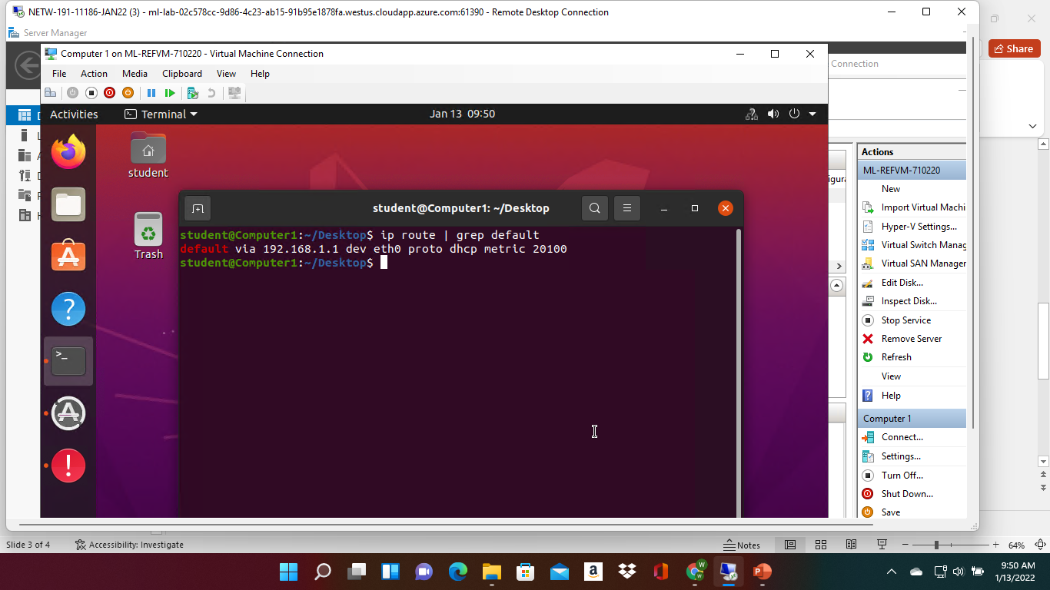
Preparation
This screenshot should include the terminal window that shows the default gateway IP address.

Slide 5
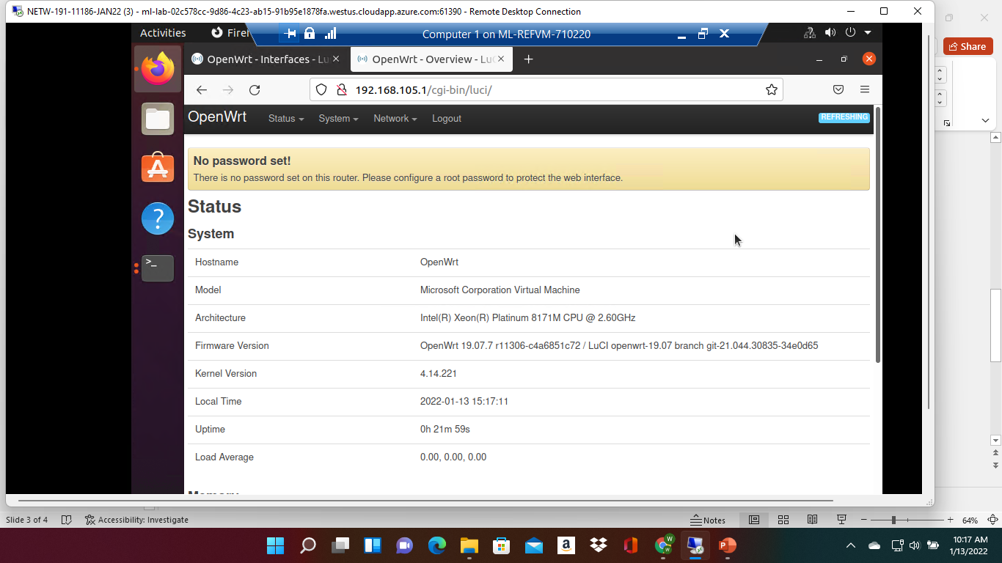
IPv4 Address Assignment
This screenshot should include the Interfaces page that shows the new IPv4 address on the LAN interface.

Slide 6
Project 2
In this project the objective of this module is to test the connectivity among the two computers and SOHO Router.

Slide 7
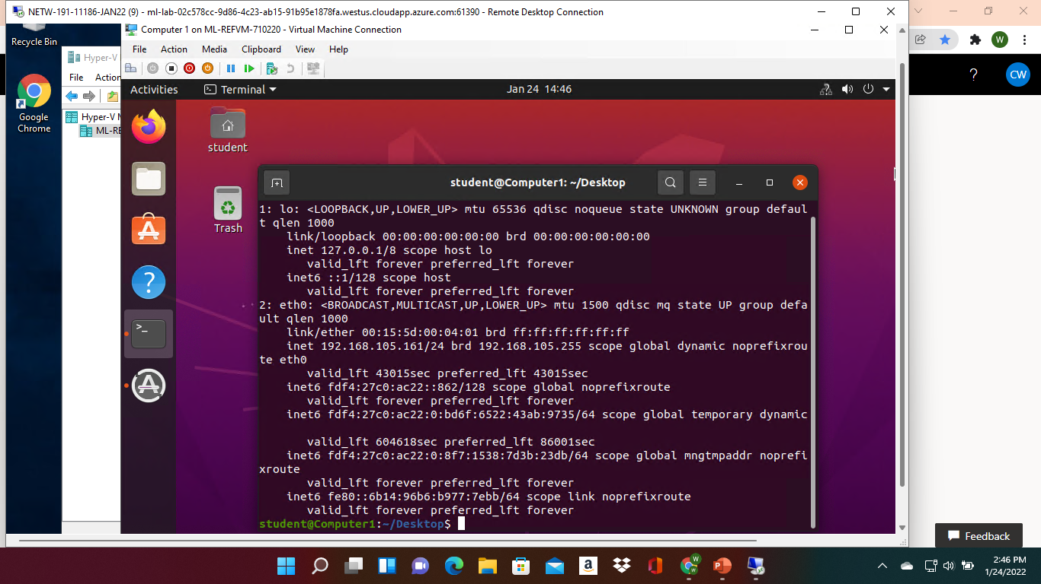
Dynamic IP Address Assignment
This screenshot should show the IPv4 address of the Computer 1 VM.

Slide 8
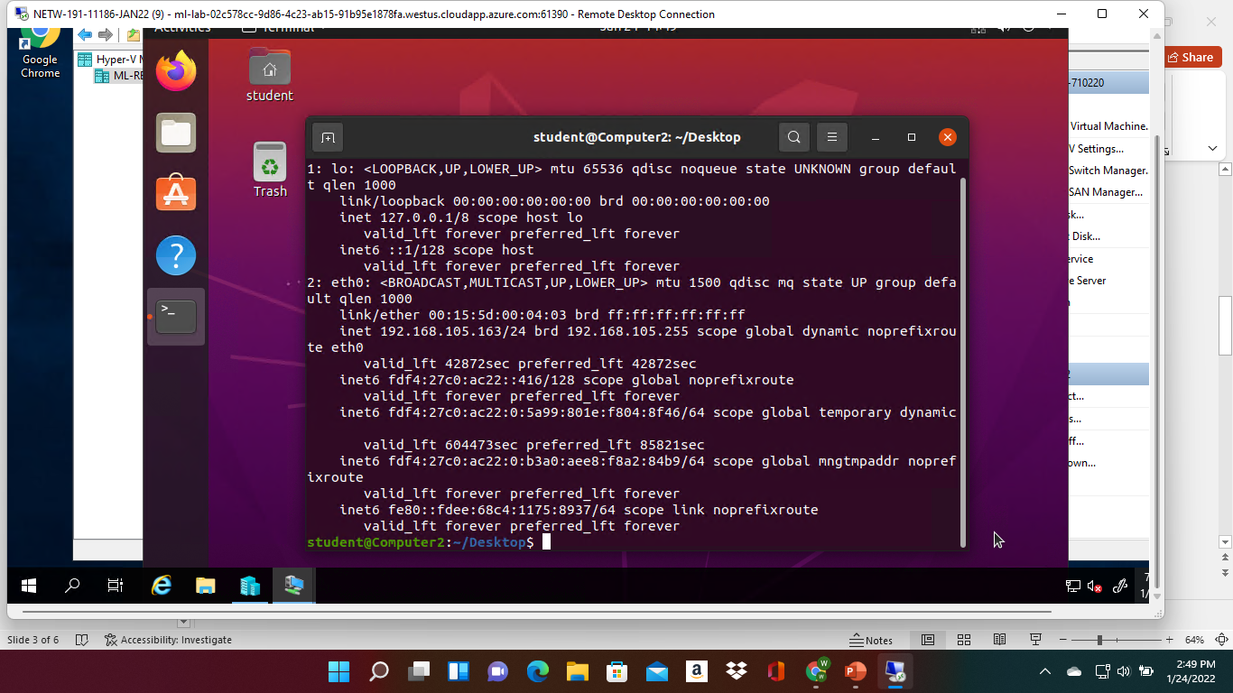
Dynamic IP Address Assignment
This screenshot should show the IPv4 address of the Computer 2 VM.

Slide 9
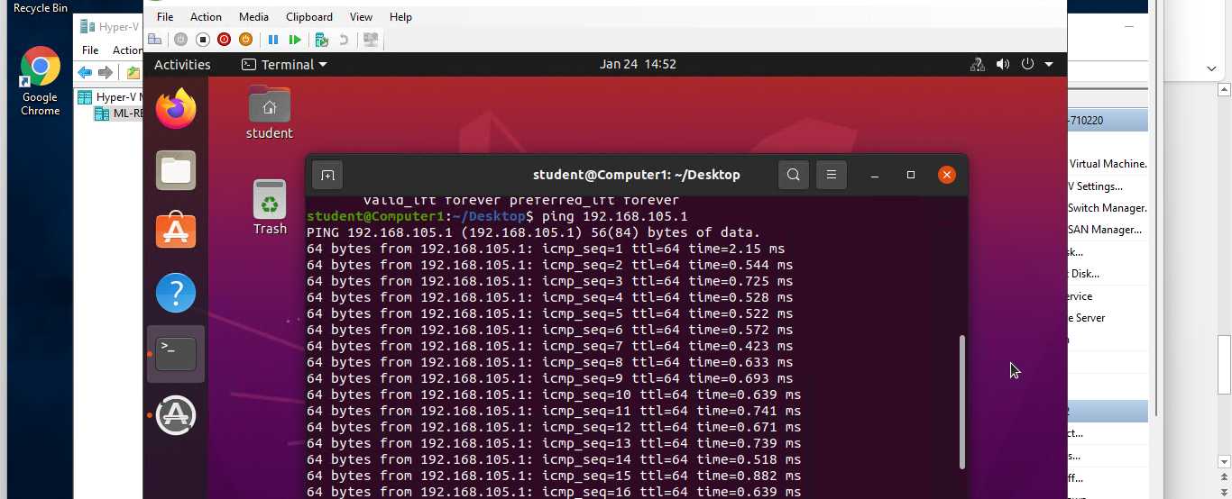
Connectivity Test
This screenshot should show the connectivity tests between the Computer 1 VM and the other two devices (i.e., the SOHO Router VM and Computer 2 VM).

Slide 10
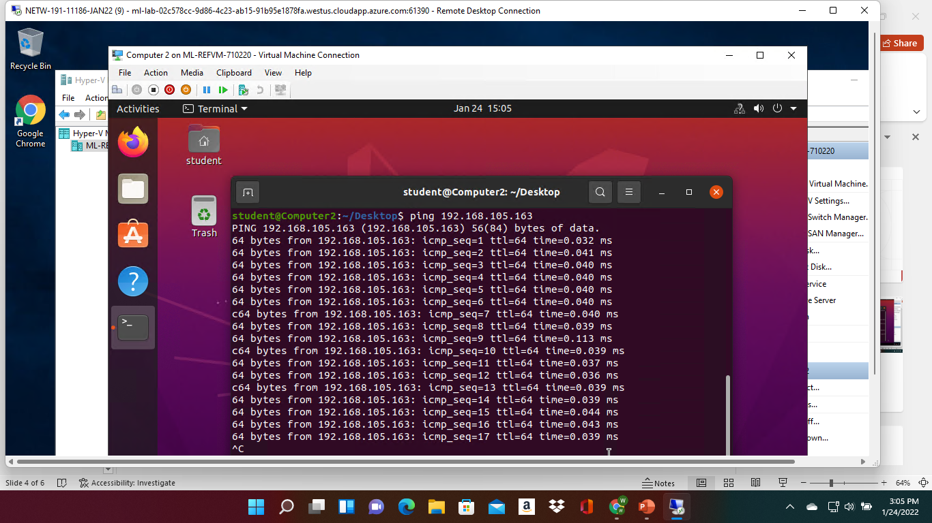
Connectivity Test
This screenshot should show the connectivity tests between the Computer 2 VM and the other two devices (i.e., the SOHO Router VM and Computer 1 VM).

Slide 11
Project 3
In this project we start with a class C network and divide its block of IP addresses into smaller blocks (i.e., subnets). Next, you will configure two Loopback interfaces on the SOHO Router, by using IP addresses of newly created subnets, to simulate two LAN segments.

Slide 12
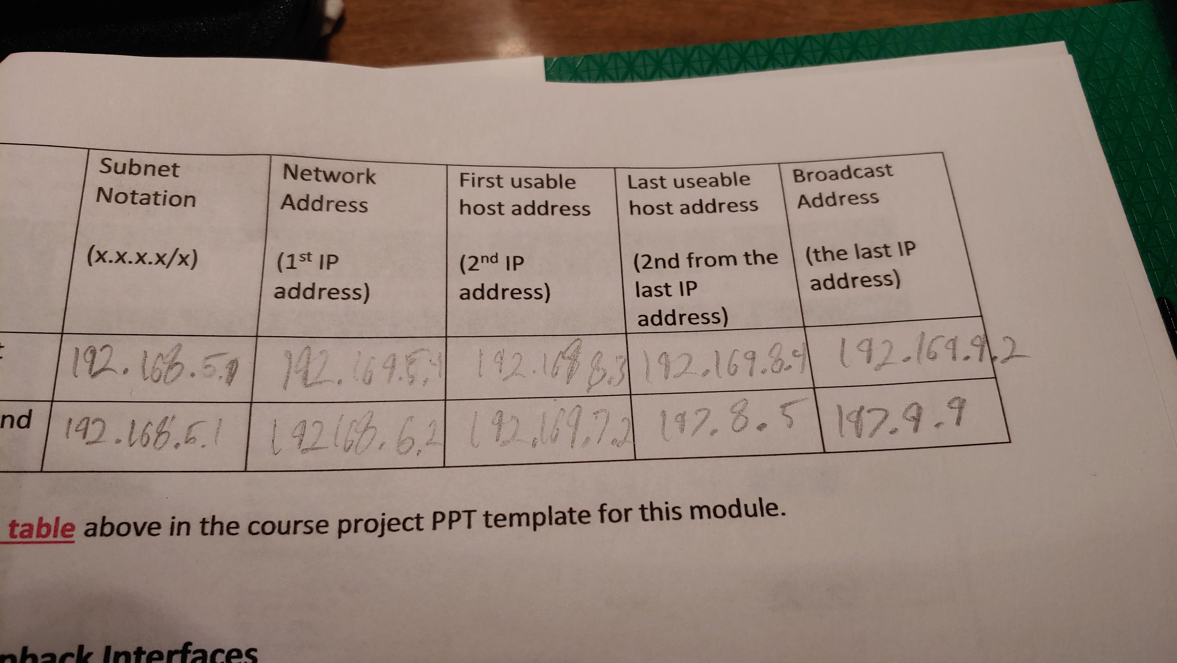
Subnetting Table
This table should include two /25 subnets, listing the subnet notation, network address, first usable host address, last usable host address, and broadcast address of each subnet.

Slide 13
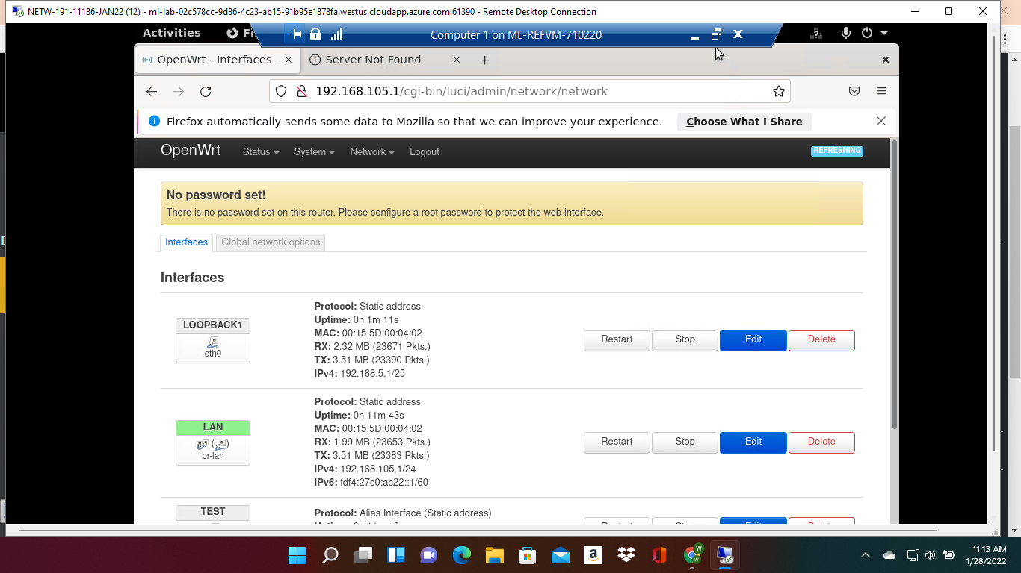
Loopback Interfaces
This screenshot should show both Loopback1 and Loopback2 interfaces and their correct IPv4 addresses.

Slide 14
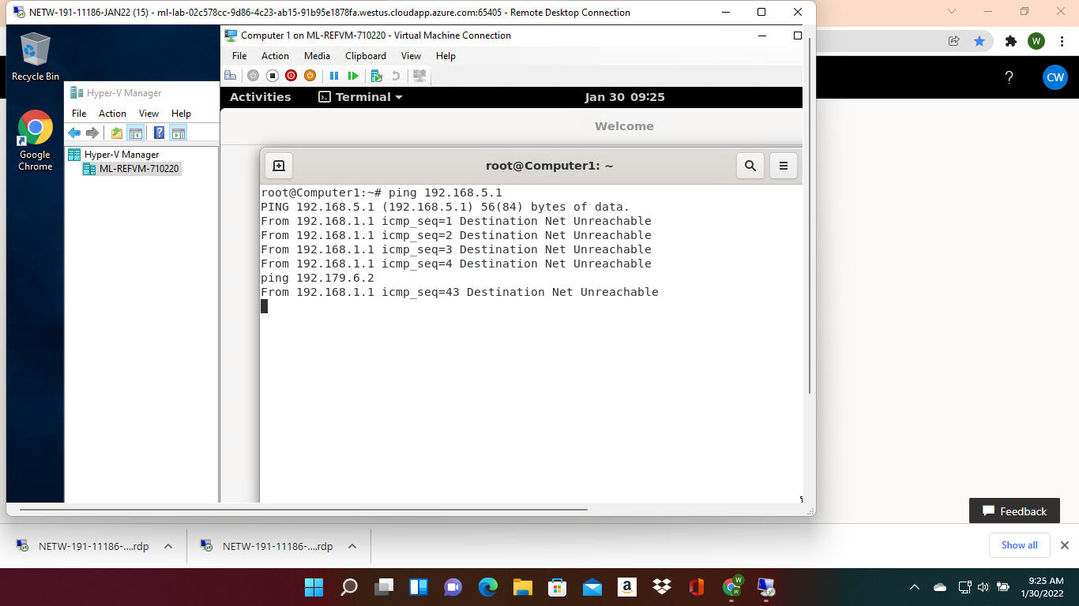
Connectivity Tests
This screenshot should show two successful ping tests from the Computer 1 VM to the Loopback 1 and Loopback 2 interfaces.

Slide 15
Project 4
In this project, we use Microsoft Visio to create a network diagram that depicts the interconnection of the Computer 1 VM, the Computer 2 VM, and the SOHO Router VM.

Slide 16
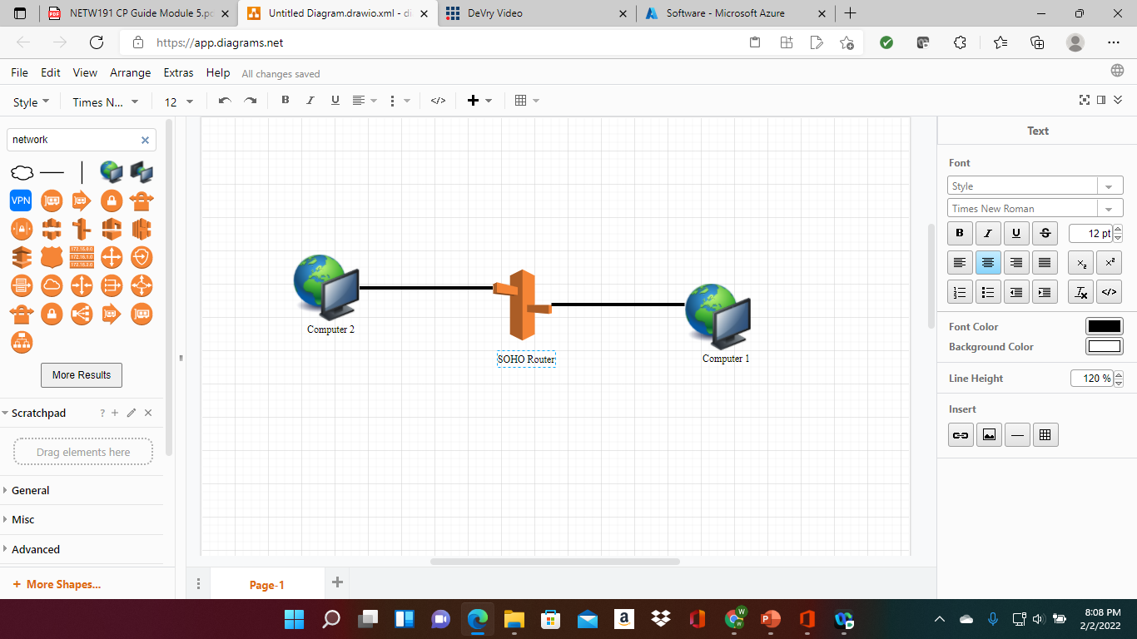
Microsoft Visio Network Diagram
This diagram should illustrate the interconnection of the Computer 1 VM, the Computer 2 VM, and the SOHO Router VM.

Slide 17
Project 5
In this module,we explore some router configurations that could be used to add protection to a SOHO wireless network.

Slide 18
SOHO Wireless Network Security
1. What are the factory default username and password of a TP-Link router? Why is it important to change the default username and password of a SOHO router?
Answer: Both password and username are admin. So, people are not able to login into your router with out your prominin.
2. To protect a SOHO wireless network with a small number of devices, which address management method provides more control, configuring the device IP addresses manually (static IP) or using a DHCP server (dynamic IP)? Why?
Answer: Dynamic would be better because the I.P. address would change over time.
3. What does MAC filtering do? If needed, when would you use deny filtering rules and when would you use allow filtering rules? What happens to devices that want to connect, if the “Allow the stations specified by any enabled entries in the list to access” function is enabled but there are no entries in the list?
Answer: It blocks other machines from getting access to your device.

Slide 19
SOHO Wireless Network Security
1. What wireless security settings are displayed on the Wireless Security page? Which one is recommended by the vendor? Why?
Answer:WPA2-PSK
2. Among the configurations you explored in this module, which one is a true security function? Why?
Answer: The one that will change your ip address every time to get on the machine.
3. What would you do to protect your wireless network at home? Why?
Answer: Have a good protection in place on your machine and teach others that use your internet not understand the signs on bad or websites that will let you network open to others.

Slide 20
Closing
Some of the struggles I had during this class was try to understand the network and how they create I.P. address.
I did get a better understand of how people's networks work and how we are able to connect with other over the internet.

